Slide 1
Substance Use Harm Reduction
Notes:
SUD Keys to Education is a product for educators and clinical supervisors developed in 2022 by the Mountain Plains and Pacific Southwest Addiction Technology Transfer Centers (MPATTC and PSATTC). The main developer of the harm reduction slides is Abby Roach-Moore. Additional guidance and editing support were provided by Trisha Dudkowski, BA, Thomas E. Freese, PhD, Kenneth Flanagan, PhD, Terra Hamblin, MA, Cindy Juntenen, PhD, Shannon McCarty, BS, LP, Kim Miller, MS, Abby Roach-Moore, MSW, Nancy Roget, MS, Beth Rutkowski, MPH, and Maridee Shogren, DNP.
This product was developed to help community college/university faculty, as well as clinical supervisors and recovery support staff have access to brief, science-based content with the goal of providing materials that can be easily infused into existing substance use disorder and related courses (e.g., social work, nursing, criminal justice, foundation of addiction courses, ethics, counseling courses, etc.) and for clinical and recovery staff use in in-service meetings. Individuals can select the specific content to infuse into existing curricula/materials depending on specific needs of their learners. Each slide in the slide decks contain notes to provide guidance on the topics along with references and handouts where appropriate.
If you require further information, please do not hesitate to contact the MPATTC (http://www.mpattc.org) or PSATTC (http://www.psattc.org) . You are free to use these slides and pictures, but please give credit to the MPATTC and PSATTC when using them by referencing both Centers at the beginning of your presentation. The MPATTC (HHS Region 8) and PSATTC (HHS Region 9) are part of the SAMHSA-funded ATTC Network that offers training and technical assistance (TA) services. HHS Region 8 is comprised of Colorado, Montana, North Dakota, South Dakota, Utah, and Wyoming, and HHS Region 9 is comprised of Arizona, California, Hawaii, Nevada, and the six U.S.-affiliated Pacific Jurisdictions (American Samoa, Commonwealth of the Northern Mariana Islands, Federated States of Micronesia, Guam, Republic of the Marshall Islands, and Republic of Palau). For additional information, please visit http://www.mpattc.org and http://www.psattc.org.
Funding for this product was made possible (in part) by SAMHSA Cooperative Agreement numbers UR1 TI080200 (MPATTC) and UR1 TI080211 (PSATTC). The views expressed in these materials do not necessarily reflect the official policies of the Department of Health and Human Services, nor does mention of trade names, commercial practices, or organizations imply endorsement by the U.S. Government.
Additional resources are available to enhance and support the information provided in this brief presentation.
Date last updated: November 1, 2022

Slide 2
What is Substance Use Harm Reduction?
Substance use harm reduction is an approach to serving people who use drugs to prevent overdose and infectious disease transmission, improve their physical, mental, and social wellbeing, and offer low-threshold options for accessing substance use disorder treatment and other health care services.
(SAMHSA, 2022)
Notes:
Note that SAMHSA describes harm reduction as an approach and not a treatment modality. But harm reduction can be an important part of the treatment and recovery process for some.
REFERENCE: Substance Abuse and Mental Health Services Administration. (2022) Harm Reduction. Retrieved from, https://www.samhsa.gov/find-help/harm-reduction

Slide 3
Harm Reduction Looks Like
Practical strategies to reduce negative consequences of drug use.
A spectrum of strategies including safer techniques, managed use, and abstinence.
Meeting people “where they’re are” but doesn't leave them there.
Principles of Harm Reduction (2020)
Notes:
Harm reduction incorporates a spectrum of strategies that includes safer use, managed use, abstinence, meeting people who use drugs “where they're at,” and addressing conditions of use along with the use itself.
Examples of safer techniques include testing or starting with a small amount at a time, never using alone or with trusted people, always using a clean needle and/or syringe, using in a less risky manner (smoking instead of injection).
Examples of managed use are limiting use, drinking a water between alcoholic drinks, sticking to one drug and not mixing substances.
REFERENCE : National Harm Reduction Coalition. (2020) Principles of Harm Reduction. Retrieved from, https://harmreduction.org/wp-content/uploads/2020/08/NHRC-PDF-Principles_Of_Harm_Reduction.pdf

Slide 4
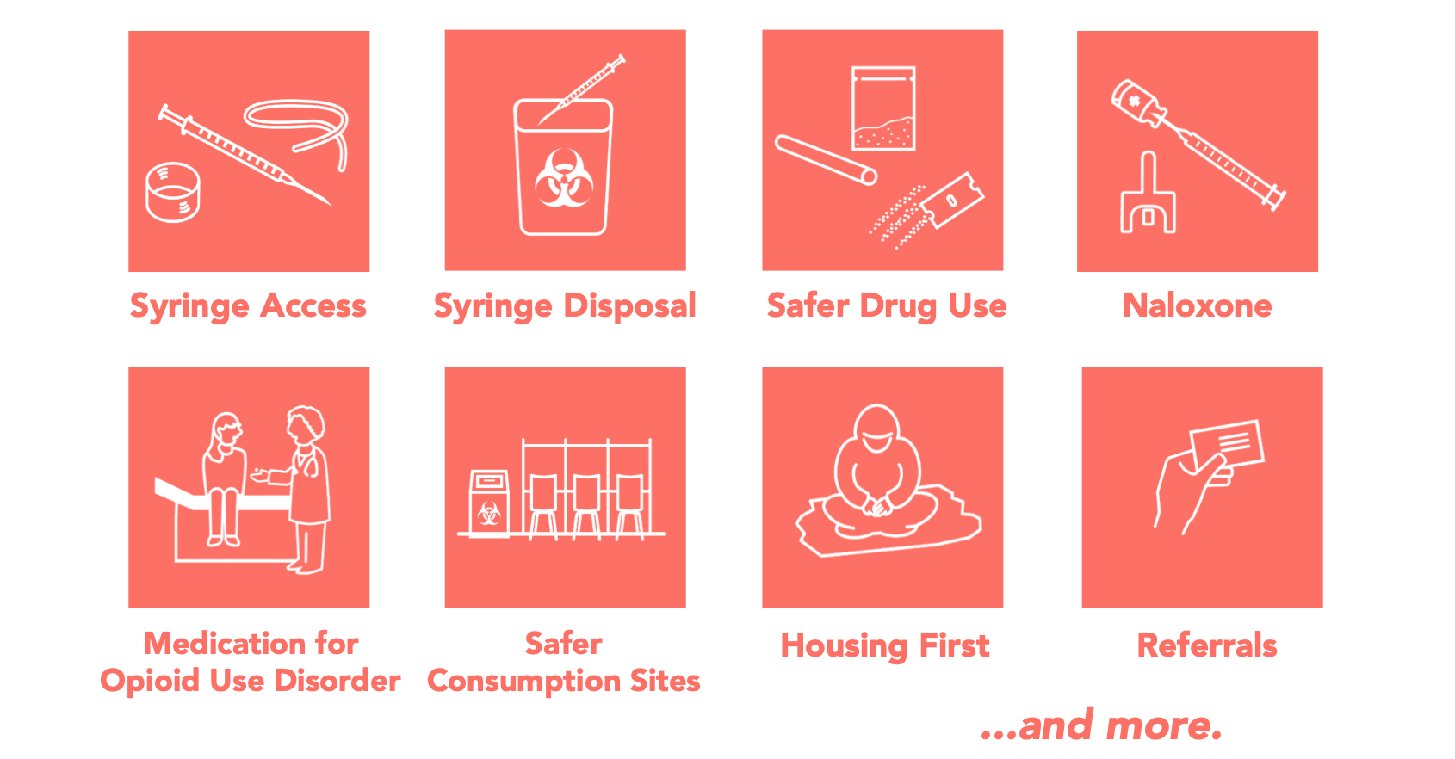
Harm reduction services include…
(Spirit of Harm Reduction, 2021)
Notes:
Discuss other harm reduction practices that are not related to substance use. To add to this discussion you can use the Mountain Plains ATTC “what is harm reduction?” poster found at the following link: https://attcnetwork.org/centers/mountain-plains-attc/product/what-harm-reduction-poster
Image Retrieved from: National Harm Reduction Coalition. (2021, January 20) Spirit of Harm Reduction: A Toolkit for Communities of Faith Facing Overdose. Retrieved from, https://harmreduction.org/wp-content/uploads/2020/11/Spirit-of-Harm-Reduction-Toolkit.pdf

Slide 5
Principles of Harm Reduction
Health and Dignity
Participant-Centered Services
Participant Involvement
Participant Autonomy
Sociocultural Factors
Pragmatism/Realism
National Harm Reduction Coalition (2020)
Notes:
5
The National Harm Reduction Coalition considers the following principles central to harm reduction practice. The following slides go through each of these principles.
REFERENCE : National Harm Reduction Coalition. (2020) Principles of Harm Reduction. Retrieved from, https://harmreduction.org/wp-content/uploads/2020/08/NHRC-PDF-Principles_Of_Harm_Reduction.pdf

Slide 6
Focus on Health and Dignity
Establishes quality of individual and community life and wellbeing as the criteria for successful interventions and policies.
Photo by George Hodan
National Harm Reduction Coalition (2020)
Notes:
Establishes quality of a participant’s individual and community life and well-being — not necessarily cessation of all drug use — as the criteria for successful interventions and policies.
ASK
What does ‘Health and Dignity’ look like?
REFERENCE : National Harm Reduction Coalition. (2020) Principles of Harm Reduction. Retrieved from, https://harmreduction.org/wp-content/uploads/2020/08/NHRC-PDF-Principles_Of_Harm_Reduction.pdf
IMAGE CREDIT: George Hodan
6

Slide 7
Participant-Centered
Nonjudgmental, non-coercive provision of services and resources to people who use drugs and the communities in which they live in order to assist them in reducing attendant harm.
Photo by Maliz Ong
National Harm Reduction Coalition (2020)
Notes:
Nonjudgmental, non-coercive provision of services and resources to people who use drugs and the communities in which they live in order to assist them in reducing attendant harm.
Participant is the lead.
The participant guides the encounter.
Providers engage low-threshold services to increase chances to reach higher-risk or vulnerable populations who may not have the documentation or money or systemic good standing in order to receive services in traditional healthcare settings.
Providers provide options.
Providers work with program participants.
Think about where, when, how services are provided. Is programming accessible, practical, and user-friendly?
REFERENCE : National Harm Reduction Coalition. (2020) Principles of Harm Reduction. Retrieved from, https://harmreduction.org/wp-content/uploads/2020/08/NHRC-PDF-Principles_Of_Harm_Reduction.pdf
IMAGE CREDIT: Maliz Ong
7

Slide 8
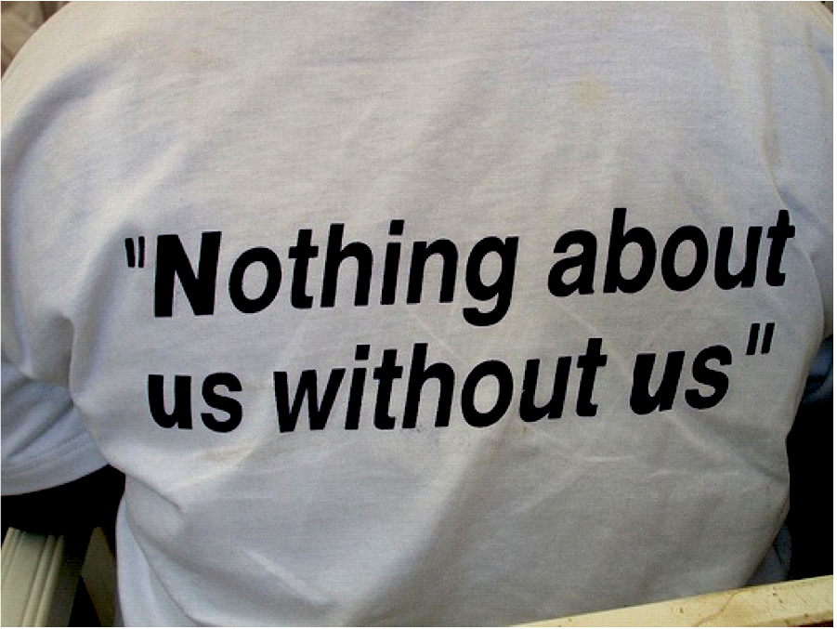
Participant Involvement
Ensures participants and communities impacted have a real voice in the creation of programs and policies designed to serve them.
Photo by ASWA
National Harm Reduction Coalition (2020)
Notes:
Ensures that people who use drugs and those with a history of drug use routinely have a real voice in the creation of programs and policies designed to serve them
REFERENCE : National Harm Reduction Coalition. (2020) Principles of Harm Reduction. Retrieved from, https://harmreduction.org/wp-content/uploads/2020/08/NHRC-PDF-Principles_Of_Harm_Reduction.pdf
IMAGE CREDIT: ASWA: https://www.flickr.com/photos/africansexworkeralliance/4754499188/
8

Slide 9
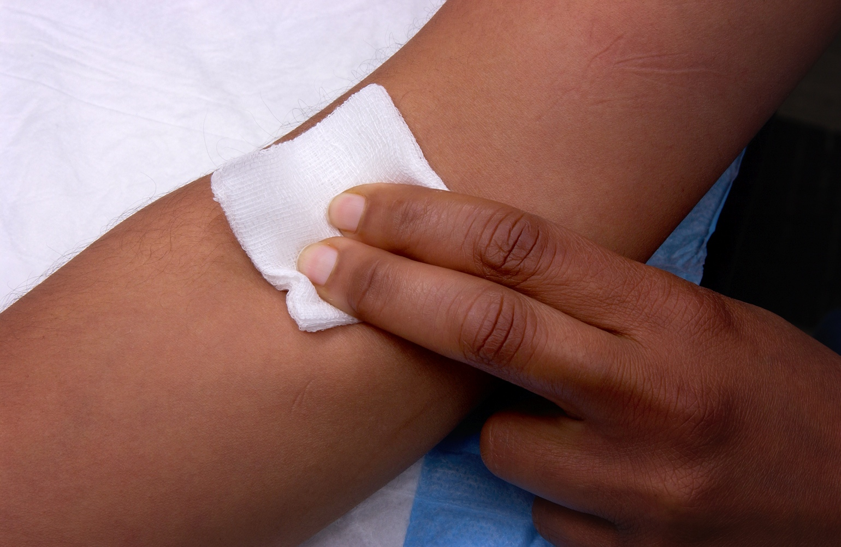
Participant Autonomy
Affirms participants as the primary agents of change and seeks to empower participants to share information and support each other in strategies which meet their actual conditions of harm.
Photo by CDC/James Gathany
National Harm Reduction Coalition (2020)
Notes:
Affirms people who use drugs (PWUD) themselves as the primary agents of reducing the harms of their drug use and seeks to empower PWUD to share information and support each other in strategies which meet their actual conditions of use
Participant Self-Rule
This can also be called Participant Autonomy, or Self-Determination.
This is the act or power of making one’s own choices or decisions.
Participant self-rule affirms the person is their own primary agent of reducing the harms of drug use and sexual behaviors.
Each person is an expert in their own life.
Self-rule empowers individuals to share information and support each other in strategies which meet their actual conditions of use or behavior.
Providers can give out supplies but it will be the participant them self who will use the gear.
People will change when: 1) they are ready, and 2) circumstances allow.
REFERENCE : National Harm Reduction Coalition. (2020) Principles of Harm Reduction. Retrieved from, https://harmreduction.org/wp-content/uploads/2020/08/NHRC-PDF-Principles_Of_Harm_Reduction.pdf
IMAGE CREDIT: CDC/James Gathany
9

Slide 10
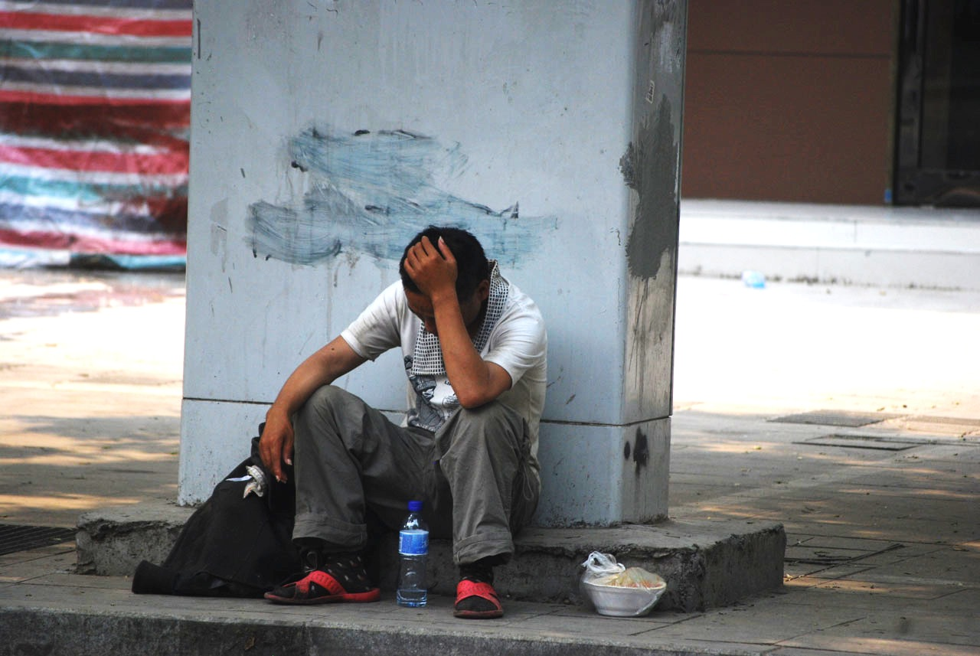
Sociocultural Factors
Recognizes that the realities of various social inequalities affect both people’s vulnerability to and capacity for effectively dealing with potential harm.
Photo by Peter Griffin
National Harm Reduction Coalition (2020)
Notes:
Recognize Inequalities and Injustices
Harm Reduction recognizes the realities of poverty, class, racism, social isolation, past trauma, sex-based discrimination and other social inequalities impact 1) people’s vulnerability to, and 2) capacity for effectively dealing with drug-related harm.
ASK
How do these sociocultural factors influence people’s ability to reduce harm, access services, use drugs, or make decisions under what circumstances they will engage in sexual behavior?
NOTES
Inequities impact marginalized communities that exist in environments where social networks in the community do not have positive and strong collective efficacy.
Ex: poor school system, lack of job employment, high turnover rates, low property taxes, high crime rates, transient populations, high rates of communicable disease, environmental pollution, condensed housing structures, abandoned housing and property, open lots, high drug trafficking, etc.
REFERENCE : National Harm Reduction Coalition. (2020) Principles of Harm Reduction. Retrieved from, https://harmreduction.org/wp-content/uploads/2020/08/NHRC-PDF-Principles_Of_Harm_Reduction.pdf
IMAGE CREDIT: Peter Griffin
10

Slide 11
Practical and Realistic
Does not attempt to minimize or ignore the real and tragic harm and danger associated with drug use or other risk behaviors.
HRC Hepatitis C Prevention Poster
National Harm Reduction Coalition (2020)
Notes:
KEY MESSAGES
Does not attempt to minimize or ignore the real and tragic harm and danger that can be associated with illicit drug use
Practical and Realistic
Harm reduction contains the attitude or practice of accepting a situation as it is and being prepared to deal with it accordingly.
Harm reduction does not attempt to minimize or ignore the real harm or danger associated with licit and illicit drug use or sexual behaviors.
Harm reduction applies a reasonable and logical way of doing things or of thinking about problems that is based on dealing with specific situations instead of on ideas and theories.
REFERENCE : National Harm Reduction Coalition. (2020) Principles of Harm Reduction. Retrieved from, https://harmreduction.org/wp-content/uploads/2020/08/NHRC-PDF-Principles_Of_Harm_Reduction.pdf
IMAGE CREDIT: HRC Hepatitis C Prevention Poster
11

Slide 12
Why Harm Reduction Works
Increase Trust with Clients and Fosters Engagement
Provides a space for people to be open about their drug use and sexual behavior.
Values people and their expertise
Evidence-Based
Harm reduction is rooted in evidence-based practices that have shown to decrease health and social harms of drug use.
Keeps People Alive & Healthy
Harm reduction can keep someone engaged with services, supplies, and education if they return to use.
Principles of Harm Reduction (2020)
Notes:
KEY MESSAGES
INCREASE TRUST WITH CLIENTS AND FOSTERS ENGAGEMENT
Provides a space for people to be open about their drug use and sexual behavior so it’s not hidden, perpetuating feelings of isolation
If the client knows the provider will judge them because they trade sex for money, the client will be less likely to talk about themselves; making it more difficult for the provider to build a relationship that could lead to Motivational Interviewing, or supported referrals.
When providers create an environment that is positive, honest, productive, and without judgement or bias, they will have a more engaging relationship with clients.
Values people and their expertise so they feel empowered to determine and voice their own hierarchy of need and next steps are clear between provider and participant.
The client is the expert of their own life and is responsible for choosing the type and timing of their behavior change.
EVIDENCE-BASED
Foundational components for client-based harm reduction stem from evidence-based research and practice to decrease overdose fatalities, acute life-threatening infections related to unsterile drug injection, and chronic diseases such as HIV/HCV.
KEEPS PEOPLE ALIVE AND ENGAGED
Harm reduction continues to keep people engaged if they return to use so if or when the person resumes behavior without risk, they have a chance not to contend with disease, infection, or unwanted pregnancy, alongside.
Harm reduction continues to keep people engaged if they never had plans to quit or abstain from sex and drugs.
REFERENCE : National Harm Reduction Coalition. (2020) Principles of Harm Reduction. Retrieved from, https://harmreduction.org/wp-content/uploads/2020/08/NHRC-PDF-Principles_Of_Harm_Reduction.pdf

Slide 13
Share which principle:
Key Principles
Health and Dignity
Participant-Centered
Participant Involvement
Participant Self-Rule
Recognize Inequalities & Injustices
Practical and Realistic
Resonates
Most Challenging
Notes:
Ask each participant to share which principle resonates with them and which one might be challenging. You may have participants write them down or share in a way that they feel comfortable.
Discuss ways to work through challenges that are brought up.
REFERENCE : National Harm Reduction Coalition. (2020) Principles of Harm Reduction. Retrieved from, https://harmreduction.org/wp-content/uploads/2020/08/NHRC-PDF-Principles_Of_Harm_Reduction.pdf
IMAGE CREDIT: Microsoft Office Suit Free Clip Art

