Slide 1
Alcohol’s Impact
Notes:
SUD Keys to Education is a product for educators and clinical supervisors developed in 2022 by the Mountain Plains and Pacific Southwest Addiction Technology Transfer Centers (MPATTC and PSATTC). The main developers of the alcohol materials are Nancy Roget, MS, Kim Miller, MS, and Trisha Dudkowski, BA. Additional guidance and editing support were provided by Kenneth Flanagan, PhD, Terra Hamblin, MA, Cindy Juntenen, PhD, Shannon McCarty, BS, LP, Abby Roach-Moore, MSW, Beth Rutkowski, MPH, Thomas E. Freese, PhD, and Maridee Shogren, DNP.
This product was developed to help community college/university faculty, as well as clinical supervisors and recovery support staff have access to brief, science-based content with the goal of providing materials that can be easily infused into existing substance use disorder and related courses (e.g., social work, nursing, criminal justice, foundation of addiction courses, ethics, counseling courses, etc.) and for clinical and recovery staff use in in-service meetings. Individuals can select the specific content to infuse into existing curricula/materials depending on specific needs of their learners. Each slide in the slide decks contain notes to provide guidance on the topics along with references and handouts where appropriate.
If you require further information, please do not hesitate to contact the MPATTC (http://www.mpattc.org) or PSATTC (http://www.psattc.org) . You are free to use these slides and pictures, but please give credit to the MPATTC and PSATTC when using them by referencing both Centers at the beginning of your presentation. The MPATTC (HHS Region 8) and PSATTC (HHS Region 9) are part of the SAMHSA-funded ATTC Network that offers training and technical assistance (TA) services. HHS Region 8 is comprised of Colorado, Montana, North Dakota, South Dakota, Utah, and Wyoming, and HHS Region 9 is comprised of Arizona, California, Hawaii, Nevada, and the six U.S.-affiliated Pacific Jurisdictions (American Samoa, Commonwealth of the Northern Mariana Islands, Federated States of Micronesia, Guam, Republic of the Marshall Islands, and Republic of Palau). For additional information, please visit http://www.mpattc.org and http://www.psattc.org.
Funding for this product was made possible (in part) by SAMHSA Cooperative Agreement numbers UR1 TI080200 (MPATTC) and UR1 TI080211 (PSATTC). The views expressed in these materials do not necessarily reflect the official policies of the Department of Health and Human Services, nor does mention of trade names, commercial practices, or organizations imply endorsement by the U.S. Government.
Additional resources are available to enhance and support the information provided in this brief presentation.
Image Credit: Shutterstock (unless otherwise noted)
Date last updated: July 27, 2022.

Slide 2
Current, Binge, and Healvy Alcohol Use
Notes:
These notes are written by SAMHSA staff to describe the slide.
‘In this diagram, the smallest inner circle represents the number of people in millions who were heavy alcohol users. The next circle refers to the number of people in millions who were binge alcohol users. The largest circle represents the number of people in millions who were current alcohol users. Of the 138.5 million people aged 12 or older in 2020 who were current alcohol users, 61.6 million were binge alcohol users, who made up 44.4 percent of all current alcohol users. There were 17.7 million people aged 12 or older who were heavy alcohol users, who made up 28.8 percent of all binge alcohol users and 12.8 percent of all current alcohol users.
“Binge Alcohol Use is defined as drinking five or more drinks (for males) or four or more drinks (for females) on the same occasion on at least 1 day in the past 30 days. Heavy Alcohol Use is defined as binge drinking on the same occasion on 5 or more days in the past 30 days; all heavy alcohol users are also binge alcohol users.”’
These notes were adapted from the notes in figure description of the SAMHSA Report cited below.
Reference(s)
Substance Abuse and Mental Health Services Administration. (2021). Key substance use and mental health indicators in the United States: Results from the 2020 National Survey on Drug Use and Health (HHS Publication No. PEP21-07-01-003, NSDUH Series H-56). https://www.samhsa.gov/data/

Slide 3
Alcohol Facts
Alcohol contributes to more than 200 health conditions—including liver cirrhosis, cancers, and injuries World Health Organization 2018
Causes more than 3 million deaths each year globally (5.3% of all deaths worldwide) Global Status Report, 2018
The health risks of alcohol tend to be dose-dependent and the likelihood of certain harms, such as cancer, begin at relatively low amounts Rehm, et al., 2017
Even drinking within the U.S. Dietary Guidelines, increases the risk of breast cancer Cao, et al., 2015; Freudenheim, et al., 2016
Earlier research suggested alcohol had cardiovascular benefits- little or no protective effect of alcohol on cardiovascular or other outcomes currently Wood, et al., 2018
https://www.niaaa.nih.gov/health-professionals-communities/core-resource-on-alcohol/medical-complications-common-alcohol-related-concerns#:~:text=Alcohol%20is%20a%20leading%20cause,in%20the%20U.S.%20each%20year
Notes:
Review these facts with students/clinicians/peers. These facts were curated from a fact sheet produced by the National Institute on Alcoholism and Alcohol Abuse (NIAAA). https://www.niaaa.nih.gov/health-professionals-communities/core-resource-on-alcohol/medical-complications-common-alcohol-related-concerns#:~:text=Alcohol%20is%20a%20leading%20cause,in%20the%20U.S.%20each%20year
Reference(s)
World Health Organization. (2022, May 9). Alcohol. Retrieved July 15, 2022 from https://www.who.int/news-room/fact-sheets/detail/alcohol
World Health Organization. (2018). Global status report on alcohol and health 2018. World Health Organization. https://www.who.int/publications/i/item/9789241565639
Rehm, J., Gmel, G. E., Sr, Gmel, G., Hasan, O., Imtiaz, S., Popova, S., Probst, C., Roerecke, M., Room, R., Samokhvalov, A. V., Shield, K. D., & Shuper, P. A. (2017). The relationship between different dimensions of alcohol use and the burden of disease-an update. Addiction (Abingdon, England), 112(6), 968–-1001. https://doi.org/10.1111/add.13757
Cao, Y., Willett, W. C., Rimm, E. B., Stampfer, M. J., & Giovannucci, E. L. (2015) Light to moderate intake of alcohol, drinking patterns, and risk of cancer: Results from two prospective US cohort studies. British Medical Journal, 351, h4238. https://doi.org/10.1136/bmj.h4238
Freudenheim, J. L. (2020). Alcohol’s effects on breast cancer in women. Alcohol Research: Current Reviews, 40(2), 11. https://doi.org/10.35946/arcr.v40.2.11
Wood, A. M., Kaptoge, S., Butterworth, A. S., Willeit, P., Warnakula, S., Bolton, T., Paige, E., Paul, D. S., Sweeting, M., Burgess, S., Bell, S., Astle, W., Stevens, D., Koulman, A., Selmer, R. M., Verschuren, W. M. M., Sato, S. Njolstad, I., Woodward, M. ... & Danesh, J. (2018). Risk thresholds for alcohol consumption: Combined analysis of individual-participant data for 599 912 current drinkers in 83 prospective studies. The Lancet, 391(10129), 1513-1523. https://doi.org/10.1016/S0140-6736(18)30134-X

Slide 4
Excessive alcohol use is one of the leading causes of preventable death in the US
Annually in the U.S., 99,000 alcohol attributable deaths occur
Pilar, et al., 2020; CDC Alcohol and Public Health
More than half of the deaths result from chronic heavy alcohol consumption while the remainder result from acute injuries sustained while intoxicated.
Esser, 2020
Notes:
This slide highlights how many annual deaths can be attributed to alcohol use in the US. Engage students/clinicians/peers in a discussion about their reaction to excessive alcohol use being the leading cause of preventable death. Ask students/clinicians/peers to give their opinion about the term preventable death. For example, why is alcohol use considered a preventable death?
Reference(s)
Centers for Disease Control and Prevention (CDC). Alcohol and Public Health: Alcohol-Related Disease Impact (ARDI). Annual Average for United States 2011–2015 Alcohol-Attributable Deaths Due to Excessive Alcohol Use, All Ages. https://nccd.cdc.gov/DPH_ARDI/Default/Default.aspx.
Esser, M. B., Sherk, A., Liu, Y., Naimi, T., S., Stockwell, T., Stahre, M., Kanny, D., Landen, M., Saitz, R., & Brewer, R. D. (2020). Deaths and years of potential life lost from excessive alcohol use—United States, 2011–2015. Morbidity Mortality Weekly Report (MMWR), 69, 981-7. https://doi.org/10.15585/mmwr.mm6930a1
Pilar, M. R., Eyler, A. A., Moreland-Russell, S., & Brownson, R. C. (2020). Actual causes of death in relation to media, policy, and funding attention: Examining public health priorities. Frontiers in public health, 8, 279. https://doi.org/10.3389/fpubh.2020.00279

Slide 5
Alcohol-Related Chronic Illness & Death in US
Between 2011 and 2015, the leading causes of alcohol-attributable deaths due to chronic conditions in the United States were
alcohol-associated liver disease
heart disease and stroke
unspecified liver cirrhosis
upper aerodigestive tract cancers
liver cancer
cardiac dysrhythmia
breast cancer
hypertension
(CDC, 2020)
Notes:
This slide continues the discussion of alcohol-related deaths from diseases
Reference(s)
Centers for Disease Control and Prevention (CDC). Alcohol and Public Health: Alcohol-Related Disease Impact (ARDI). Annual Average for United States 2011–2015 Alcohol-Attributable Deaths Due to Excessive Alcohol Use, All Ages. https://nccd.cdc.gov/DPH_ARDI/Default/Default.aspx.
Methodology: According to CDC, due to scientific updates to ARDI, estimates of alcohol-attributable deaths or years of potential life lost generated in the current version of ARDI should not be compared with estimates that were generated using the ARDI default reports or analyses in the ARDI Custom Data Portal prior to July 30, 2020.

Slide 6
Current research indicates there is no safe drinking level, underscoring the message that “the less, the better” when it comes to alcohol.
Global Burden of Disease, 2018
Notes:
Ask students/clinicians/peers their reaction to this statement. Facilitate a discussion. Or to facilitate a more interactive exercise create a continuum (e.g., this side of the room agrees strongly with this statement and the other side of the room disagrees with this statement). Then ask people to place themselves on the line that adheres to their views. Depending on the size of the group and the time available, ask people why they placed themselves in that position on the continuum.
Reference(s)
World Health Organization. (2018). Global status report on alcohol and health 2018. World Health Organization. https://www.who.int/publications/i/item/9789241565639

Slide 7
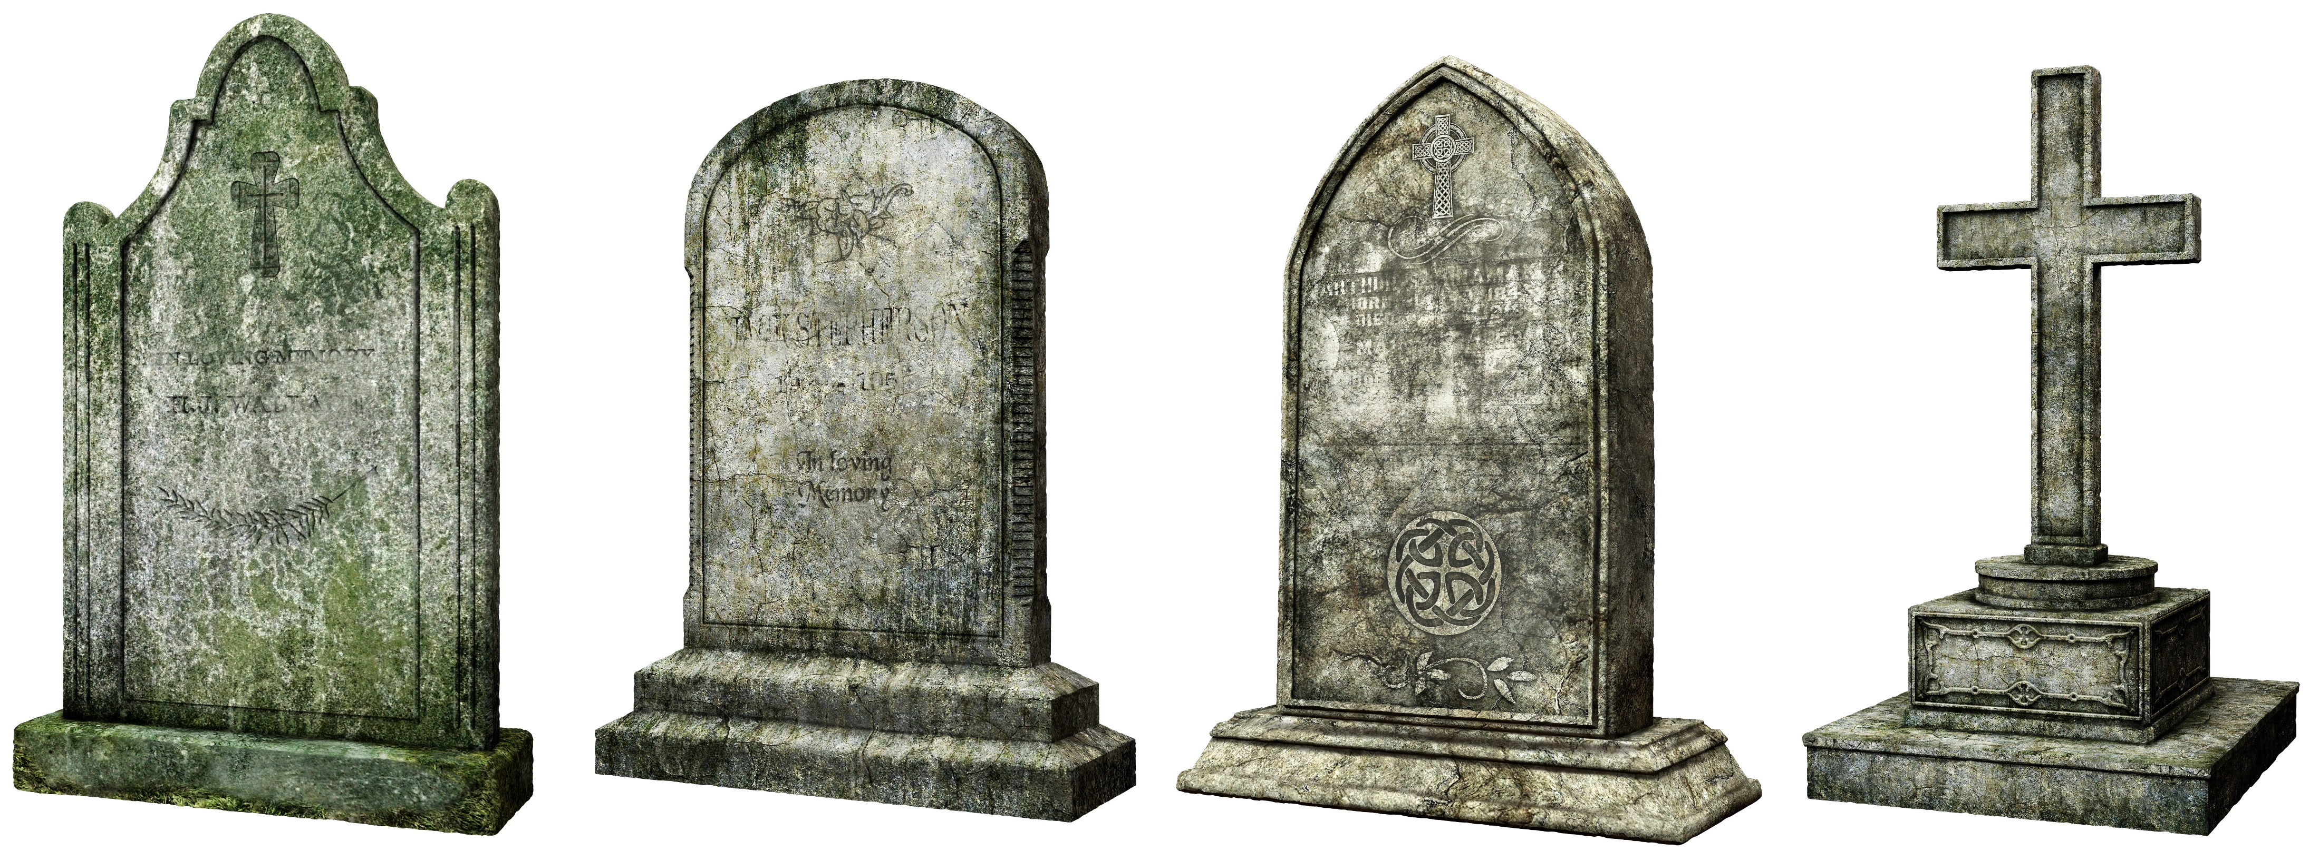
Alcohol-Related Deaths During COVID
Deaths due to alcohol-associated liver disease increased 22.4%
Deaths due to underlying mental behavioral disorders increased 35.1%.
Deaths due to opioid overdoses involving alcohol as a contributing cause increased 40.8%
Deaths due to overdoses on synthetic opioids other than methadone, mainly fentanyl involving alcohol as a contributing cause increased 59.2%
Overall, the increase in alcohol-related deaths was 25%
Alcohol-related deaths accounted for 2.8% of all deaths in 2019 and 3.0% in 2020
Notes:
A recent study found that deaths related to alcohol and drug use increased during the pandemic. Data shows that alcohol use contributed to drug-related deaths as well.
Reference(s)
White, A. M., Castle, I. P., Powell, P. A., Hingson, R. W., Koob, G. F. (2022). Alcohol-related deaths during the COVID-19 pandemic. Journal of the American Medical Association Psychiatry, 327(17), 1704–1706. http://dx.doi.org/10.1176/appi.ajp.2020.20091375

Slide 8
Families Impacted by Alcohol
Approximately 10.5% (7.5 million) of U.S. children 17 years old and younger live with a parent with AUD, according to a 2017 report
1.2 million are 0-2 years of age
1.2 million are 3 to 5 years of age
2.4 million are 6 to 11 years of age
2.7 million are 12 to 17 years of age
Lipari & Van Horn, 2017
Notes:
The authors of this short report used the NSDUH data from 2009-2014 to estimate these numbers. It is important to know the number of children 17 years old or younger living with a parent with an AUD. Numerous research studies demonstrate that these children experience:
Lower socioeconomic status
More difficulties in academic, social, and family functioning
Higher rates of behavioral health disorders (mental health, substance use, and other behavioral issues)
Reference(s)
Lipari, R. N., & Van Horn, S. L. (2017). The Center for Behavioral Health Statistics and Quality (CBHSQ) report: Children living with parents who have a substance use disorder. Rockville, MD: SAMHSA. https://www.samhsa.gov/data/sites/default/files/report_3223/ShortReport-3223.html

Slide 9
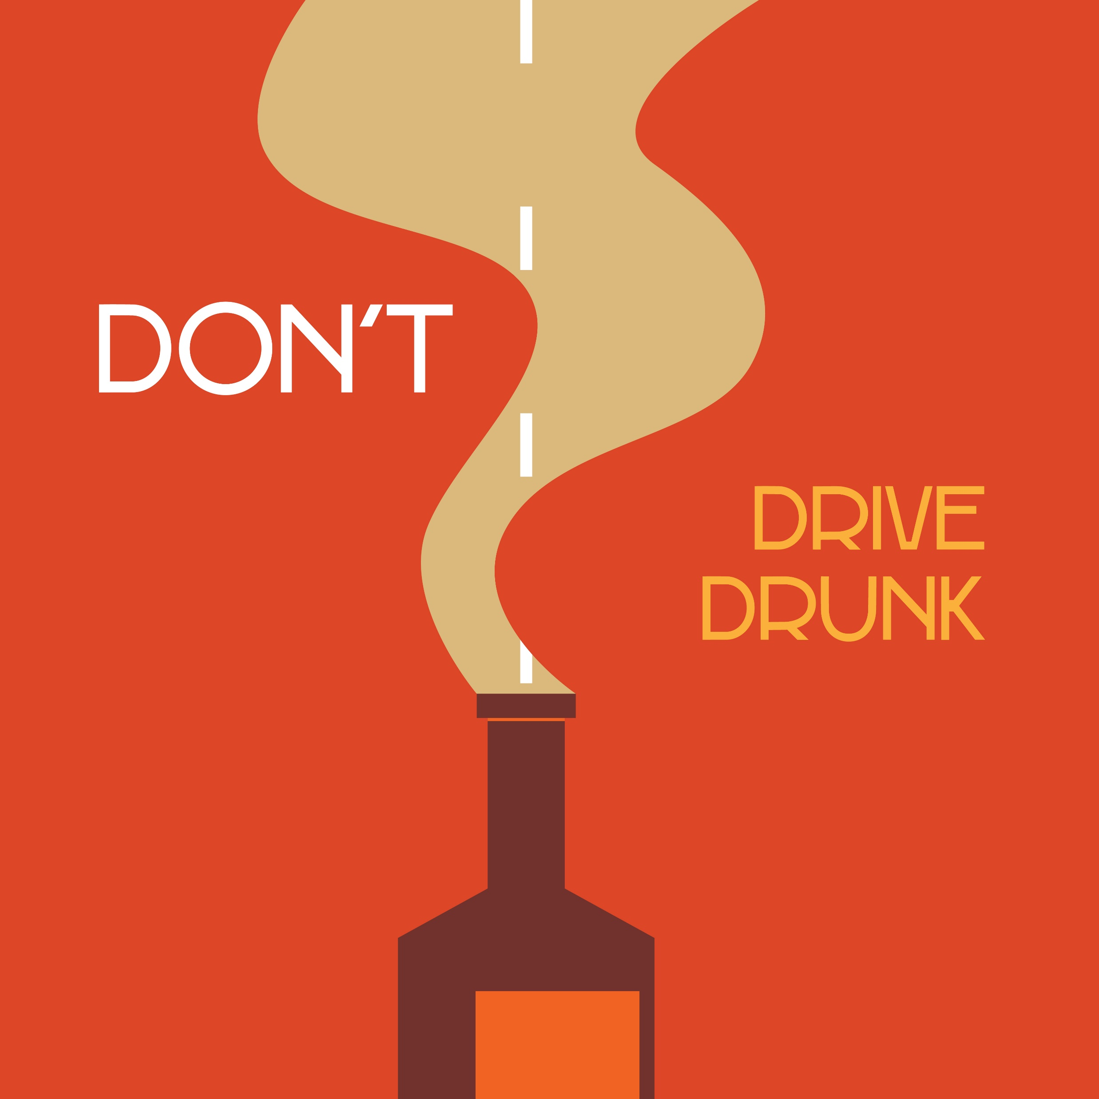
Alcohol and Driving
In 2019, alcohol-impaired driving fatalities accounted for 10,142 deaths (28.0% of overall driving fatalities)
68% of the fatalities (6,872) were in crashes in which at least one driver had a BAC of .15 or higher
An average of 1 alcohol-impaired driving fatality occurred every 52 minutes in 2019.
(National Center for Statistics and Analysis, National Highway Traffic Safety Administration)
file:///C:/Users/Nancy/Downloads/2019%20Alcohol-Impaired%20Driving%20Traffic%20Safety%20Fact%20Sheet.pdf
Notes:
This slide reviews data from the National Highway Traffic Safety Administration regarding alcohol-impaired driving. Point out that in 68% of the fatalities, at least one driver had almost twice the legal limit BAC.
Reference(s)
National Center for Statistics and Analysis. (2021, August). State alcohol-impaired-driving estimates: 2019 data (Traffic Safety Facts. Report No. DOT HS 813 106). National Highway Traffic Safety Administration.

Slide 10
Alcohol & Violence
Excessive drinking was associated with more than one quarter of violent and nonviolent injury deaths Specifically….
Almost 1 in 4 unintentional firearm injury deaths
1 in 3 homicides
1 in 5 poisonings (not alcohol)
1 in 5 suicides involved alcohol
^{(Alpert, et al., 2022)}
Notes:
A recent study looked at the connection between alcohol consumption and fatal injuries. The next slide provides data regarding why alcohol use puts a person more at risk for violent and nonviolent injuries and deaths.
Reference(s)
Alpert, H. R., Slater, M. E., Yoon, Y. H., Chen, C. M., Winstanley, N., & Esser, M. B. (2022). Alcohol consumption and 15 causes of fatal injuries: a systematic review and meta-analysis. American Journal of Preventive Medicine, 63(2), 286-300. https://doi.org/10.1016/j.amepre.2022.03.025

Slide 11
Alcohol & Violence – Why?
Excessive drinking impairs brain function resulting in:
poor judgment
slow decision making and reaction time
reduced perception and response to hazards
loss of balance and motor skills
increased risk taking
reduced inhibitions
reduced processing of communications
increased aggression
Some effects of alcohol, including impairment in judgment and motor dysfunction are apparent at BAC levels <0.10 g/dL.
^{(Alpert, et al., 2022)}
Notes:
This slide provides a reminder of how alcohol impairs brain function that can lead to risky and/or violent behaviors. Instructors/trainers have found it unhelpful to ask students/clinicians/peers to share their negative experiences with alcohol as it can cause some to relive a traumatic experience or serve as a trigger for other students.
Reference(s)
Alpert, H. R., Slater, M. E., Yoon, Y. H., Chen, C. M., Winstanley, N., & Esser, M. B. (2022). Alcohol consumption and 15 causes of fatal injuries: a systematic review and meta-analysis. American Journal of Preventive Medicine, 63(2), 286-300. https://doi.org/10.1016/j.amepre.2022.03.025

