Slide 1

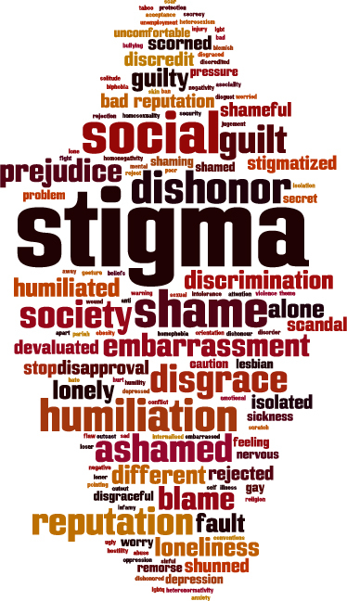
Stigma and Stigma Reduction
A brief introduction for all healthcare professionals
Notes:
SUD Keys to Education is a product for educators and clinical supervisors developed in 2022 by the Mountain Plains and Pacific Southwest Addiction Technology Transfer Centers (MPATTC and PSATTC). The main developer of the stigma reduction slides is Cindy Juntunen, PhD. Additional guidance and editing support were provided by Trisha Dudkowski, BA, Thomas E. Freese, PhD, Kenneth Flanagan, PhD, Terra Hamblin, MA, Shannon McCarty, BS, LP, Kim Miller, MS, Abby Roach-Moore, MSW, Nancy Roget, MS, Beth Rutkowski, MPH, and Maridee Shogren, DNP.
​
This product was developed to help community college/university faculty, as well as clinical supervisors and recovery support staff have access to brief, science-based content with the goal of providing materials that can be easily infused into existing substance use disorder and related courses (e.g., social work, nursing, criminal justice, foundation of addiction courses, ethics, counseling courses, etc.) and for clinical and recovery staff use in in-service meetings. Individuals can select the specific content to infuse into existing curricula/materials depending on specific needs of their learners. Each slide in the slide decks contain notes to provide guidance on the topics along with references and handouts where appropriate.​
If you require further information, please do not hesitate to contact the MPATTC (http://www.mpattc.org) or PSATTC (http://www.psattc.org) . You are free to use these slides and pictures, but please give credit to the MPATTC and PSATTC when using them by referencing both Centers at the beginning of your presentation. The MPATTC (HHS Region 8) and PSATTC (HHS Region 9) are part of the SAMHSA-funded ATTC Network that offers training and technical assistance (TA) services. HHS Region 8 is comprised of Colorado, Montana, North Dakota, South Dakota, Utah, and Wyoming, and HHS Region 9 is comprised of Arizona, California, Hawaii, Nevada, and the six U.S.-affiliated Pacific Jurisdictions (American Samoa, Commonwealth of the Northern Mariana Islands, Federated States of Micronesia, Guam, Republic of the Marshall Islands, and Republic of Palau). For additional information, please visit http://www.mpattc.org and http://www.psattc.org.​
Funding for this product was made possible (in part) by SAMHSA Cooperative Agreement numbers UR1 TI080200 (MPATTC) and UR1 TI080211 (PSATTC). The views expressed in these materials do not necessarily reflect the official policies of the Department of Health and Human Services, nor does mention of trade names, commercial practices, or organizations imply endorsement by the U.S. Government.​
Date Last updated: October 2022

Slide 2

Class Activity
Notes:
Refer to the Stigma Class Activity guide sheet. This exercise can be done as an individual writing exercise, a large-group discussion, or small group discussions. Instructions for each variation are provided in the guide sheet.
This exercise can be completed in as little as two minutes, or with discussion can be extended to up to 15 minutes, depending on course priorities.

Slide 3
What is Stigma?
Stigma is a social phenomenon in which a negative attitude or belief discredits a person or group because of an attribute- including an identity or health condition (Goffman, 1963)
  Assumes that the person who is the target of the stigma will experience discrimination due to the identified attribute
SAMHSA defines stigma as:
‘the complex of attitudes, beliefs, behaviors, and structures that interact at different levels of society (i.e., individuals, groups, organizations, systems) and manifest in prejudicial attitudes about and discriminatory practices against people with mental and substance use disorders’
(National Academies of Sciences, Engineering and Medicine, 2016)
Notes:
Stigma can be defined in many ways, most of which are derived from the classic definition of Goffman, 1963: “an attribute that is deeply discrediting” that reduces the individual “from a whole and usual person to a tainted, discounted one.”
As you discuss these definitions, clarify for students the following key points: stigma is a set of beliefs, it is socially constructed, and it assumes negative attributes.
To help students understand what stigma is, you can ask “Have you ever experienced stigma?” or “Can you think of statements you have heard that would represent or be an example of stigma?”
Reference(s)
Goffman, E. (1963). Stigma: Notes on the management of spoiled identity. Prentice-Hall.
National Academies of Sciences, Engineering, and Medicine. (2016). Ending discrimination against people with mental and substance use disorders: The evidence for stigma change. Washington, DC: The National Academies Press. https://doi.org/10.17226/23442

Slide 4
Types of Stigma
Public or Social
Public attitudes resulting in discrimination or devaluation
Systemic
Reduced access to care and resources due to policies & practices
Self or Personal
Internalization of negative stereotypes
Enacted
The experience of discriminatory treatment by others
Anticipated
or Felt
Expecting to be a target of discrimination in the future.
Notes:
There are as many as 7 types of stigma (NAMI, 2018), but these 5 are particularly important to understand the impact stigma has on clinical presentation, treatment, and recovery. Note that each of the 5 types highlighted above is demonstrate or experienced from a different perspective.
The primary mechanisms or processes that underly and support stigma are stereotypes, prejudice and discrimination (Fox et al, 2018). These represented the cognitive, affective (emotional) and behavioral responses people might have to an individual with an identity or condition that is devalued in some way.
Research has demonstrated that stigma is measurable among healthcare professionals (Muncan et al, 2020; Van Boekel et al, 2013), making care providers a potential source of multiple types of stigma: public, enacted, anticipated, and systemic.
Reference(s)
Fox, A.B., Earnshaw, V.A., Taverna, E.C., & Vogt, D. (2018). Conceptualizing and measuring mental illness stigma: The mental illness stigma framework and critical review of measures. Stigma Health, 3(4), 348-376. doi:10.1037/sah0000104
Muncan, B., Walters, S.M., Ezell, J., & Ompad, D.C. (2020).“They look at us like junkies”: Influences of drug use stigma on the healthcare engagement of people who inject drugs in New York City. Harm Reduction Journal, 17, 53. https://doi.org/10.1186/s12954-020-00399-8
National Alliance on Mental Illness (NAMI). (2018, October). Overcoming stigma. Retrieved from https://www.nami.org/Blogs/NAMI-Blog/October-2018/Overcoming-Stigma
Van Boekel, L.C., Brouwers, E.P., Van Weeghel, J., & Garretsen, H.F. (2013). Stigma among health professionals towards patients with substance use disorders and its consequences for healthcare delivery: Systematic review. Drug and Alcohol Dependence, 131(1–2), 23–35. https://doi.org/ 10.1016/j.drugalcdep.2013.02.018

Slide 5
Another Perspective on Stigma
STRUCTURAL
(Social Norms, Laws, Policies & Practices)
INTERPERSONAL
(Everyday & Episodic Interactions)
INDIVIDUAL
(Beliefs & Behaviors)
(Adapted from White Hughto et al, 2015)
Notes:
Here, the focus is not so much on the perspectives being taken. Rather, the focus is on how stigma is expressed across multiple levels of lived experience.
EXAMPLES:
Structural Stigma: Structural stigma includes institution-level practices and policies that lead to differential treatment. For example: policies that limit treatment access or health care; lack of training in substance abuse across health profession programs; difficulty getting coverage for SUD treatment
Interpersonal Stigma: Interpersonal stigma refers to stigma that occurs between people during social interactions. For example: discrimination among healthcare workers (Van Boekel et al, 2013); employment discrimination; rejection by family and others; assuming people with SUDs caused their own problems
Individual Stigma: Individual stigma is that which is expressed internally or in one’s own belief system. For example: concealing stigma; not seeking help; internalizing negative attitudes of others.
Reference(s)
White Hughto, J.M., Reisner, S.L., & Pachankis, J.E. (2015). Transgender stigma and health: A critical review of stigma determinants, mechanisms, and interventions. Social Sciences & Medicine, 147, 222-31. https://doi.org/ 10.1016/j.socscimed.2015.11.010

Slide 6
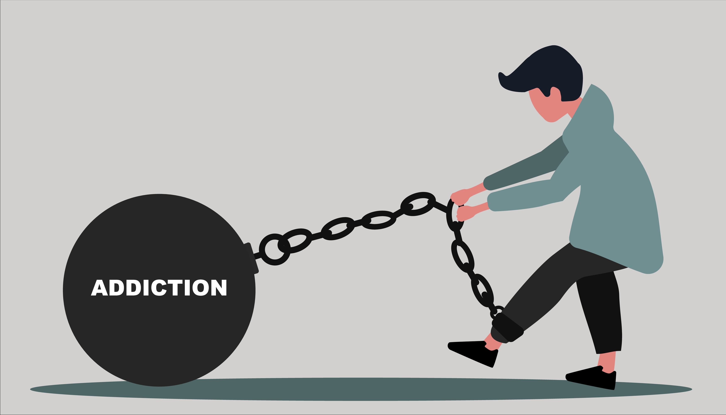
Stigma and Substance Use Disorders
‘Addiction’ is one of the most stigmatized conditions, globally (Barry et al, 2014; Room et al, 2001)
  Illicit drug use – MOST stigmatized (#1)
  Alcohol use - #4 (after HIV+ and criminal record)
The long-lasting negative attitudes toward people with SUDs are reinforced through media (McGinty et al, 2019), which has a preponderance of negative stories that reinforce stigma.
Notes:
In a study conducted for the World Health Organization, Room and colleagues (2001) measured stigma for 18 conditions across 14 countries, and found high levels of stigma for both drug and alcohol use.
Similarly, Barry and colleagues (2014) found, in a large US sample, that respondents were much less likely to want to associate with a person with a SUD than a person with a mental illness. Further, they were more accepting of discriminatory treatment, including lower access to housing and less insurance coverage for treatment for individuals with SUDs.
Photo credit: Shutterstock
Reference(s)
Barry, C. L., McGinty, E. E., Pescosolido, B. A., & Goldman, H. H. (2014). Stigma, discrimination, treatment effectiveness, and
policy: public views about drug addiction and mental illness. Psychiatric Services, 65(10), 1269-1272. https://doi.org/10.1176/appi.ps.201400140
McGinty, E.E., Kennedy-Hendricks, A., & Barry, C.L. (2019). Stigma in the Media. In J. D. Avery, J. J. Avery (eds.), The Stigma of Addiction, pp. 201.213. https://doi.org/10.1007/978-3-030-02580-9_11.
Room, R., Rehm, J., Trotter, R.T., Paglia, A., & Ustun, T.B. (2001), Cross-cultural views on stigma valuation parity and societal attitudes towards disability. In T. B. Üstün, S. Chatterji, J. E. Bickenbach, R. T. Trotter II, R. Room, J. Rehm, & S. Saxena [Eds.], Disability and culture: Universalism and diversity (pp. 247–291). Hofgrebe & Huber Publishers.

Slide 7

Why the Strong Relationship Between
Stigma and SUDs?
Blame
  Assumption that people with SUDs caused their illness
“She brought it on herself”
Poor Prognosis and Need for Continued Care
  Assumption that treatment won’t help, at least not without lasting a lifetime
“Addicts always relapse”
Social Distance
  Reluctance to form close attachments
  “I don’t want my child dating an addict”
Fear
  Fear that people with SUDs are dangerous or fear that SUD could happen to anyone
  “We’re a good family – that will never happen to my kids.”
Kelly, 2021
Notes:
The perception that people with substance use disorders both have control over the SUD and are responsible for developing the disorder contribute to high levels of negative evaluation and stigma.
Stigma is reinforced by widely held beliefs that treatment will not work, or will need to be repeated numerous times to be effective.
Together, these factors cause people to distance from individuals with SUD, which minimizes the opportunity for countering attitudes to develop and reinforces the “other-ness” of individuals with SUD. Fear plays a powerful role in both distancing from and not identifying with individuals with SUD .
Photo credit: Shutterstock
Reference(s)
Kelly, J.F. (June 2021). Understanding and addressing substance use disorder stigma in clinical care settings. A presentation sponsored by the Opioid Response Network, Recovery Research Institute, and SAMHSA. http://www.recoveryanswers.org/assets/1.-Webinar-2.-AAAP-ORN-Stigma-FINAL-JF-KELLY-6-30-21.pdf

Slide 8

The Implications of Stigma
Stigma reduces human dignity
  Public and enacted stigma marginalize, isolate, or “other” individuals
  Systemic stigma violates the human right to care and concern by limiting access to treatment
  Internalized stigma reduces self-esteem and increases isolation
  Anticipated stigma decreases help-seeking behavior
(Boticelli, 2019)
Notes:
The various types of stigma work together to increase hesitancy to seek care, and also serve to make health care less accessible and sometimes less appropriate. Stigma among health care providers has led to “under treatment” (Boticelle, 2019) of people with SUDs.
By putting distance between people with a diagnosis of SUD and others, we are minimizing the respect with which they are treated. This violates essential ethical principles of justice, fidelity, and beneficence. (For definitions, see:
Photo credit: Shutterstock
Reference(s)
Boticelli, M. (2019). Stigma and substance use disorder: Breaking down barriers to treatment and sound public policy. HealthCity Newsletter. https://healthcity.bmc.org/policy-and-industry/stigma-key-barrier-sud-treatment-and-sound-public-policy

Slide 9

Stigma in Practice: Scenario
Alice is going to see Dr. Jones for an annual checkup. She has gained some weight since her last physical, and she is hoping to get some advice from Dr. Jones about how to adjust her diet.
When Dr. Jones sees Alice, he says, “Oh, I see you’ve fallen off the sugar wagon. You know, at your age, you are at risk for Type II diabetes if you can’t get your food consumption under control. I won’t be able to keep you on as a patient if you can’t manage that.”
Notes:
Discussion Questions for this scenario:
What are your impressions of Dr. Jones’s comments?
How might Alice be feeling about Dr. Jones after this exchange? How might she feel about herself? What impact could this have on her decision to ask him for help or advice?
If this happened to you, would you return to Dr. Jones? Why or why not?
Now, imagine Dr. Jones has this conversation with a patient who has a history of substance use disorder, and that patient has had a relapse and is trying to get support to get back into recovery? Which scenario seems more of less likely to happen? Why?
If you want to develop further discussion or help students develop and practice ways of responding more effectively in this situation, refer to the ACT process described in the slide deck “Addressing Stigmatizing Language in the Workplace”, located in the General Content folder of the SUD Keys

Slide 10

Stigma is Intersectional
Stigma can also be attached to identity
  Gender
  Age
  Size
  Sexual Orientation
  Race
  Class
10
Notes:
Intersectionality (Crenshaw, 1989) refers to intersection and overlapping social and cultural identities, recognizing that each may be accompanied by different aspects of oppression, privilege, discrimination and prejudice.
Although research is limited (Jackson-Best & Edwards, 2018), there does appear to be an increased impact of stigma for people who are also part of other marginalized identities (Turan et al, 2019).
The implications of this are that people with SUDs who also hold one or more of these identities will experience exponential degrees of stigma and related discrimination.
Reference(s)
Crenshaw, K. (1989). Demarginalizing the Intersection of Race and Sex: A Black Feminist Critique of Antidiscrimination Doctrine, Feminist Theory and Antiracist Politics. University of Chicago Legal Forum, 139-167.
Jackson-Best, F. & Edwards, N. (2018). Stigma and intersectionality: a systematic review of systematic reviews across HIV/AIDS, mental illness, and physical disability. BMC Public Health 18, 919. https://doi.org/10.1186/s12889-018-5861-3
Turan, J.M., Elafros, M.A., Logie, C.H., Banik, S., Turan, B., Crockett, K.B., Pescosolido, B., & Murray, S.M. (2019). Challenges and opportunities in examining and addressing intersectional stigma and health. BMC Med 17, 7. https://doi.org/10.1186/s12916-018-1246-9

Slide 11

Language: A Powerful Tool to Reduce Stigma
Use person-first language
Use objective terms, rather than values- or morality-based words
Avoid fear-based or sensational language
Avoid slang or derogatory terms
Notes:
In a study of more than 500 mental health professionals, the authors found different perceptions of analogue clients based on the single difference of whether the client was presented as a “substance abuser” or “having a substance use disorder”
The authors concluded that “even among highly trained mental health professionals, exposure to these two commonly used terms evokes systematically different judgments. The commonly used "substance abuser" term may perpetuate stigmatizing attitudes.”
Photo credit: Shutterstock
Reference(s)
Kelly, J. F., Dow, S. J., & Westerhoff, C. (2010). Does our choice of substance-related terms influence perceptions of treatment need? An empirical investigation with two commonly used terms. Journal of Drug Issues, 40(4), 805-818. https://doi.org/10.1177/002204261004000403

Slide 12
AVOID USE
Addict, junkie, pothead, alcoholic Person with a substance use disorder Tested clean/Tested dirty Positive or negative test
Clean/Sober/On the wagon In recovery
Drug Abuse Use (illicit) or Misuse (prescribed)
Addicted baby Newborn exposed to substances
Addiction is a lifelong battle SUDs can be treated
Notes:
Link back to opening class exercise and work with students to identify non-stigmatizing language options.
Bring up examples from the initial class discussion and have students find alternative language they could use to communicate their point without stigmatizing language. Discuss how students might feel if the language was directed at them, and how they would respond differently to the two version of the message.
Reference(s)
Kelly, J.F., Walkerman, S.E. & Saitz, R. (2015, January). Stop talking 'dirty': clinicians, language, and quality of care for the leading cause of preventable death in the United States. The American Journal of Medicine, 128(1), 8-9. https://doi.org/ 10.1016/j.amjmed.2014.07.043

