Slide 1
Stimulants – What Are We Talking About?
Stimulants Mini-Deck #1
Notes:
SUD Keys to Education is a product for educators and clinical supervisors developed in 2022 by the Mountain Plains and Pacific Southwest Addiction Technology Transfer Centers (MPATTC and PSATTC). The main developers of the stimulant materials are Beth Rutkowski, MPH, and Thomas E. Freese, PhD. Additional guidance and editing support was provided by Cindy Juntenen, PhD, LP, Nancy Roget, MS, Trisha Dudkowski, BA, Kenneth Flanagan, PhD, Terra Hamblin, MA, Shannon McCarty, BS, Kim Miller, MS, Abby Roach-Moore, MSW, and Maridee Shogren, DNP.
This product was developed to help community college/university faculty, as well as clinical supervisors and recovery support staff to have access to brief, science-based content with the goal of providing materials that can be easily infused into existing substance use disorder and related courses (e.g., social work, nursing, criminal justice, foundation of addiction courses, ethics, counseling courses, etc.) and for clinical and recovery staff use in in-service meetings. Individuals can select the specific content to infuse into existing curricula/materials depending on specific needs of their learners. Each slide in the slide decks contain notes to provide guidance on the topics along with references and handouts where appropriate.
If you require further information, please do not hesitate to contact the MPATTC (http://www.mpattc.org) or PSATTC (http://www.psattc.org). You are free to use these slides and pictures, but please give credit to the MPATTC and PSATTC when using them by referencing both Centers at the beginning of your presentation. The MPATTC (HHS Region 8) and PSATTC (HHS Region 9) are part of the SAMHSA-funded ATTC Network that offers training and technical assistance (TA) services. HHS Region 8 is comprised of Colorado, Montana, North Dakota, South Dakota, Utah, and Wyoming, and HHS Region 9 is comprised of Arizona, California, Hawaii, Nevada, and the six U.S.-affiliated Pacific Jurisdictions (American Samoa, Commonwealth of the Northern Mariana Islands, Federated States of Micronesia, Guam, Republic of the Marshall Islands, and Republic of Palau. For additional information, please visit http://www.mpattc.org and http://www.psattc.org.
Funding for this product was made possible (in part) by SAMHSA Cooperative Agreement numbers UR1 TI080200 (MPATTC) and UR1 TI080211 (PSATTC). The views expressed in these materials do not necessarily reflect the official policies of the Department of Health and Human Services, nor does mention of trade names, commercial practices, or organizations imply endorsement by the U.S. Government.
Additional resources are available to enhance and support the information provided in this brief presentation.
Date last updated: August 4, 2022.

Slide 2
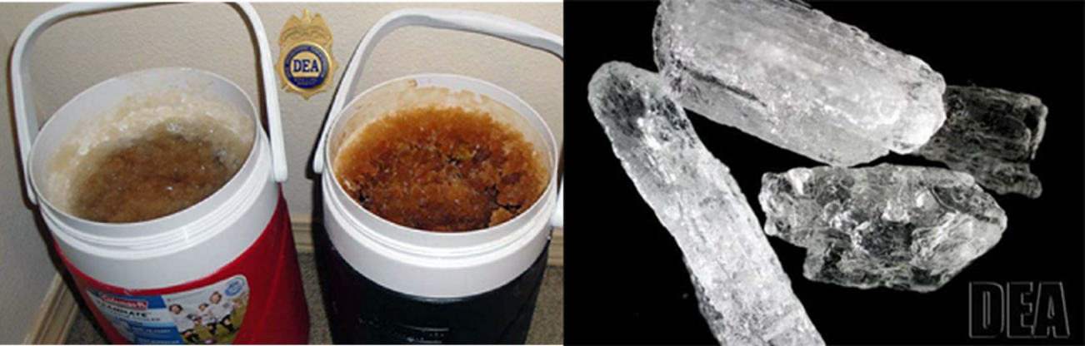
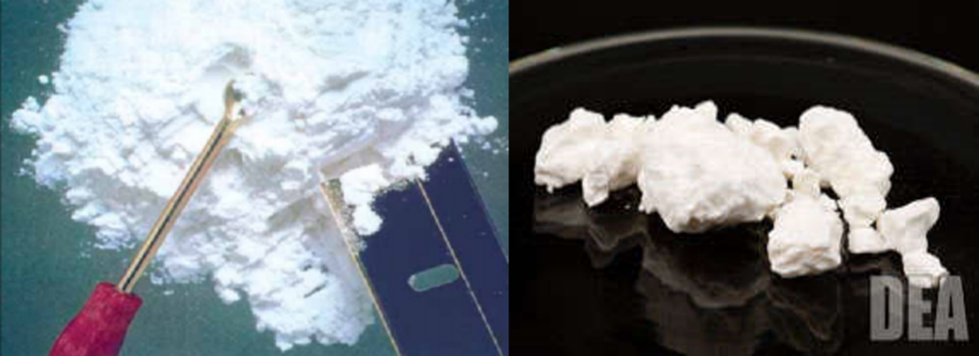
The Broader Classification: Stimulants
Methamphetamine
Powder and Crack Cocaine
Notes:
The main types of stimulants are methamphetamine, amphetamines (not pictured), crack cocaine, and powder cocaine. Stimulants increase alertness and arousal by stimulating the central nervous system.
IMAGE CREDITS:
U.S. Drug Enforcement Administration website, various publications.

Slide 3
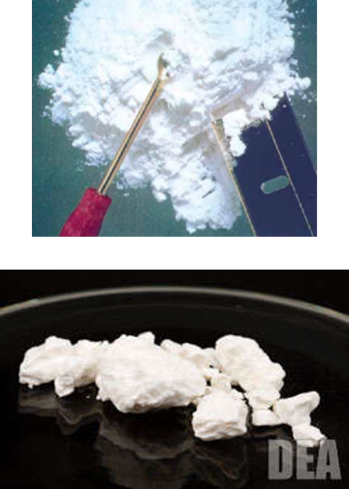

Forms of Cocaine
Powder cocaine (Hydrochloride salt)
Smokable cocaine (Crack, rock, freebase)
Cocaine half-life: ~1-2 hours
SOURCE: NIDA, 2018.
Notes:
The powdered hydrochloride salt form of cocaine can be snorted or dissolved in water and injected. Powder cocaine is most often snorted. Crack is the form of cocaine that has not been neutralized by an acid to make the hydrochloride salt. This form of cocaine comes in a rock crystal that can be heated and its vapours smoked. Crack may be smoked in a pipe bowl containing 50-100 mg or in a cigarette with as much as 300 mg. The term "crack" refers to the crackling sound heard when the mixture is smoked (heated). The cocaine high is most intense if you smoke or inject cocaine. Smoking crack bypasses the vasoconstriction that results when cocaine is snorted; therefore, the effects are like taking cocaine intravenously.
Common street names can differ by region. Ask the audience to offer additional street names. Many other street names exist for crack, and the popularity of these names varies by geographic region of the U.S. Additional street names include: 24-7; Badrock; Beat; Candy; Chemical; Cloud; Cookies; Crumbs; Crunch & munch; Devil drug; Dice; Electric Kool-Aid; Fat bags; French fries; Glo; Gravel; Grit; Hail; Hard ball; Hard rock; Hotcakes; Ice cube; Jelly beans; Nuggets; Paste; Piece; Prime time; Product; Raw; Rock(s); Scrabble; Sleet; Snow coke; Tornado; and Troop.
Additional Information for the Presenter:
The half-life of cocaine depends on the route of administration. The following table summarizes the duration of effects and half-life, by route of administration.
Smoking:
Onset: 7 seconds
Peak Effect (min): 1-5 minutes
Duration (min): 20 minutes
Half-Life (min): 40-60 minutes
Injection:
Onset: 15 seconds
Peak Effect (min): 3-5 minutes
Duration (min): 20-30 minutes
Half-Life (min): 40-60 minutes
Nasal/Inhalation:
Onset: 3 minutes
Peak Effect (min): 15 minutes
Duration (min): 45-90 minutes
Half-Life (min): 60-90 minutes
Oral:
Onset: 10 minutes
Peak Effect (min): 60 minutes
Duration (min): 60 minutes
Half-Life (min): 60-90 minutes
REFERENCE:
National Institute on Drug Abuse. (2018, July 13). Cocaine. Retrieved May 8, 2020, from https://www.drugabuse.gov/publications/drugfacts/cocaine.
IMAGE CREDITS:
U.S. Drug Enforcement Administration website, various publications.

Slide 4
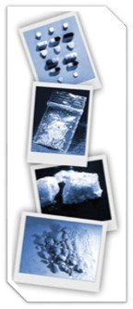
Methamphetamine
Methamphetamine Powder: Beige, yellowy, or off-white powder
Base/Paste Methamphetamine: Oily, gunky, gluggy gel, moist, waxy
Crystalline Methamphetamine: White/clear crystals/rocks; crushed glass/rock salt
SOURCE: NIDA, 2019.
Notes:
Methamphetamine is commonly found in a few forms – methamphetamine powder, base/paste methamphetamine, and crystal methamphetamine. The information on this slide is provided to describe the differences between each form of methamphetamine.
REFERENCE:
National Institute on Drug Abuse. (2019, May 16). Methamphetamine. Retrieved May 12, 2020, from https://www.drugabuse.gov/publications/drugfacts/methamphetamine.
IMAGE CREDIT:
U.S. Drug Enforcement Administration, 2017.

Slide 5
Methamphetamine vs. Cocaine
Methamphetamine
Cocaine
Stimulant
Man-made
Smoking produces a long-lasting high
50% of drug is removed from body in 12 hours
Increases dopamine release and blocks dopamine re-uptake
Limited medical use
Stimulant and local anesthetic
Plant-derived
Smoking produces a brief high
50% of drug is removed from body in 1 hour
Blocks dopamine re-uptake
Limited use as a local anesthetic (surgical)
SOURCE: NIDA, 2019.
Notes:
Methamphetamine is structurally similar to amphetamine, but it is quite different from cocaine. Although these stimulants have similar behavioral and physiological effects, there are some major differences in their basic mechanisms of action. In contrast to cocaine, which is quickly removed and almost completely metabolized in the body, methamphetamine has a much longer duration of action and a larger percentage of the drug remains unchanged in the body. This results in methamphetamine being present in the brain longer, which ultimately leads to prolonged stimulant effects. The half-life of methamphetamine is about 10 hours, vs. a half-life of cocaine of approximately 2 hours.
Although both methamphetamine and cocaine increase levels of the brain chemical dopamine, animal studies reveal much higher levels of dopamine following administration of methamphetamine due to the different mechanisms of action within nerve cells in response to these drugs. Cocaine prolongs dopamine’s action in the brain by blocking dopamine re-uptake. While at low doses, methamphetamine blocks dopamine re-uptake, methamphetamine also increases the release of dopamine, leading to much higher concentrations in the synapse, which can be toxic to nerve terminals.
Methamphetamine is neurotoxic, but cocaine does not appear to be neurotoxic. Methamphetamine-induced paranoia can last as long as 7 to 14 days (or longer), whereas cocaine paranoia usually subsides within about 4-8 hours following drug cessation.
REFERENCE:
National Institute on Drug Abuse. (2019, May 16). Methamphetamine. Retrieved May 12, 2020, from https://www.drugabuse.gov/publications/drugfacts/methamphetamine.

