Slide 1
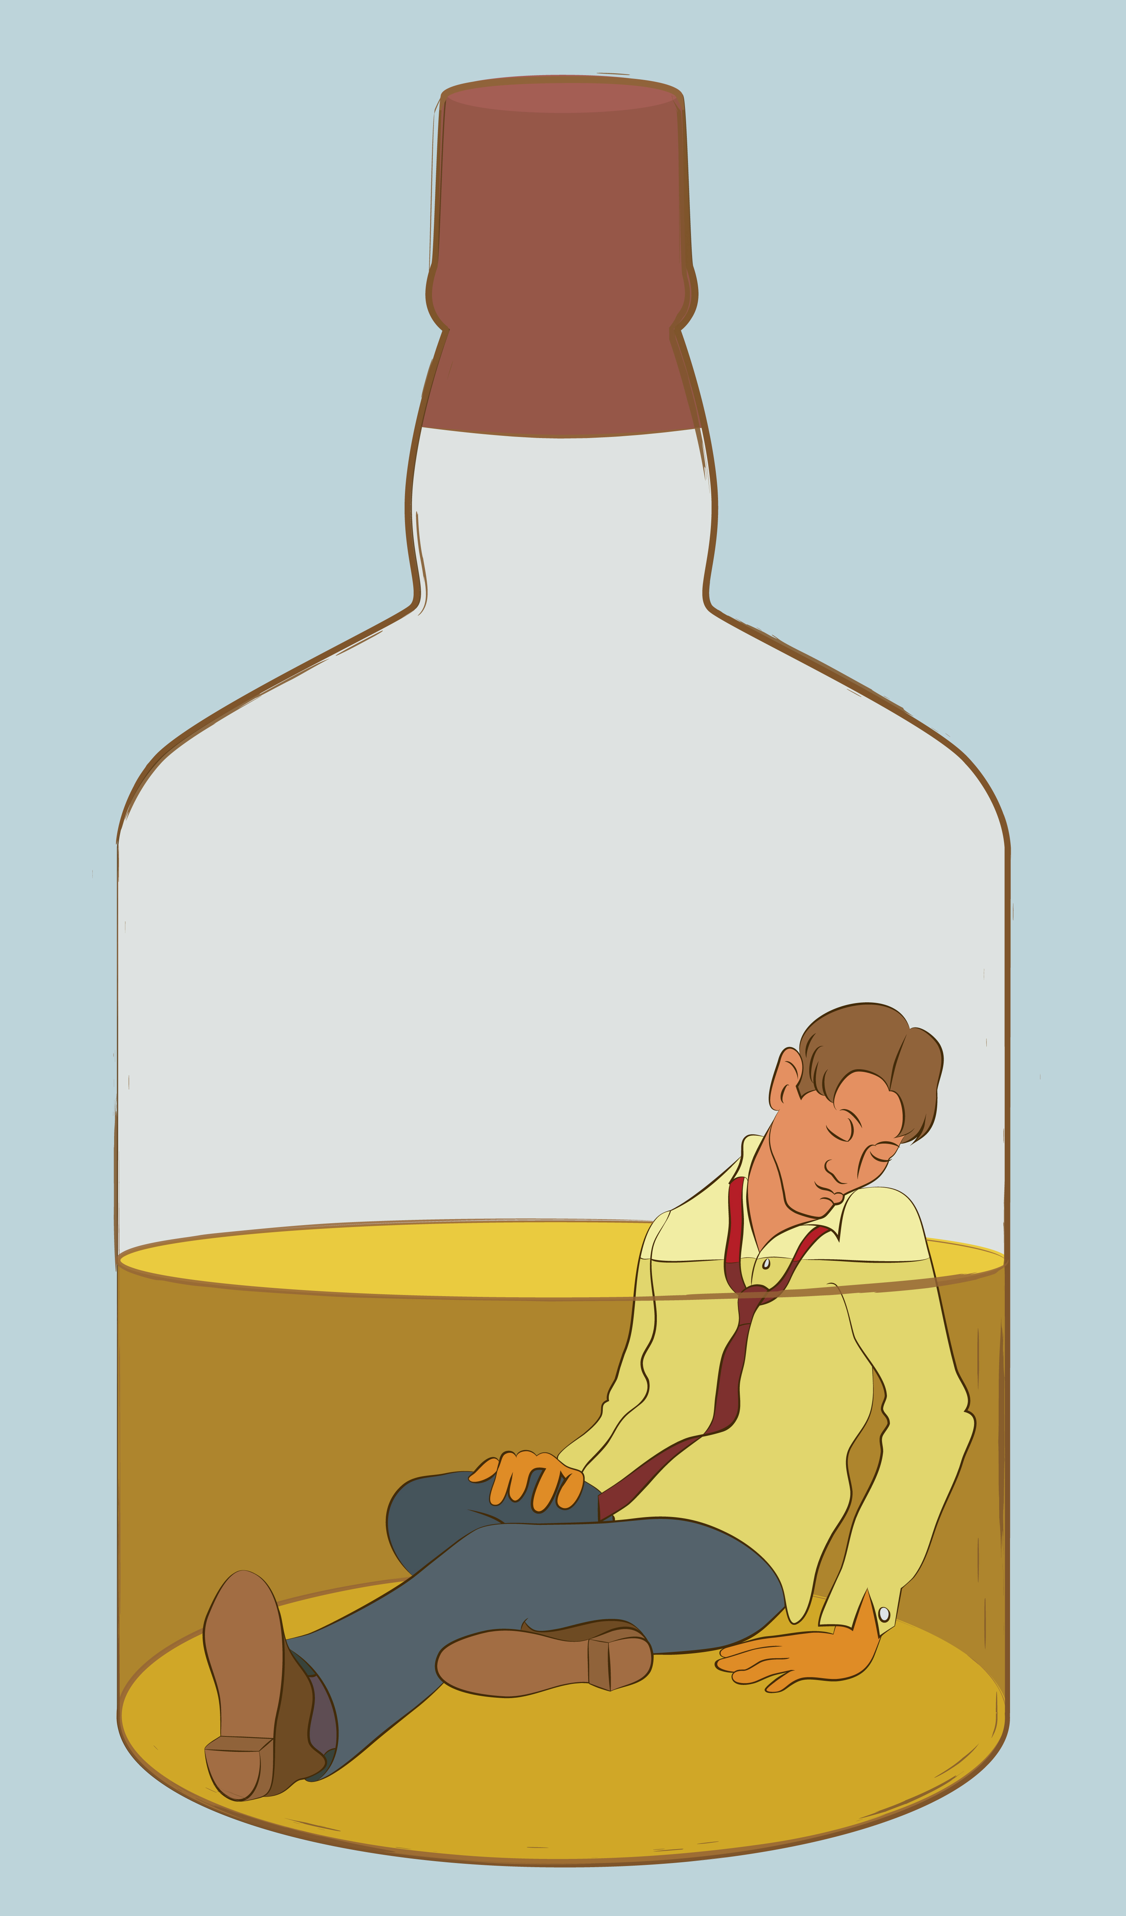
Risky Drinking Or Alcohol Use Disorder?
Notes:
SUD Keys to Education is a product for educators and clinical supervisors developed in 2022 by the Mountain Plains and Pacific Southwest Addiction Technology Transfer Centers (MPATTC and PSATTC). The main developers of the alcohol materials are Nancy Roget, MS, Kim Miller, MS, and Trisha Dudkowski, BA. Additional guidance and editing support were provided by Kenneth Flanagan, PhD, Thomas E. Freese, PhD, Terra Hamblin, MA, Cindy Juntenen, PhD, Shannon McCarty, BS, LP, Abby Roach-Moore, MSW, Beth Rutkowski, MPH, and Maridee Shogren, DNP.
This product was developed to help community college/university faculty, as well as clinical supervisors and recovery support staff have access to brief, science-based content with the goal of providing materials that can be easily infused into existing substance use disorder and related courses (e.g., social work, nursing, criminal justice, foundation of addiction courses, ethics, counseling courses, etc.) and for clinical and recovery staff use in in-service meetings. Individuals can select the specific content to infuse into existing curricula/materials depending on specific needs of their learners. Each slide in the slide decks contain notes to provide guidance on the topics along with references and handouts where appropriate.
If you require further information, please do not hesitate to contact the MPATTC (http://www.mpattc.org) or PSATTC (http://www.psattc.org) . You are free to use these slides and pictures, but please give credit to the MPATTC and PSATTC when using them by referencing both Centers at the beginning of your presentation. The MPATTC (HHS Region 8) and PSATTC (HHS Region 9) are part of the SAMHSA-funded ATTC Network that offers training and technical assistance (TA) services. HHS Region 8 is comprised of Colorado, Montana, North Dakota, South Dakota, Utah, and Wyoming, and HHS Region 9 is comprised of Arizona, California, Hawaii, Nevada, and the six U.S.-affiliated Pacific Jurisdictions (American Samoa, Commonwealth of the Northern Mariana Islands, Federated States of Micronesia, Guam, Republic of the Marshall Islands, and Republic of Palau). For additional information, please visit http://www.mpattc.org and http://www.psattc.org.
Funding for this product was made possible (in part) by SAMHSA Cooperative Agreement numbers UR1 TI080200 (MPATTC) and UR1 TI080211 (PSATTC). The views expressed in these materials do not necessarily reflect the official policies of the Department of Health and Human Services, nor does mention of trade names, commercial practices, or organizations imply endorsement by the U.S. Government.
Additional resources are available to enhance and support the information provided in this brief presentation.
Image Credit: Shutterstock (unless otherwise noted)
Date last updated: July 27, 2022.

Slide 2
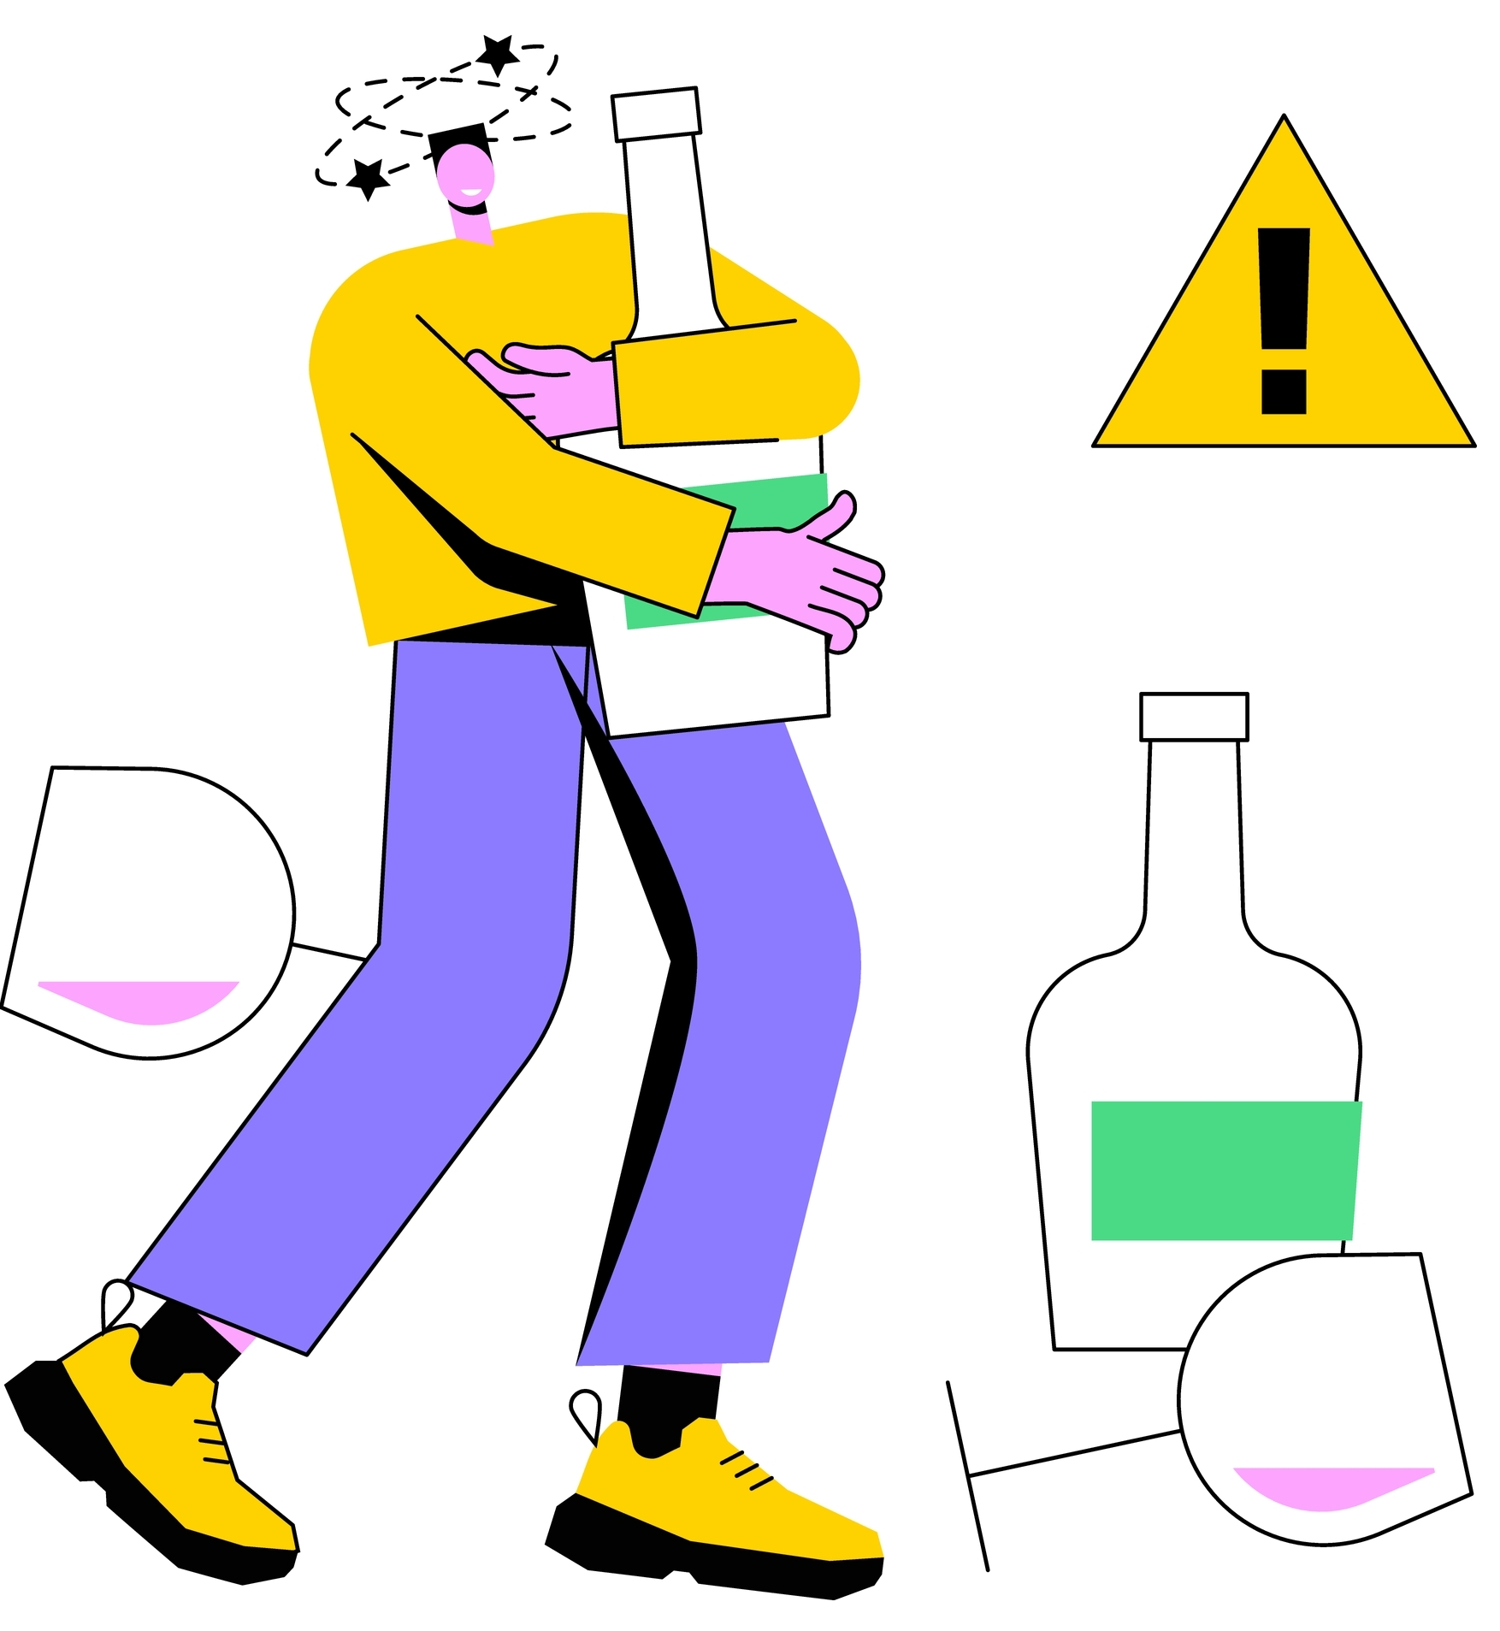
Key Terms
At Risk Drinking: alcohol use that exceed the recommended per-occasion or weekly amounts: also called ‘heavy drinking
Standard Drink: an alcoholic beverage that contains roughly 14 grams of pure alcohol
Hazardous Drinking: a quantity or pattern of alcohol consumption that places a person at risk for adverse health events
NIAAA (https://www.rethinkingdrinking.niaaa.nih.gov/how-much-is-too-much/is-your-drinking-pattern-risky/whats-at-risk-or-heavy-drinking.aspx)
Reid, Fiellin, & O’Connor, 1999
Notes:
This slide includes the definitions for several alcohol-related key terms that will be used throughout the presentation.
For more information on each term, please visit:
National Institute on Alcohol Abuse and Alcoholism (NIAAA) (2020) Understanding Alcohol Use Disorder (https://www.niaaa.nih.gov/alcohol-health/overview-alcohol-consumption/alcohol-use-disorders)
National Institute on Alcohol Abuse and Alcoholism (NIAAA). (2019). What’s “low risk” drinking for AUD? https://www.rethinkingdrinking.niaaa.nih.gov/How-much-is-too-much/Is-your-drinking-pattern-risky/Whats-Low-Risk-Drinking.aspx.
Reid MC, Fiellin DA, O'Connor PG. Hazardous and Harmful Alcohol Consumption in Primary Care. Arch Intern Med. 1999;159(15):1681–1689. doi:10.1001/archinte.159.15.1681

Slide 3
More Key Terms
Harmful Drinking: alcohol consumption that results in adverse events (e.g., physical/psychological harm)
Binge Drinking: a pattern of drinking that brings a person’s blood alcohol concentration (BAC) to 0.08 grams percent or above; usually happens when men consume 5+ drinks or women consume 4+ drinks in 2 hours
Alcohol Use Disorder: a chronic relapsing brain disease characterized by compulsive alcohol use, loss of control over alcohol intake, and a negative state when not using
NIAAA (https://www.rethinkingdrinking.niaaa.nih.gov/how-much-is-too-much/is-your-drinking-pattern-risky/whats-at-risk-or-heavy-drinking.aspx)
Reid, Fiellin, & O’Connor, 1999
Notes:
This slide continues the list of definitions for several alcohol-related key terms that will be used throughout the presentation. What’s the difference between binge drinking and AUD? Someone can be a binge drinker without having an AUD.
For more information on each term, please visit:
Centers for Disease Control and Prevention. (2018). Fact Sheets – Binge Drinking. https://www.cdc.gov/alcohol/fact-sheets/binge-drinking.htm.
National Institute on Alcohol Abuse and Alcoholism (NIAAA) (2020) Understanding Alcohol Use Disorder (https://www.niaaa.nih.gov/alcohol-health/overview-alcohol-consumption/alcohol-use-disorders)
Reid MC, Fiellin DA, O'Connor PG. Hazardous and Harmful Alcohol Consumption in Primary Care. Arch Intern Med. 1999;159(15):1681–1689. doi:10.1001/archinte.159.15.1681

Slide 4
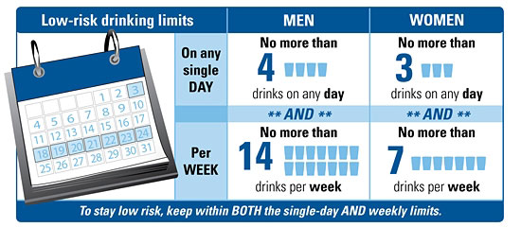
How is Risky Drinking Defined?
For women or men older than 65 years…
risky alcohol use is defined as having more than 3 drinks on any day or more than 7 standard drinks per week.
Patel & Balsanova, 2021 p. 196
https://www.niaaa.nih.gov/alcohol-health/overview-alcohol-consumption/moderate-binge-drinking
Notes:
We ask our clients and patients screening questions to identify risk. But how is risk defined? The U.S.-based National Institute on Alcohol Abuse and Alcoholism (NIAAA) defines risk as drinking more than the recommended limits. According to this image, the recommended limit for men is no more than 4 drinks per day and no more than 14 drinks per week. For women, the limit is no more than 3 drinks per day and no more than 7 drinks per week. Older adults (men and women over the age of 65) are generally advised to have no more than 3 drinks on a day and 7 per week.
According to research, women show signs of alcohol-related problems at lower drinking levels than men. Women, on average, weigh less than men, and women have less water in their bodies than men (this is relevant because alcohol disperses in body water).
Image Retrieved From: https://www.mirecc.va.gov/cih-visn2/Documents/Patient_Education_Handouts/A_Guide_to_Low_Risk_Drinking_Version_1.pdf
Patel AK, Balasanova AA. Unhealthy Alcohol Use. JAMA. 2021;326(2):196. doi:10.1001/jama.2020.2015 National Institute on Alcohol Abuse and Alcoholism (NIAAA). (2019). What’s “low risk” drinking for AUD? Retrieved from: https://www.rethinkingdrinking.niaaa.nih.gov/How-much-is-too-much/Is-your-drinking-pattern-risky/Whats-Low-Risk-Drinking.aspx.
National Institute on Alcohol Abuse and Alcoholism (NIAAA) Drinking Levels Defined https://www.niaaa.nih.gov/alcohol-health/overview-alcohol-consumption/moderate-binge-drinking

Slide 5
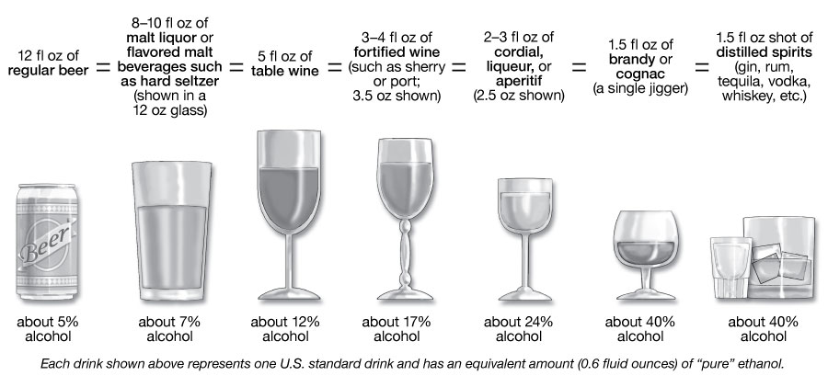
What is a Standard Drink?
https://www.niaaa.nih.gov/alcohols-effects-health/overview-alcohol-consumption/what-standard-drink
Notes:
**ACTIVITY**
Standard drink demonstration (use plastic glasses and water with food coloring to show the audience a standard-sized pour of regular beer, table wine, and 80-proof distilled spirits)
People have different personal definitions of what exactly constitutes an alcoholic “drink.” The National Institute on Alcohol Abuse and Alcoholism has developed a definition of a standard drink. A standard drink can be a 12 ounce beer, 8-9 ounces of malt liquor, 5 ounces of table wine, 3-4 ounces of fortified wine, 2-3 ounces of cordial, 1.5 ounces of brandy, or 1.5 ounces of spirits such as vodka, gin, or scotch. So, a drink for one person may be a “40-ouncer” of beer, which, if you use NIAAA’s definition of a standard drink, would equal 3 1/3 standard drinks. It is very important for alcohol dependent patients to understand what is meant by “a drink” when you are assessing the level of risk associated with their alcohol consumption.
Image Retrieved from: https://www.rethinkingdrinking.niaaa.nih.gov/How-much-is-too-much/What-counts-as-a-drink/Whats-A-Standard-Drink.aspx.
REFERENCE National Institute on Alcohol Abuse and Alcoholism (NIAAA). (2019). What’s a “standard” drink? Retrieved from: https://www.rethinkingdrinking.niaaa.nih.gov/How-much-is-too-much/What-counts-as-a-drink/Whats-A-Standard-Drink.aspx.

Slide 6
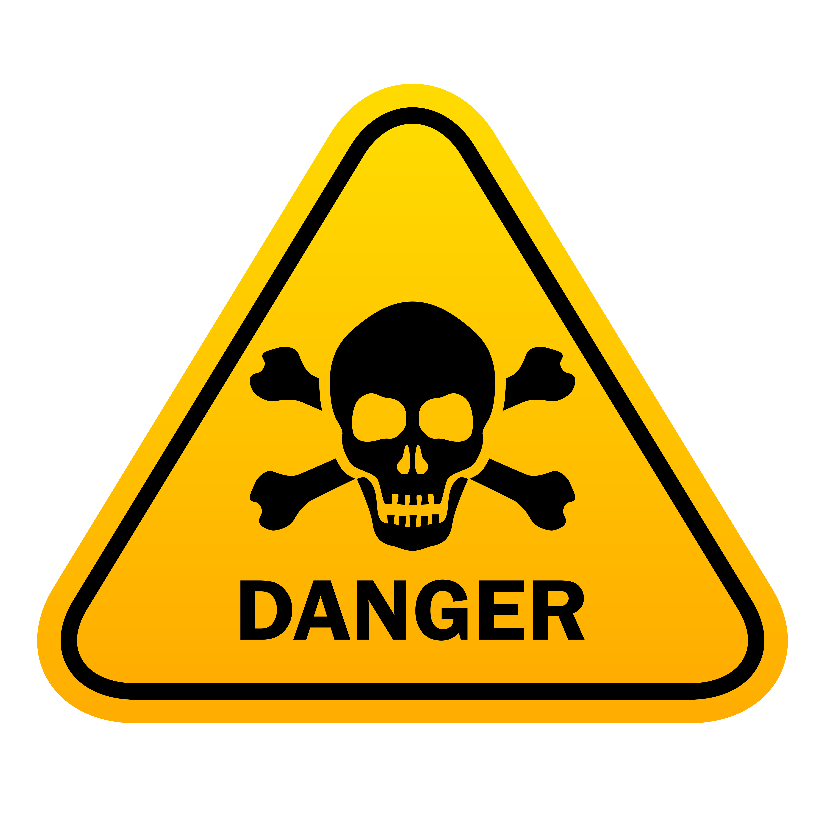
Dangers of Binge Drinking
*Unintentional Injuries
*Violence
*Sexually Transmitted Diseases
*Unintended Pregnancy
*Poor Pregnancy Outcomes
*Fetal Alcohol Spectrum Disorders (FASD)
*Sudden Infant Death Syndrome
*Chronic Diseases
*A Variety of Cancers
*Memory Problems
*Learning Problems
*Alcohol Dependence
Centers for Disease Control and Prevention. (2018). Fact Sheets – Binge Drinking. Available at:
https://www.cdc.gov/alcohol/fact-sheets/binge-drinking.htm.
Notes:
A myriad of health problems are associated with binge drinking. This slides lists several of them. Unintentional injuries include car crashes, falls, burns, and alcohol poisoning. Violence includes homicide, suicide, intimate partner violence, and sexual assault. Poor pregnancy outcomes include miscarriage and stillbirth. Chronic diseases include high blood pressure, stroke, heart disease, and liver disease. Cancers include breast, mouth, throat, esophagus, liver, and colon.
REFERENCES
Centers for Disease Control and Prevention. (2018). Fact Sheets – Binge Drinking. Available at:
https://www.cdc.gov/alcohol/fact-sheets/binge-drinking.htm.
World Health Organization. (2018). Global status report on alcohol and health 2018. World Health Organization. https://www.who.int/publications/i/item/9789241565639
Naimi, T.S., Lipscomb, L.E., Brewer, R.D., & Colley, B.G. (2003). Binge drinking in the preconception period and the risk of unintended pregnancy: Implications for women and their children. Pediatrics, 111(5 Pt 2), 1136-1141.
Iyasu, S., Randall, L.L., Welty, T.K., Hsia, J.; Kinney, H.; Mandell, F.; McClain, M.; Randall, B.; Habbe, D.; Wilson, H.; Willinger, M. (2003). Risk factors for sudden infant death syndrome among northern plains Indians. JAMA, 288(21), 2717-2723.

Slide 7
Dangers of Binge Drinking (2)
39.3% of College Students meet the criteria for binge drinking
Being between 21-22 years of age is a strong risk factor
Binge drinking in adults has increased
Adults who binge drink are at increased risk for alcohol problems
Berger, et al., 2022
Berger, et al., 2022
‘Nearly 1 in 3 US adults have risky alcohol use according to NIAAA estimates. Alcohol use disorder has been estimated to affect 29% of adults in the US in their lifetimes.’
Patel & Balsanova, 2021 p. 196
Notes:
A pattern of binge drinking was linked to an almost 3x increase in alcohol problems and a 40% increase in the number of alcohol problems 9 years later. Prevention efforts should target adult moderate level drinkers since they make up the most cases of binge drinking.
Berger; A. Wang; Z. Martusewicz & L. Cottler (2022) “Defining Belonging and Its Association to Binge Drinking among College Students” Journal of Substance Use & Misuse Defining Belonging and Its Association to Binge Drinking among College Students: Substance Use & Misuse: Vol 57, No 8 https://doi.org/10.1080/10826084.2022.2079136
Patel AK, Balasanova AA. Unhealthy Alcohol Use. JAMA. 2021;326(2):196. doi:10.1001/jama.2020.2015

Slide 8
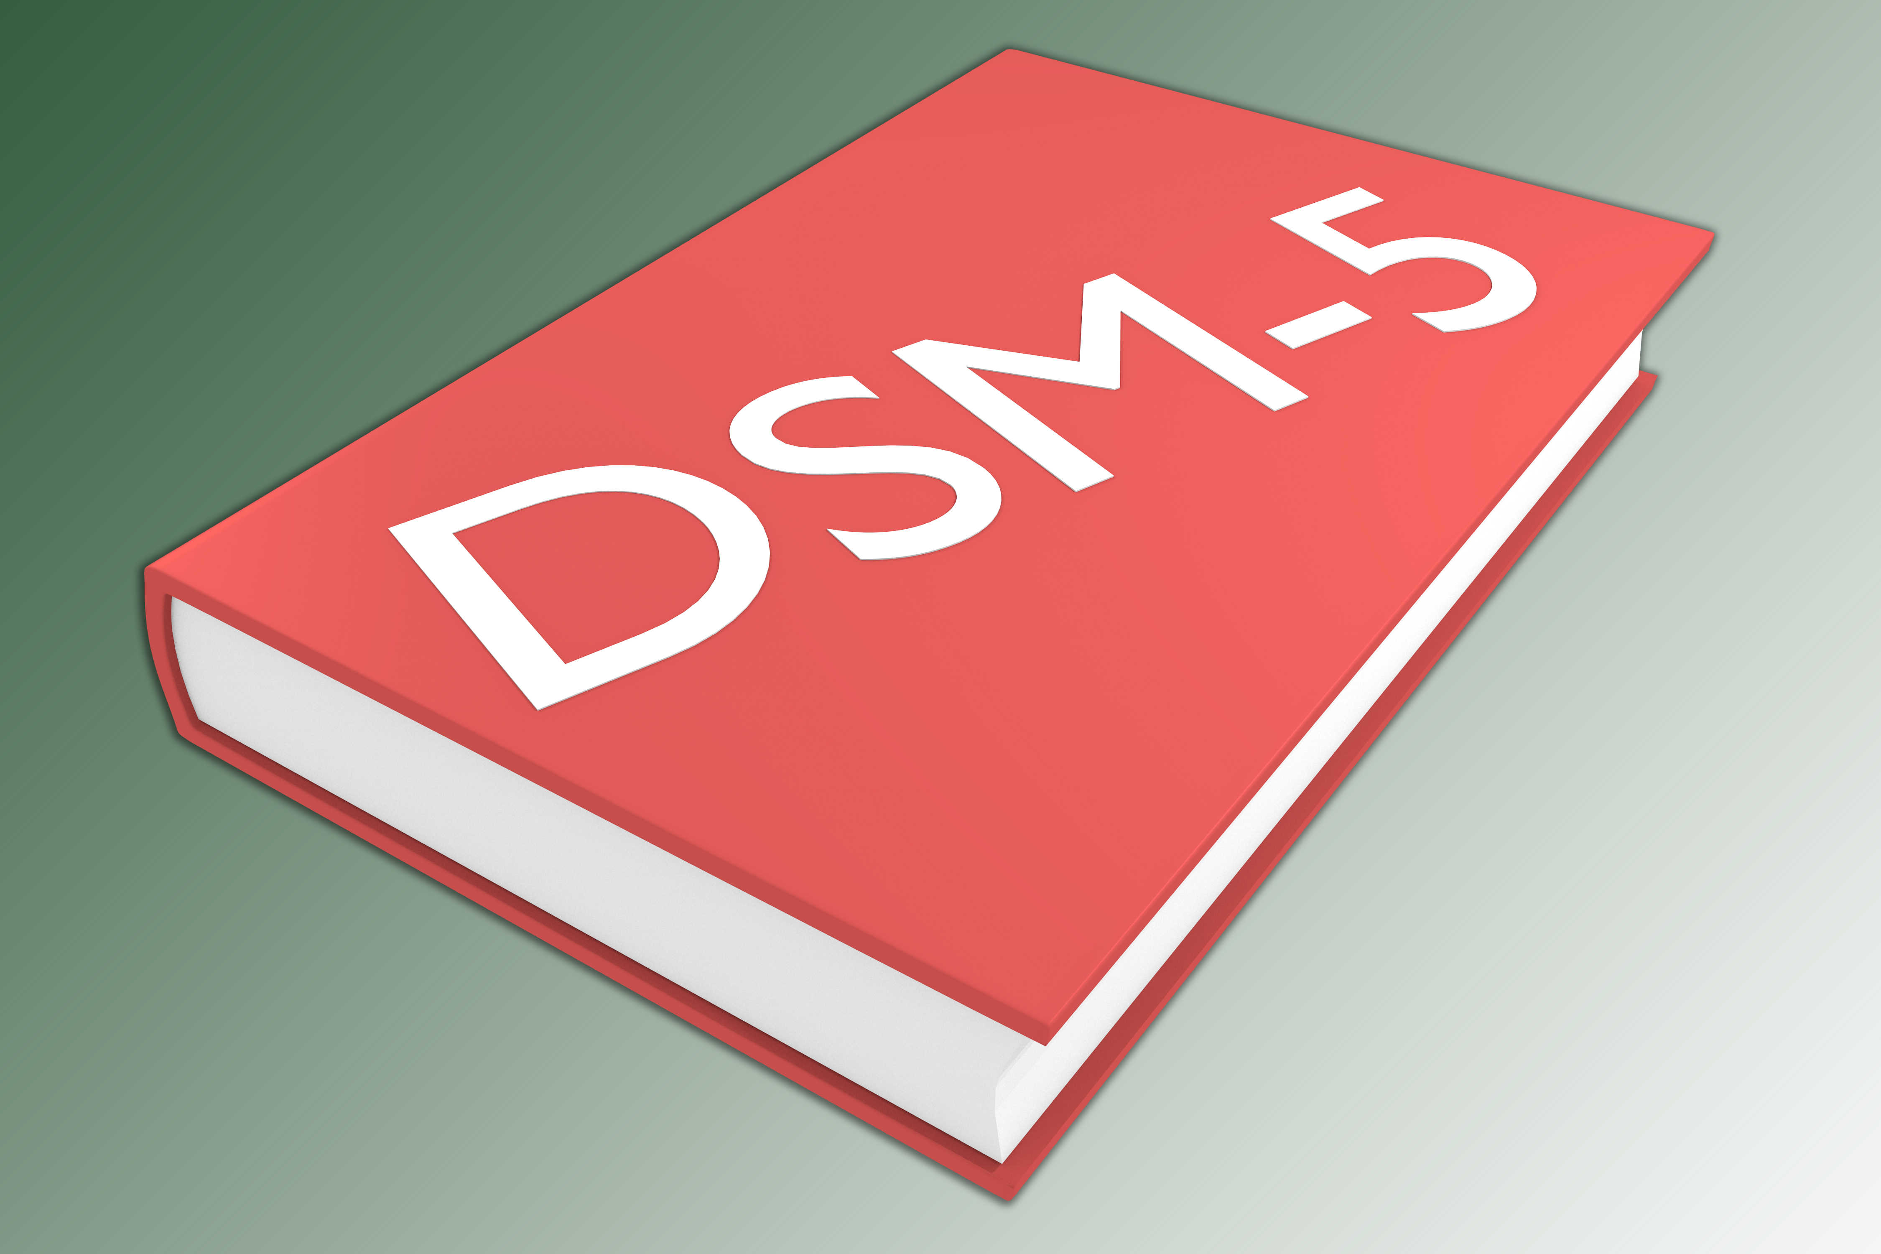
Alcohol Use Disorders Diagnostic Statistical Manual-5
DSM-5 integrates alcohol abuse and alcohol dependence into a single disorder called alcohol use disorder (AUD)
Mild, moderate, and severe sub-classifications
Anyone meeting any two of 11 criteria during the same 12-month period receives a diagnosis of AUD
Criteria can be grouped by impaired control, social impairment, risky use, and pharmacological criteria
APA, DSM V, 2013
Notes:
In May 2013, the American Psychiatric Association issued the 5th edition of the Diagnostic and Statistical Manual of Mental Disorders (DSM-5).
The DSM-5 criteria for AUD include: (1) had times when you ended up drinking more, or longer, than you intended; (2) more than once wanted to cut down or stop drinking, or tried, but could not; (3) spent a lot of time drinking or being sick or getting over aftereffects; (4) wanted a drink so badly you could not think of anything else; (5) found that drinking or being sick from drinking often interfered with taking care of your home or family or caused job or school troubles; (6) continued to drink even if it was causing trouble with family and friends; (7) gave up or cut back on activities that were important or interesting to you, or gave you pleasure in order to drink; (8) more than once got into situations while drinking or after drinking that increased chance of getting hurt; (9) continued to drink even though it was making you feel depressed or anxious, added to another health problem, or after having a memory blackout; (10) had to drink much more than you once did to get the effect you want or found that your usual number of drinks had much less effect than before; and (11) found that when the effects of alcohol were wearing off, you had withdrawal symptoms.
REFERENCE
National Institute on Alcohol Abuse and Alcoholism (NIAAA). (2016). Alcohol Use Disorder: A Comparison between DSM-IV and DSM-5, NIH Publication No. 13-7999.
https://www.niaaa.nih.gov/publications/brochures-and-fact-sheets/alcohol-use-disorder-comparison-between-dsm.
American Psychiatric Association. (2013). Diagnostic and statistical manual of mental disorders (5th ed.). https://doi.org/10.1176/appi.books.9780890425596
American Psychiatric Association. (2013). Diagnostic and statistical manual of mental disorders (5th ed.). https://doi.org/10.1176/appi.books.9780890425596

Slide 9
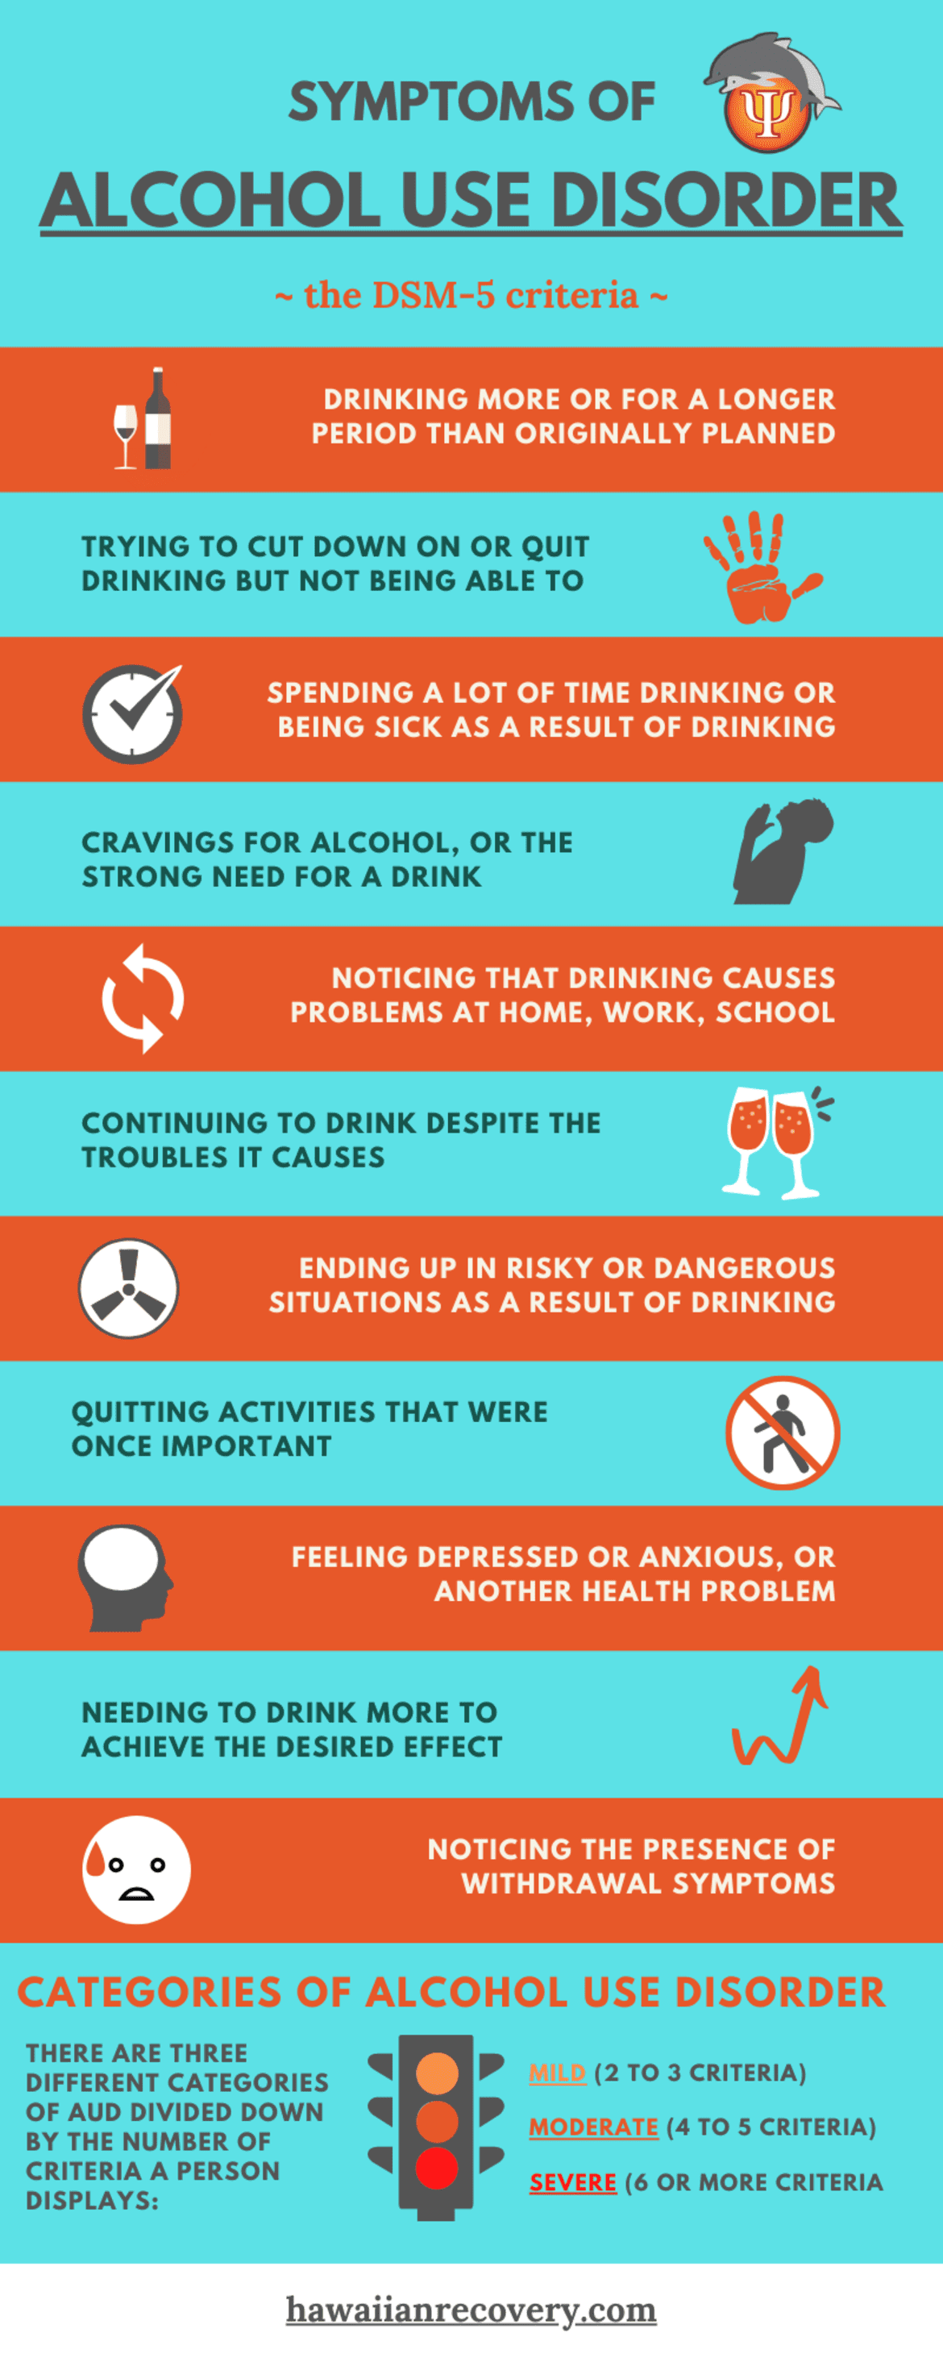
Alcohol Use Disorders – DSM-5
Have you drank more than intended?
Tried to cut down or stop drinking?
Spent a lot of time drinking or recovering from drinking?
Wanted a drink? Craved a drink?
Has drinking caused trouble with family? Work? Or school?
Do you have to drink more to feel the way you want to?
Have you felt sick, shaky, restless or had to have a drink to feel better?
Have you been unable to remember what you did while drinking? Or did things you wouldn't have done if you were sober?
APA, DSM V, 2013
https://hawaiianrecovery.com/rehab-blog/everything-about-alcohol-use-disorder
Notes:
Here are additional possible symptoms related to alcohol use disorder and there are different levels of severity -
The severity of an AUD is defined as:
Mild – presence of 2-3 symptoms
Moderate – presence of 4-5 symptoms
Severe – presence of 6+ symptoms
Image Retrieved from: https://hawaiianrecovery.com/rehab-blog/everything-about-alcohol-use-disorder
REFERENCE
National Institute on Alcohol Abuse and Alcoholism (NIAAA). (2016). Alcohol Use Disorder: A Comparison between DSM-IV and DSM-5, NIH Publication No. 13-7999.
https://www.niaaa.nih.gov/publications/brochures-and-fact-sheets/alcohol-use-disorder-comparison-between-dsm.
American Psychiatric Association. (2013). Diagnostic and statistical manual of mental disorders (5th ed.). https://doi.org/10.1176/appi.books.9780890425596
Hawaii Island Recovery: Everything About Alcohol Use Disorder (2021) https://hawaiianrecovery.com/rehab-blog/everything-about-alcohol-use-disorder

Slide 10
Who's at Risk?
Binge Drinkers
Family History of SUD
History of Trauma
Mental Illness Diagnosis
NIAAA, Risk Factors, 2022
https://www.niaaa.nih.gov/health-professionals-communities/core-resource-on-alcohol/risk-factors-varied-vulnerability-alcohol-related-harm
Notes:
Drinking alcohol doesn't mean you have an alcohol use disorder. Millions of people drink and never experience any problems. However, a person who binge drinks as described in the slides is at risk for negative consequences related to drinking along with the risk of progressing to an alcohol use disorder. Factors that increase risk include a family history of substance use disorders, and/or experiencing some kind of trauma/having a higher ACEs score. There may be some genetic factors- nature- along with family patterns – nurture.
National Institute on Alcohol Abuse and Alcoholism (NIAAA) (2022) https://www.niaaa.nih.gov/health-professionals-communities/core-resource-on-alcohol/risk-factors-varied-vulnerability-alcohol-related-harm

