Slide 1
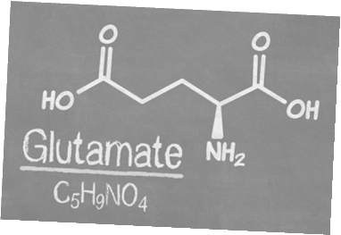
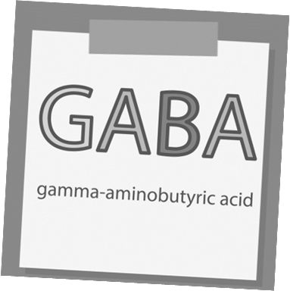
Alcohol Metabolism
Notes:
SUD Keys to Education is a product for educators and clinical supervisors developed in 2022 by the Mountain Plains and Pacific Southwest Addiction Technology Transfer Centers (MPATTC and PSATTC). The main developers of the alcohol materials are Thomas E. Freese, PhD, Nancy Roget, MS, Kim Miller, MS, and Trisha Dudkowski, BA. Additional guidance and editing support were provided by Kenneth Flanagan, PhD, Terra Hamblin, MA, Cindy Juntenen, PhD, Shannon McCarty, BS, LP, Abby Roach-Moore, MSW, Beth Rutkowski, MPH, and Maridee Shogren, DNP.
This product was developed to help community college/university faculty, as well as clinical supervisors and recovery support staff have access to brief, science-based content with the goal of providing materials that can be easily infused into existing substance use disorder and related courses (e.g., social work, nursing, criminal justice, foundation of addiction courses, ethics, counseling courses, etc.) and for clinical and recovery staff use in in-service meetings. Individuals can select the specific content to infuse into existing curricula/materials depending on specific needs of their learners. Each slide in the slide decks contain notes to provide guidance on the topics along with references and handouts where appropriate.
If you require further information, please do not hesitate to contact the MPATTC (http://www.mpattc.org) or PSATTC (http://www.psattc.org) . You are free to use these slides and pictures, but please give credit to the MPATTC and PSATTC when using them by referencing both Centers at the beginning of your presentation. The MPATTC (HHS Region 8) and PSATTC (HHS Region 9) are part of the SAMHSA-funded ATTC Network that offers training and technical assistance (TA) services. HHS Region 8 is comprised of Colorado, Montana, North Dakota, South Dakota, Utah, and Wyoming, and HHS Region 9 is comprised of Arizona, California, Hawaii, Nevada, and the six U.S.-affiliated Pacific Jurisdictions (American Samoa, Commonwealth of the Northern Mariana Islands, Federated States of Micronesia, Guam, Republic of the Marshall Islands, and Republic of Palau). For additional information, please visit http://www.mpattc.org and http://www.psattc.org.
Funding for this product was made possible (in part) by SAMHSA Cooperative Agreement numbers UR1 TI080200 (MPATTC) and UR1 TI080211 (PSATTC). The views expressed in these materials do not necessarily reflect the official policies of the Department of Health and Human Services, nor does mention of trade names, commercial practices, or organizations imply endorsement by the U.S. Government.
Additional resources are available to enhance and support the information provided in this brief presentation.
Audio Recording: Thomas E. Freese, PhD
Image Credit: Shutterstock (unless otherwise noted)
Date last updated: July 27, 2022.

Slide 2
Four Main Neurotransmitters are Relevant to Alcohol (1)
Endogenous opioids
Deadens pain and causes euphoria
Dopamine
Makes you happy
Notes:
As was demonstrated in the brief video, two processes occur simultaneously when alcohol is consumed. One process acts on the naturally occurring opioids in the brain (which deaden pain and cause feelings of euphoria), and dopamine (which makes things feel good). The next slide shows the other process.

Slide 3
Alcohol Neuronal Activity (1)
Alcohol is used
Endogenous opioids are released into the pleasure centers of the brain
In response to this increased endogenous opioid activity, dopamine is released
Dopamine makes the drinker feel good. This reinforces the behavior and increases the likelihood it will recur.
Notes:
In the first process, a person drinks alcohol and this causes the release of the endogenous, or naturally occurring, opioids to be released in the pleasure centers of the brain. This in turn, causes the release of dopamine. Since dopamine makes the person feel good, drinking is reinforced and this increases the likelihood of repeated use. A subsequent section of this training will review two medications used to treat alcohol directly by addressing the pleasurable effects of alcohol.

Slide 4
Alcohol Neuronal activity (2)
GABA is increased, slowing the brain down
Over time, the brain reacts to the over-abundance of GABA by creating more receptors for glutamate
The increased effect of glutamate energizes the system and restores balance
Notes:
At the same time that alcohol is making the person feel good, a second process occurs. When the person drinks, GABA (the inhibitory neurotransmitter) is released and this slows down the brain. This results in the symptoms of intoxication from alcohol, such as difficulty with coordination, drowsiness, slurring speech, etc. With repeated use, the brain attempts to correct for the overabundance of GABA by creating more receptors for glutamate. This increases the effectives of glutamate, and the system is energized and balance is restored.

Slide 5
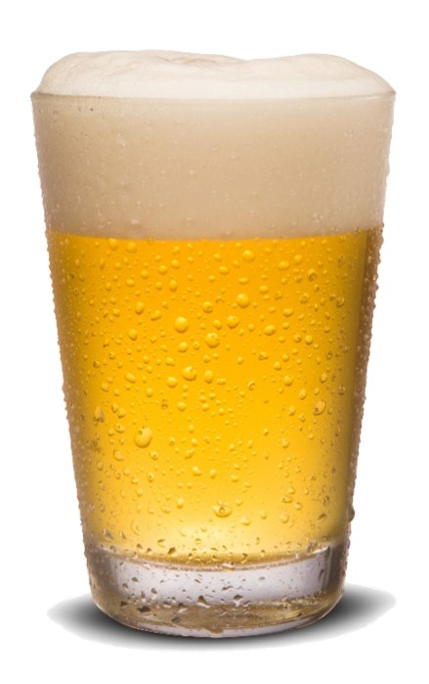
The Excitatory and Inhibitory Balance (1)
GABA Inhibitory Neurotransmitter
Glutamate Excitatory Neurotransmitter
Notes:
**ANIMATIONS**
GABA is the brain’s main inhibitory neuron. When it is stimulated, the brain slows down. For instance, when you are relaxing in the evening and start to get sleepy, GABA is beginning to surge forward preparing you to sleep.
Glutamate is the major excitatory neuron. Glutamate surges to alert the brain of the need for increased activity making neurotransmitters ready to fire.
GABA and Glutamate should work in balance with each other, so that one or the other surges forward depending on need, maintaining function and overall balance in the brain.
[Click once to move animation forward] When alcohol is introduced, it causes a surge in GABA and with repeated drinks, the glutamate system becomes less able to keep up and maintain balance.
Over time, as alcohol continues to be consumed, the brain’s compensatory mechanisms kick in and works to restore balance by creating more [upregulating] glutamate [NMDA] receptors.
[Click once to move animation forward] This restores balance again.
[Advance to next slide]
IMAGE CREDIT Purchased Image, n.d.

Slide 6
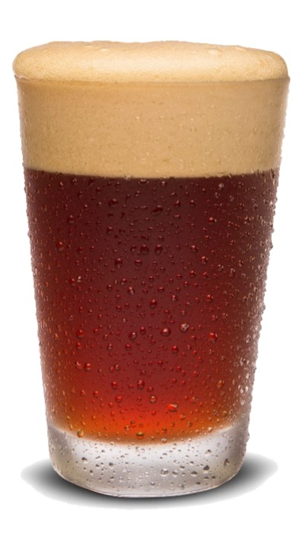
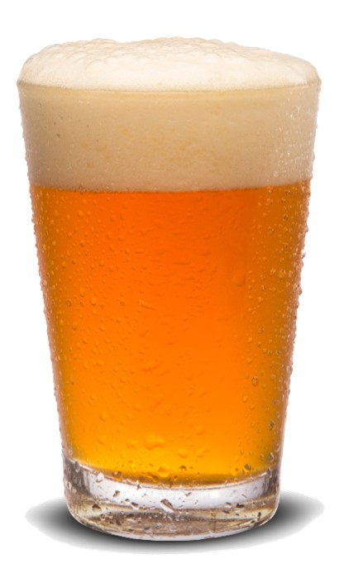
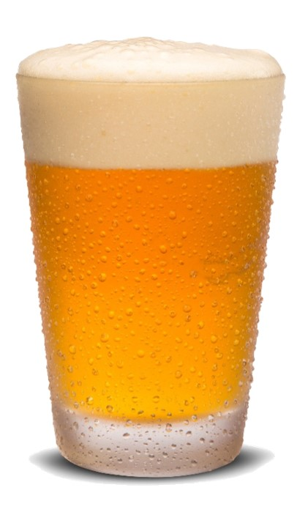
The Excitatory and Inhibitory Balance (2)
GABA Inhibitory Neurotransmitter
Glutamate Excitatory Neurotransmitter
Notes:
**ANIMATIONS**
Now in order to feel that intoxicating feeling, more alcohol needs to be consumed. [Click once to move animation forward]
This again results in a surge in GABA, [click once to move animation forward] overwhelming the glutamate system again.
This process repeating over time results in what we know as tolerance. You will hear more about tolerance on slide 24.
The compensatory mechanisms continue, [click once to move animation forward] more glutamate [NMDA] receptors are again added to system and balance is again restored.
[Advance to next slide]
IMAGE CREDIT Purchased Image, n.d.

Slide 7
The Excitatory and Inhibitory Balance (3)
GABA Inhibitory Neurotransmitter
Glutamate Excitatory Neurotransmitter
Notes:
**ANIMATIONS**
Now we have a brain that is held in balance with alcohol boosting GABA, and a supercharged glutamate system with greatly upregulated numbers of glutamate [NMDA] receptors.
[Click to move animation forward] What happens when a person stops drinking?
[Click to move animation forward] GABA levels fall to normal or below. Because there are way too many NMDA receptors that are not being counterbalanced, the brain goes into overdrive and is over excited in many areas. This leads to the experience of withdrawal such as shakiness, sweating, loss of appetite, agitation, restlessness, irritability, nausea or vomiting, anxiety or nervousness, fast heart rate, tremor, disorientation, headache, insomnia, or seizures.
IMAGE CREDIT Purchased Image, n.d.

