Slide 1
Alcohol Withdrawal
Notes:
SUD Keys to Education is a product for educators and clinical supervisors developed in 2022 by the Mountain Plains and Pacific Southwest Addiction Technology Transfer Centers (MPATTC and PSATTC). The main developers of the alcohol materials are Nancy Roget, MS, Kim Miller, MS, and Trisha Dudkowski, BA. Additional guidance and editing support were provided by Kenneth Flanagan, PhD, Terra Hamblin, MA, Cindy Juntenen, PhD, Shannon McCarty, BS, LP, Abby Roach-Moore, MSW, Beth Rutkowski, MPH, Thomas E. Freese, PhD, and Maridee Shogren, DNP.
This product was developed to help community college/university faculty, as well as clinical supervisors and recovery support staff have access to brief, science-based content with the goal of providing materials that can be easily infused into existing substance use disorder and related courses (e.g., social work, nursing, criminal justice, foundation of addiction courses, ethics, counseling courses, etc.) and for clinical and recovery staff use in in-service meetings. Individuals can select the specific content to infuse into existing curricula/materials depending on specific needs of their learners. Each slide in the slide decks contain notes to provide guidance on the topics along with references and handouts where appropriate.
If you require further information, please do not hesitate to contact the MPATTC (http://www.mpattc.org) or PSATTC (http://www.psattc.org) . You are free to use these slides and pictures, but please give credit to the MPATTC and PSATTC when using them by referencing both Centers at the beginning of your presentation. The MPATTC (HHS Region 8) and PSATTC (HHS Region 9) are part of the SAMHSA-funded ATTC Network that offers training and technical assistance (TA) services. HHS Region 8 is comprised of Colorado, Montana, North Dakota, South Dakota, Utah, and Wyoming, and HHS Region 9 is comprised of Arizona, California, Hawaii, Nevada, and the six U.S.-affiliated Pacific Jurisdictions (American Samoa, Commonwealth of the Northern Mariana Islands, Federated States of Micronesia, Guam, Republic of the Marshall Islands, and Republic of Palau). For additional information, please visit http://www.mpattc.org and http://www.psattc.org.
Funding for this product was made possible (in part) by SAMHSA Cooperative Agreement numbers UR1 TI080200 (MPATTC) and UR1 TI080211 (PSATTC). The views expressed in these materials do not necessarily reflect the official policies of the Department of Health and Human Services, nor does mention of trade names, commercial practices, or organizations imply endorsement by the U.S. Government.
Additional resources are available to enhance and support the information provided in this brief presentation.
Image Credit: Shutterstock (unless otherwise noted)
Date last updated: July 27, 2022.

Slide 2
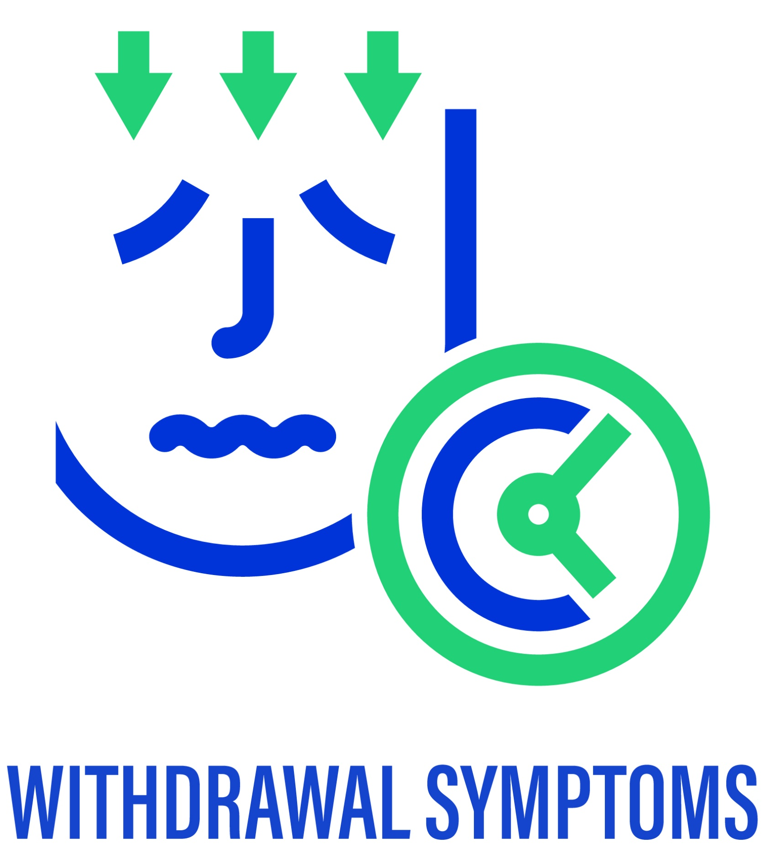
Alcohol Withdrawal
50% of individuals with a history of long-term, heavy alcohol consumption for a prolonged period (more than two weeks) of heavy use will experience alcohol withdrawal symptoms when alcohol use is reduced or stopped
Within 8 to 24 hours after a drop in blood alcohol levels symptoms and signs usually appear
Day & Daly, (2022); Tiglao, Meisenheimer, & Oh, 2021
Notes:
This slide deck highlights important issues regarding alcohol withdrawal symptoms. The goal of this slide deck is to help students/clinicians/peers understand the risks associated with alcohol and the symptoms associated with alcohol withdrawal.
This slide demonstrates the frequency of alcohol withdrawal symptoms, especially with individuals with a history of long-term heavy alcohol consumption for over two weeks. This slide also helps build the case regarding the importance of taking a thorough alcohol/drug use history.
Reference(s)
Day, E., & Daly, C. (2022). Clinical management of the alcohol withdrawal syndrome. Addiction, 117(3), 804-814. https://doi.org/10.1111/add.15647
Tiglao, S. M., Meisenheimer, E. S., & Oh, R. C. (2021). Alcohol withdrawal syndrome: Outpatient management. American family physician, 104(3), 253-262.

Slide 3
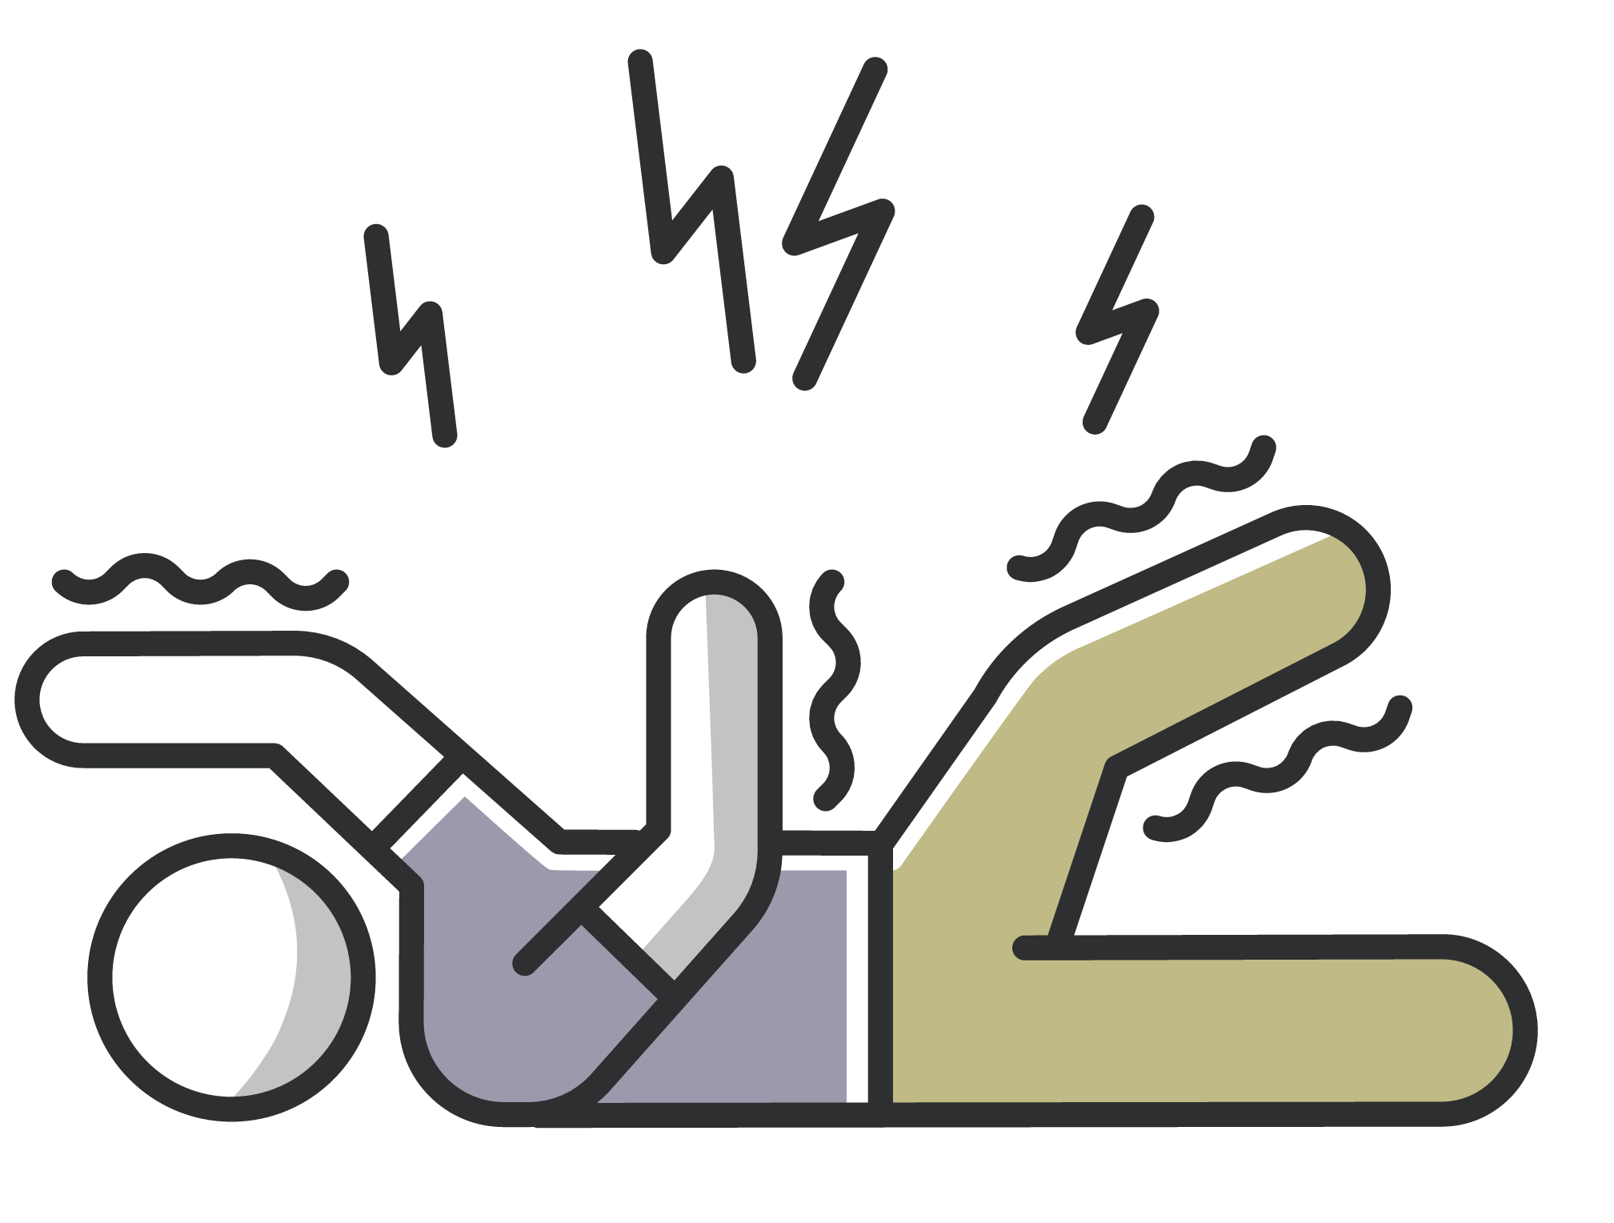
Alcohol Withdrawal- Seizures
Approximately 10% individuals with alcohol withdrawal symptoms experience seizures
Seizures- 12 to 48 hours after cessation or significant reduction in consumption
Day & Daly, (2022); Tiglao, Meisenheimer, & Oh, 2021; Steel & Bradley, 2021
Notes:
It is possible that individuals with severe alcohol withdrawal symptoms will experience a seizure (approximately 10%). Remind students/clinicians/peers that seizures can be life threatening. Medications are available to enhance GABBA and suppress Glutamate (neurotransmitters impacted by alcohol intoxication and alcohol detoxification). Student/clinicians/peers should watch the video provided by Keys to SUD Education on neurotransmitters and alcohol for further information on GABBA and Glutamate. Typically, benzodiazepines (e.g., diazepam, etc.) along with other medications are used to manage the severe withdrawal symptoms. Recent studies are showing success with the use of phenobarbital as well. People who have experienced a seizure during alcohol withdrawal are more likely to have a seizure again when experiencing alcohol withdrawal.
Reference(s)
Day, E., & Daly, C. (2022). Clinical management of the alcohol withdrawal syndrome. Addiction, 117(3), 804-814. https://doi.org/10.1111/add.15647
Steel, T. L., & Bradley, K. A. (2021). Improving care for inpatient alcohol withdrawal syndrome: Addressing the lack of rigorous research on a common condition. Annals of the American Thoracic Society, 18(10), 1622-1623. https://doi.org/10.1513/AnnalsATS.202105-591ED
Tiglao, S. M., Meisenheimer, E. S., & Oh, R. C. (2021). Alcohol withdrawal syndrome: Outpatient management. American family physician, 104(3), 253-262.

Slide 4
Alcohol Withdrawal
If severe withdrawal symptoms are left untreated up to
1/3 of patients in hospital will progress to delirium (known as delirium tremens)
DTs include: severe tremor, hallucinations (auditory, olfactory and classically visual) and confusion, alongside associated paranoid delusions, agitation, insomnia, tachycardia, hyperthermia, hypertension, and tachypnoea (abnormally rapid breathing)
Transient visual, auditory, or tactile hallucinations
occur in 2% to 8% of individuals
Delirium tremens may also occur without seizures
Day & Daly, (2022); Tiglao, Meisenheimer, & Oh, 2021
Notes:
Delirium tremens (DTs) can occur as part of severe alcohol withdrawal symptoms. Review the list of symptoms for individuals with DTs highlighting hallucinations that occur. It is important to collect information about recent (How many hours ago was your last drink?) and past drinking, specifically in the last two weeks (Prior to your last drink how much alcohol were your drinking a day in the last two weeks?). Remind students/clinicians/peers about having a non-judgmental attitude when asking these questions about alcohol use. Assisting the patient/client to seek medical care if experiencing DTs to manage withdrawal symptoms is indicated (e.g., call 911) while ensuring that follow-up treatment/recovery support sessions are in place.
Reference(s)
Day, E., & Daly, C. (2022). Clinical management of the alcohol withdrawal syndrome. Addiction, 117(3), 804-814. https://doi.org/10.1111/add.15647
Tiglao, S. M., Meisenheimer, E. S., & Oh, R. C. (2021). Alcohol withdrawal syndrome: Outpatient management. American family physician, 104(3), 253-262.

Slide 5
Aligning the patient’s/client’s/peers’ symptoms to the time since their last drink is useful in anticipating the progression of symptoms.
………
Day & Daly, (2022); Tiglao, Meisenheimer, & Oh, 2021
Notes:
It is important to ask patients/clients/peers the time of their last use of alcohol and how much they consumed. As a reminder, some individuals can begin the alcohol withdrawal process while still being intoxicated. DTs are considered a medical emergency due to possible injury caused by confusion and/or hallucinations, irregular heartbeat, seizures, etc. The American Society of Addiction Medicine (ASAM) has divided alcohol withdrawal symptoms into Mild, Medium, Severe, and Complicated. These designations may be helpful in determining a referral. It is ALWAYS appropriate for students/clinicians/peers to refer patients/clients/peers to have the individual examined/evaluated by a health care provider to determine their risk for severe or complicated alcohol withdrawal symptoms.
Reference(s)
Day, E., & Daly, C. (2022). Clinical management of the alcohol withdrawal syndrome. Addiction, 117(3), 804-814. https://doi.org/10.1111/add.15647
Tiglao, S. M., Meisenheimer, E. S., & Oh, R. C. (2021). Alcohol withdrawal syndrome: Outpatient management. American family physician, 104(3), 253-262.

Slide 6
It is also important to enquire about the outcomes of past attempts to stop (have you experienced seizures previously), any problems with stopping, and the use of other psychoactive substances.
Day & Daly, (2022); Tiglao, Meisenheimer, & Oh, 2021
Notes:
The goal is to collect data in order to make an appropriate assessment of the patient’s/client’s/peers’ condition to provide services or refer for medical services. As mentioned previously, make sure questions are asked about the results from previous attempts to stop alcohol use (did they experience seizures? If so, chances are higher that they would experience seizures again) and what other psychoactive substances are they using that may complicate or mask alcohol withdrawal symptoms.
Reference(s)
Day, E., & Daly, C. (2022). Clinical management of the alcohol withdrawal syndrome. Addiction, 117(3), 804-814. https://doi.org/10.1111/add.15647
Tiglao, S. M., Meisenheimer, E. S., & Oh, R. C. (2021). Alcohol withdrawal syndrome: Outpatient management. American family physician, 104(3), 253-262.

Slide 7
Evaluating Risk of Severe or Complicated AWS
The patient's symptom severity should be evaluated using a validated scale to determine the risk of severe or complicated AWS.
Mild AWS tend to have mild to moderate anxiety, sweating, and insomnia, but tremor is absent.
Moderately severe AWS causes moderate anxiety, sweating, insomnia, and mild tremor.
Severe AWS experience severe anxiety and moderate to severe tremor, but they do not have confusion, hallucinations, or seizures.
Complicated AWS is identified by seizures or signs and symptoms indicative of delirium, such as the inability to fully comprehend instructions, confusion, or new onset of hallucinations.
ASAM Withdrawal Management http://eguideline.guidelinecentral.com/i/1254278-alcohol-withdrawal-management/1?
Notes:
The American Society of Addiction Medicine (ASAM) has a pocket guide for alcohol withdrawal management designating different levels of alcohol withdrawal symptoms. The levels go from mild to moderately severe, to severe, to complicated. Clinicians/peers should put and/or have policies and procedures in place regarding when clinicians/peers should refer a client/peer experiencing alcohol withdrawal symptoms for a medical assessment. Once again, it is important for clinicians and peers to ask clients/peers about their recent use of alcohol (quantity and time of last use) and if they have experienced alcohol withdrawals in the past ensuring to ask about previous seizures.
Reference(s)
American Society of Addiction Medicine. (2020). The ASAM Clinical Practice Guideline on Alcohol Withdrawal Management. http://eguideline.guidelinecentral.com/i/1254278-alcohol-withdrawal-management/1?

Slide 8
Diagnostical Statistical Manual V Diagnostic Criteria for Alcohol Withdrawal
A. Cessation of (or reduction in) alcohol use that has been heavy and prolonged.
B. Two (or more) of the following, developing within several hours to a few days after the cessation of (or reduction in) alcohol use described in Criterion A:
1. Autonomic hyperactivity (e.g., sweating or pulse rate greater than 100 beats per minute).
2. Increased hand tremor.
3. Insomnia.
4. Nausea or vomiting.
5. Transient visual, tactile, or auditory hallucinations or illusions.
6. Psychomotor agitation.
7. Anxiety.
8. Generalized tonic-clonic seizures.
C. The signs or symptoms in Criterion B cause clinically significant distress or impairment in social, occupational, or other important areas of functioning.
D. The signs or symptoms are not attributable to another medical condition and are not better explained by another mental disorder, including intoxication or withdrawal from another substance.
2 of 8
Notes:
The Diagnostical Statistical Manual 5 (DSM-5) has criteria for diagnosing alcohol withdrawal in patients. Review this list of criteria. Underscore that the client/peer only needs to meet 2 of the 8 criteria in Section B.
Reference(s)
American Psychiatric Association. (2013). Diagnostic and statistical manual of mental disorders (5th ed.). https://doi.org/10.1176/appi.books.9780890425596

Slide 9
Long-term treatment of AUD should begin concurrently with the management of AWS
Day & Daly, (2022); Tiglao, Meisenheimer, & Oh, 2021
Notes:
It is recommended that clients/peers experiencing alcohol withdrawal get or remain engaged in alcohol treatment/recovery services.
Reference(s)
American Society of Addiction Medicine. (2020). The ASAM Clinical Practice Guideline on Alcohol Withdrawal Management. http://eguideline.guidelinecentral.com/i/1254278-alcohol-withdrawal-management/1?
Day, E., & Daly, C. (2022). Clinical management of the alcohol withdrawal syndrome. Addiction, 117(3), 804-814. https://doi.org/10.1111/add.15647
Tiglao, S. M., Meisenheimer, E. S., & Oh, R. C. (2021). Alcohol withdrawal syndrome: Outpatient management. American family physician, 104(3), 253-262.

Slide 10
Alcohol withdrawal management alone is not an effective treatment for alcohol use disorder
ASAM Withdrawal Management http://eguideline.guidelinecentral.com/i/1254278-alcohol-withdrawal-management/1?
Notes:
This slide reinforces the point that alcohol withdrawal management by itself is not an effective treatment intervention. Some clients/peers go through multiple alcohol withdrawal experiences before engaging in alcohol treatment services. However, every alcohol withdrawal management episode provides another opportunity to engage or re-engage in treatment/recovery services.
Reference(s)
American Society of Addiction Medicine. (2020). The ASAM Clinical Practice Guideline on Alcohol Withdrawal Management. http://eguideline.guidelinecentral.com/i/1254278-alcohol-withdrawal-management/1?

Slide 11
Which Withdrawal Can be Deadly?
Opioid Withdrawal
Alcohol Withdrawal
Notes:
This slide can be used as a part of the lecture to test students/clinicians/peers’ knowledge at the beginning or end of the lecture. The point of this slide is to highlight the risks associated with alcohol withdrawal as opposed to opioid withdrawal. The slide starts off without the red circle (animation). Ask students/clinicians/peers to answer the question Which Withdrawal Can be Deadly? Then hit enter and the red circle should appear. The goal of this slide is to dispel the myths that opioid withdrawal is more risky than alcohol or benzodiazepine withdrawal is more dangerous and more deadly.
Reference(s)
American Society of Addiction Medicine. (2020). The ASAM Clinical Practice Guideline on Alcohol Withdrawal Management. http://eguideline.guidelinecentral.com/i/1254278-alcohol-withdrawal-management/1?
Day, E., & Daly, C. (2022). Clinical management of the alcohol withdrawal syndrome. Addiction, 117(3), 804-814. https://doi.org/10.1111/add.15647
Tiglao, S. M., Meisenheimer, E. S., & Oh, R. C. (2021). Alcohol withdrawal syndrome: Outpatient management. American family physician, 104(3), 253-262.

