Slide 1
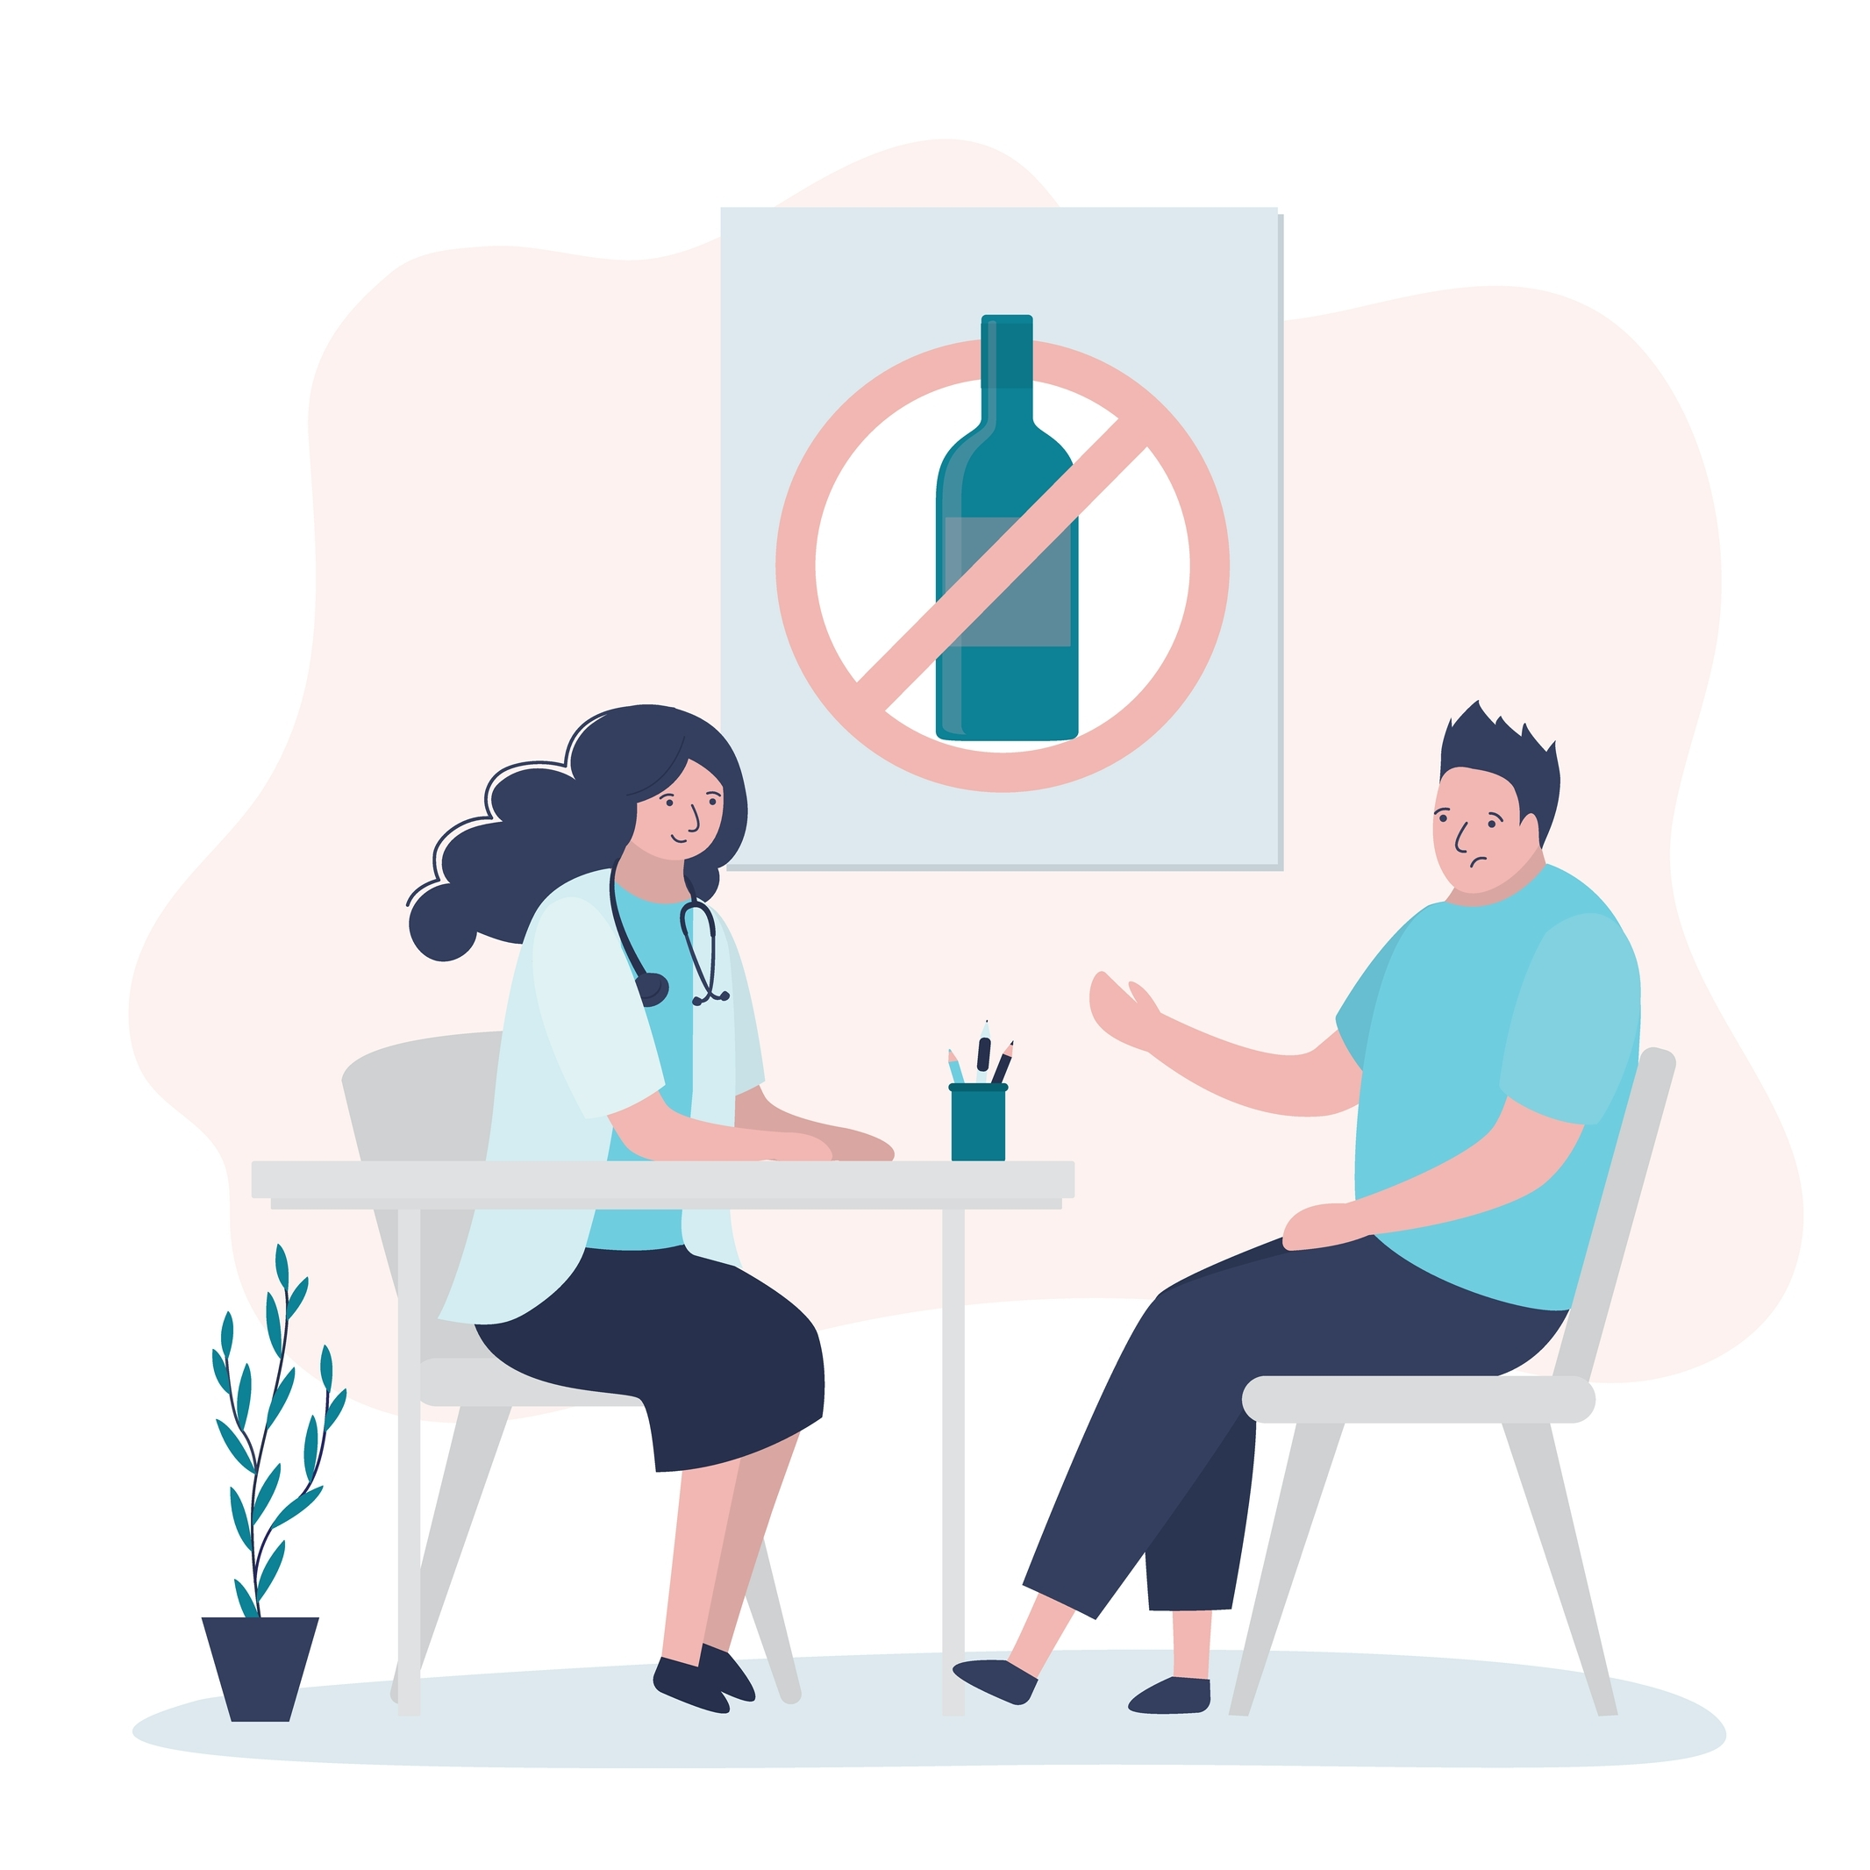
Alcohol Screening
Notes:
SUD Keys to Education is a product for educators and clinical supervisors developed in 2022 by the Mountain Plains and Pacific Southwest Addiction Technology Transfer Centers (MPATTC and PSATTC). The main developers of the alcohol materials are Nancy Roget, MS, Kim Miller, MS, and Trisha Dudkowski, BA. Additional guidance and editing support were provided by Kenneth Flanagan, PhD, Thomas E. Freese, PhD, Terra Hamblin, MA, Cindy Juntenen, PhD, Shannon McCarty, BS, LP, Abby Roach-Moore, MSW, Beth Rutkowski, MPH, and Maridee Shogren, DNP.
This product was developed to help community college/university faculty, as well as clinical supervisors and recovery support staff have access to brief, science-based content with the goal of providing materials that can be easily infused into existing substance use disorder and related courses (e.g., social work, nursing, criminal justice, foundation of addiction courses, ethics, counseling courses, etc.) and for clinical and recovery staff use in in-service meetings. Individuals can select the specific content to infuse into existing curricula/materials depending on specific needs of their learners. Each slide in the slide decks contain notes to provide guidance on the topics along with references and handouts where appropriate.
If you require further information, please do not hesitate to contact the MPATTC (http://www.mpattc.org) or PSATTC (http://www.psattc.org) . You are free to use these slides and pictures, but please give credit to the MPATTC and PSATTC when using them by referencing both Centers at the beginning of your presentation. The MPATTC (HHS Region 8) and PSATTC (HHS Region 9) are part of the SAMHSA-funded ATTC Network that offers training and technical assistance (TA) services. HHS Region 8 is comprised of Colorado, Montana, North Dakota, South Dakota, Utah, and Wyoming, and HHS Region 9 is comprised of Arizona, California, Hawaii, Nevada, and the six U.S.-affiliated Pacific Jurisdictions (American Samoa, Commonwealth of the Northern Mariana Islands, Federated States of Micronesia, Guam, Republic of the Marshall Islands, and Republic of Palau). For additional information, please visit http://www.mpattc.org and http://www.psattc.org.
Funding for this product was made possible (in part) by SAMHSA Cooperative Agreement numbers UR1 TI080200 (MPATTC) and UR1 TI080211 (PSATTC). The views expressed in these materials do not necessarily reflect the official policies of the Department of Health and Human Services, nor does mention of trade names, commercial practices, or organizations imply endorsement by the U.S. Government.
Additional resources are available to enhance and support the information provided in this brief presentation.
Image Credit: Shutterstock (unless otherwise noted)
Date last updated: July 27, 2022.

Slide 2
Why Screen For Alcohol?
1. Alcohol use leads to many common health problems
2. Screening & brief intervention can reduce drinking levels
3. Early detection averts greater harm
4. Asking about alcohol may help an entire family
Notes:
This starts the conversation about the role that health care providers or other professionals may play in screening for alcohol use/misuse. When we discuss screening we are talking about universal screening - it is not actually about drug testing. Screening helps to figure out who is at risk for alcohol/drug abuse by asking them a series of questions or having the patient/client complete a short questionnaire on paper, tablet, or online. There are many different screening options based on population/age group.
​
Reference(s)
National Institute on Alcohol Abuse and Alcoholism. Screen and Assess: Use Quick, Effective Methods. https://www.niaaa.nih.gov/health-professionals-communities/core-resources-on-alcohol/screen-and-assess-use-quick-effective-methods

Slide 3
Screening Tools
Evidence-Based Screening Tools:
AUDIT-C
CIWA
CRAFFT
BSTAD
TAPS
Older Screening Tools That Are In Use But Not Preferred:
CAGE
MAST
Notes:
There are a lot of different screening tools that have been used for years by health care professionals. SBIRT is currently used and training on it is widely available. One of the oldest is CAGE – it consists of 4 questions and it is NOT recommended for use because it does not identify all people who may benefit from a brief intervention, it primarily identifies people who are already experiencing adverse consequences from the alcohol use. CIWA (clinical institute withdrawal assessment) is used in detox/jail settings to assess for alcohol withdrawal – it was developed in 1968, it is reliable and valid but not valid for diagnosing SUD
AUDIT C alcohol use disorders identification test is 3 or10 questions and was developed from the WHO (world health organization) is used to screen people for risky & harmful alcohol use. It has been used in primary medical care and using different cut-off points, it can also screen for AUD.
The Michigan Alcoholism Screening Test (MAST) was developed in 1971. It screens for SUD and was designed for the general population. It can also be self-administered. There is also a form of the MAST that can be used for geriatric populations
BASIC is used with college students on campuses
CRAFFT is a short assessment tool used for adolescents
Reference(s)
U.S. Department of Health and Human Services. (2022, July 12) Screening tools and prevention. National Institutes of Health.
​ https://nida.nih.gov/nidamed-medical-health-professionals/screening-tools-prevention

Slide 4
AUDIT-C
How often to you have a drink containing alcohol?
How many standard drinks containing alcohol do you have on a typical day?
How often to you have six or more drinks on one occasion?
Notes:
The Alcohol Use Disorders Identification Test-Concise (AUDIT-C) is a brief alcohol screening instrument that reliably identifies person who are hazardous drinkers or have active alcohol use disorders. The AUDIT-C is a modified version of the 10 question AUDIT instrument. It has 3 questions and is scored on a scale of 0-12. Generally the higher the score, the more likely it is that a person’s drinking is affecting his or her safety.
Reference(s)
U.S Department of Health and Human Services. (2022, July 12) Screening tools and prevention. National Institutes of Health.
​ https://nida.nih.gov/nidamed-medical-health-professionals/screening-tools-prevention

Slide 5
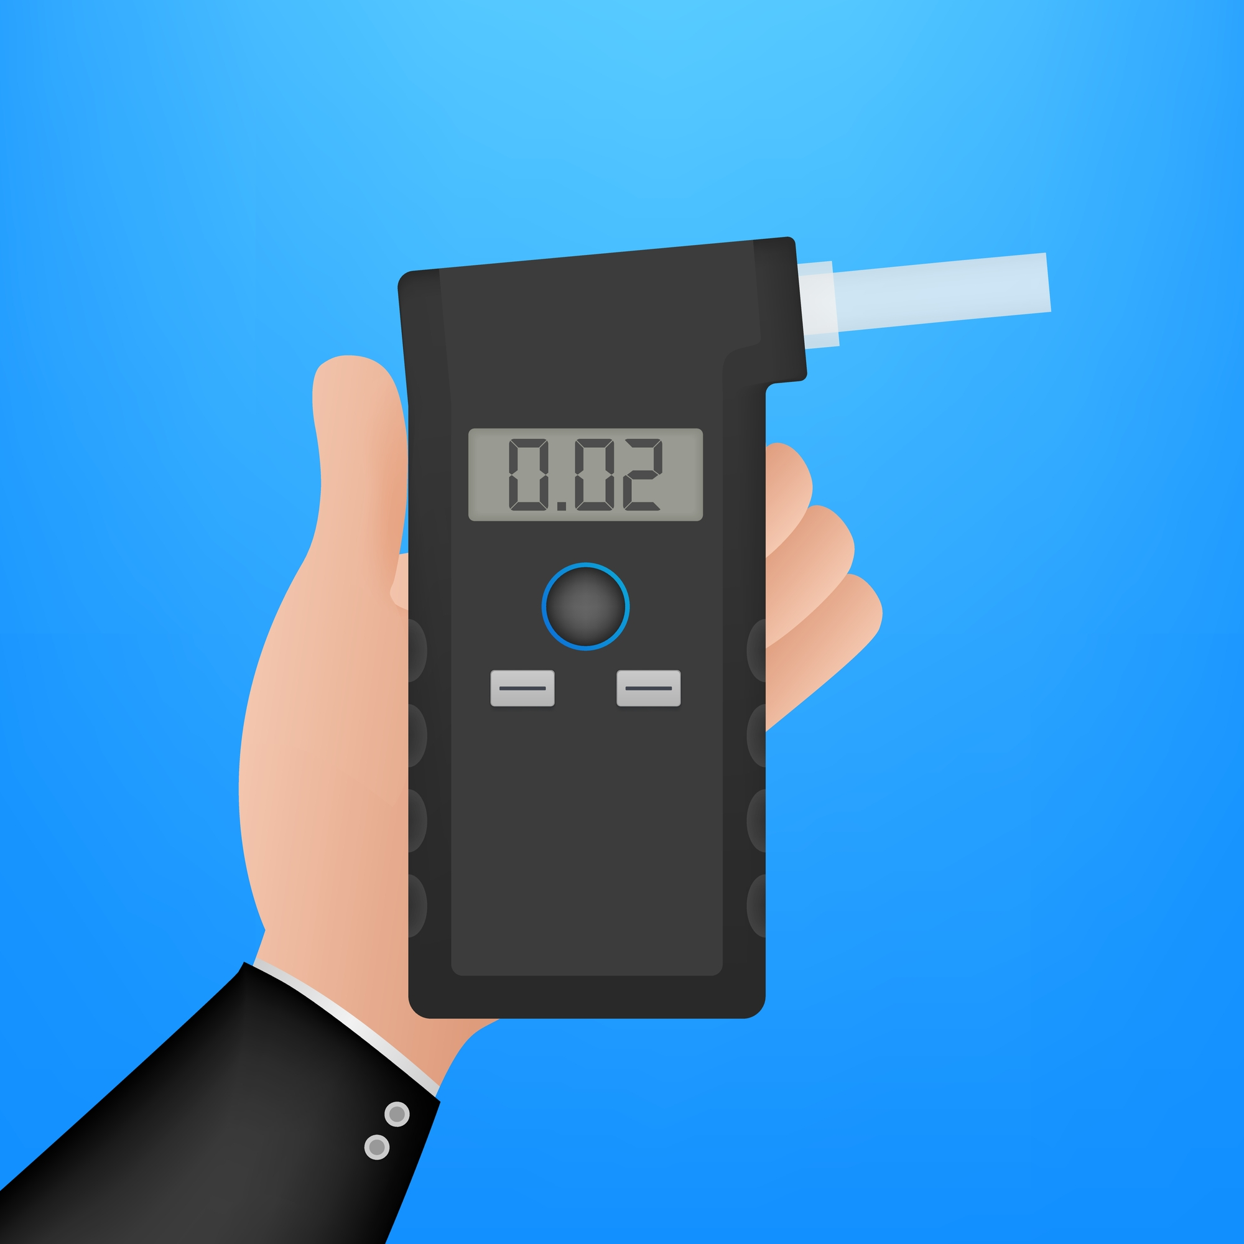
Biological Tests/Devices for Alcohol Detection/Monitoring
Blood Tests/Breathalyzer/Skin
Measures the amount of alcohol in the blood or being released by breath or sweat
Urine Testing-EtG – Ethyl Glucuronide (metabolite of ethanol)
Tests alcohol consumption up to 72 hours post use
Notes:
Law enforcement will commonly use breathalyzer tests or blood testing to determine alcohol levels at the time of an arrest for DUI/DWI. While this is an objective measure at a point in time, it is not used to make a diagnosis of substance use disorder. It merely indicates that someone used more than legally allowed prior to operating a motor vehicle on that day.
EtG testing can serve as a means of monitoring abstinence from alcohol during involvement in SUD treatment. EtG testing is usually measured in urine and will be positive with very low levels of alcohol use – even using mouthwash can cause a positive test. EtG testing is used in monitoring abstinence in treatment and criminal justice settings. Some newer testing may be able to detect alcohol use up to 3 weeks after ingestion.
Substance Abuse and Mental Health Services Administration and National Institute on Alcohol Abuse and Alcoholism. SAMSHA Advisory:
https://taadas.s3.amasonaws.com/files/36584446964799664-the-role-of-biomakers-in-the-treatment-of-alcohol-use-disorders.pdf

Slide 6
Who Should or Can Do Alcohol Screening?
Health Care Providers
School Counselors
Mental Health Providers
Law Enforcement
Court officers/Probation/Parole
Notes:
Regardless of age, people should be screened routinely by their medical providers just as they are asked about smoking, seat belt use and sexual partners
School counselors could be asking about student use as well as exposure to parental alcohol use in the home. Average of first use is 13-14 years old, the SAMSHA household survey data starts collecting from age 12 and up. The NIAAA data indicates that people who began drinking before age 15 were 4x more likely to develop AUD than those who began drinking at age 21.
References
Age of Drinking Onset Predicts Future Alcohol Abuse and Dependence | National Institute on Alcohol Abuse and Alcoholism (NIAAA) (nih.gov)
Statista. (2022, June 23). Number of children in the united states in 2020, by age group. Statista Research Department.
https://www.statista.com/statistics/457786/number-of-children-in-the-us-by-age/

Slide 7
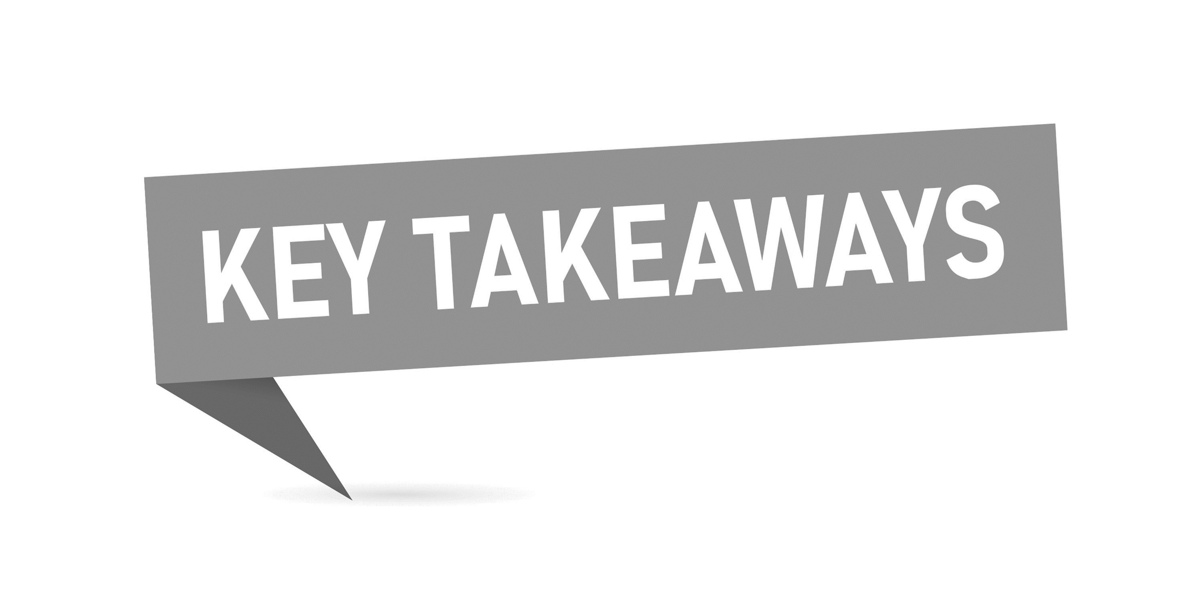
Takeaways
Everyone should be screened for alcohol/substance use
There are many different screening options available – use one that has validity/reliability and is appropriate for the specific population
Screening can reduce harm from risky alcohol use
Screening is NOT going to determine the presence of an Alcohol Use Disorder
Screening can be done by different health care providers and professionals working in human service/criminal justice settings
Notes:
This is a brief summary of the key points about screening for substance use disorder.
Screen and Assess: Use Quick, Effective Methods | National Institute on Alcohol Abuse and Alcoholism (NIAAA)
Screen and Assess: Use Quick, Effective Methods | National Institute on Alcohol Abuse and Alcoholism (NIAAA) (nih.gov)

Slide 8
Helpful Links
Updated Course: SBIRT for Health and Behavioral Health Professionals | Addiction Technology Transfer Center (ATTC) Network (attcnetwork.org)
Instrument: AUDIT-C Questionnaire | NIDA CTN Common Data Elements (drugabuse.gov)​
CRAFFT
Notes:
For more information on the use of screening tools with different populations please refer to the information on the included links.
MPATTC Learning. (2022, January 3) Mountain Plains ATTC Learning. Mountain plains attc. Updated Course: SBIRT for Health and Behavioral Health Professionals http://www.mtplainsattc.org​
U.S Department of Health and Human Services. (2022, July 12) Screening tools and prevention. National Institutes of Health.
​ https://nida.nih.gov/nidamed-medical-health-professionals/screening-tools-prevention
CRAFFT. (n.d.) https://crafft.org

