Slide 1
Alcohol Overdose
Notes:
SUD Keys to Education is a product for educators and clinical supervisors developed in 2022 by the Mountain Plains and Pacific Southwest Addiction Technology Transfer Centers (MPATTC and PSATTC). The main developers of the alcohol materials are Nancy Roget, MS, Kim Miller, MS, and Trisha Dudkowski, BA. Additional guidance and editing support were provided by Kenneth Flanagan, PhD, Thomas E. Freese, PhD, Terra Hamblin, MA, Cindy Juntenen, PhD, Shannon McCarty, BS, LP, Abby Roach-Moore, MSW, Beth Rutkowski, MPH, and Maridee Shogren, DNP.
This product was developed to help community college/university faculty, as well as clinical supervisors and recovery support staff have access to brief, science-based content with the goal of providing materials that can be easily infused into existing substance use disorder and related courses (e.g., social work, nursing, criminal justice, foundation of addiction courses, ethics, counseling courses, etc.) and for clinical and recovery staff use in in-service meetings. Individuals can select the specific content to infuse into existing curricula/materials depending on specific needs of their learners. Each slide in the slide decks contain notes to provide guidance on the topics along with references and handouts where appropriate.
If you require further information, please do not hesitate to contact the MPATTC (http://www.mpattc.org) or PSATTC (http://www.psattc.org) . You are free to use these slides and pictures, but please give credit to the MPATTC and PSATTC when using them by referencing both Centers at the beginning of your presentation. The MPATTC (HHS Region 8) and PSATTC (HHS Region 9) are part of the SAMHSA-funded ATTC Network that offers training and technical assistance (TA) services. HHS Region 8 is comprised of Colorado, Montana, North Dakota, South Dakota, Utah, and Wyoming, and HHS Region 9 is comprised of Arizona, California, Hawaii, Nevada, and the six U.S.-affiliated Pacific Jurisdictions (American Samoa, Commonwealth of the Northern Mariana Islands, Federated States of Micronesia, Guam, Republic of the Marshall Islands, and Republic of Palau). For additional information, please visit http://www.mpattc.org and http://www.psattc.org.
Funding for this product was made possible (in part) by SAMHSA Cooperative Agreement numbers UR1 TI080200 (MPATTC) and UR1 TI080211 (PSATTC). The views expressed in these materials do not necessarily reflect the official policies of the Department of Health and Human Services, nor does mention of trade names, commercial practices, or organizations imply endorsement by the U.S. Government.
Additional resources are available to enhance and support the information provided in this brief presentation.
Image Credit: Shutterstock (unless otherwise noted)
Date last updated: July 27, 2022.

Slide 2
Deaths Related to Alcohol Use
1 million people died from alcohol-related causes between 1999 and 2017
The number of death certificates mentioning alcohol more than from 35,914 in 1999 to 72,558 in 2017
In 2017- alcohol
played a role in 2.6% of all deaths in the United States
nearly 1/2 of alcohol-related deaths resulted from liver disease (31%; 22,245)
Overdoses on alcohol alone or with other drugs (18%; 12,954)
People aged 45-74 had the highest rates of deaths related to alcohol
Biggest increases over time were among people age 25-34
https://www.nih.gov/news-events/news-releases/alcohol-related-deaths-increasing-united-states
Notes:
It is not necessary to have an AUD in order to have major life threatening consequences related to drinking too much alcohol. Binge drinking occurs when a male has 5 or more drinks in 2 hours or 4 drinks for a woman. Teenagers and young adults are at risk for alcohol overdose.
Reference(s):
White A. M., Castle, I. P., Hingson, R. W., & Powell, P. A. (2020). Using death certificates to explore changes in alcohol-related mortality in the United States, 1999–2017. Alcoholism: Clinical and Experimental Research. 44(1), 178–187. https://doi.org/10.1111/acer.14239

Slide 3
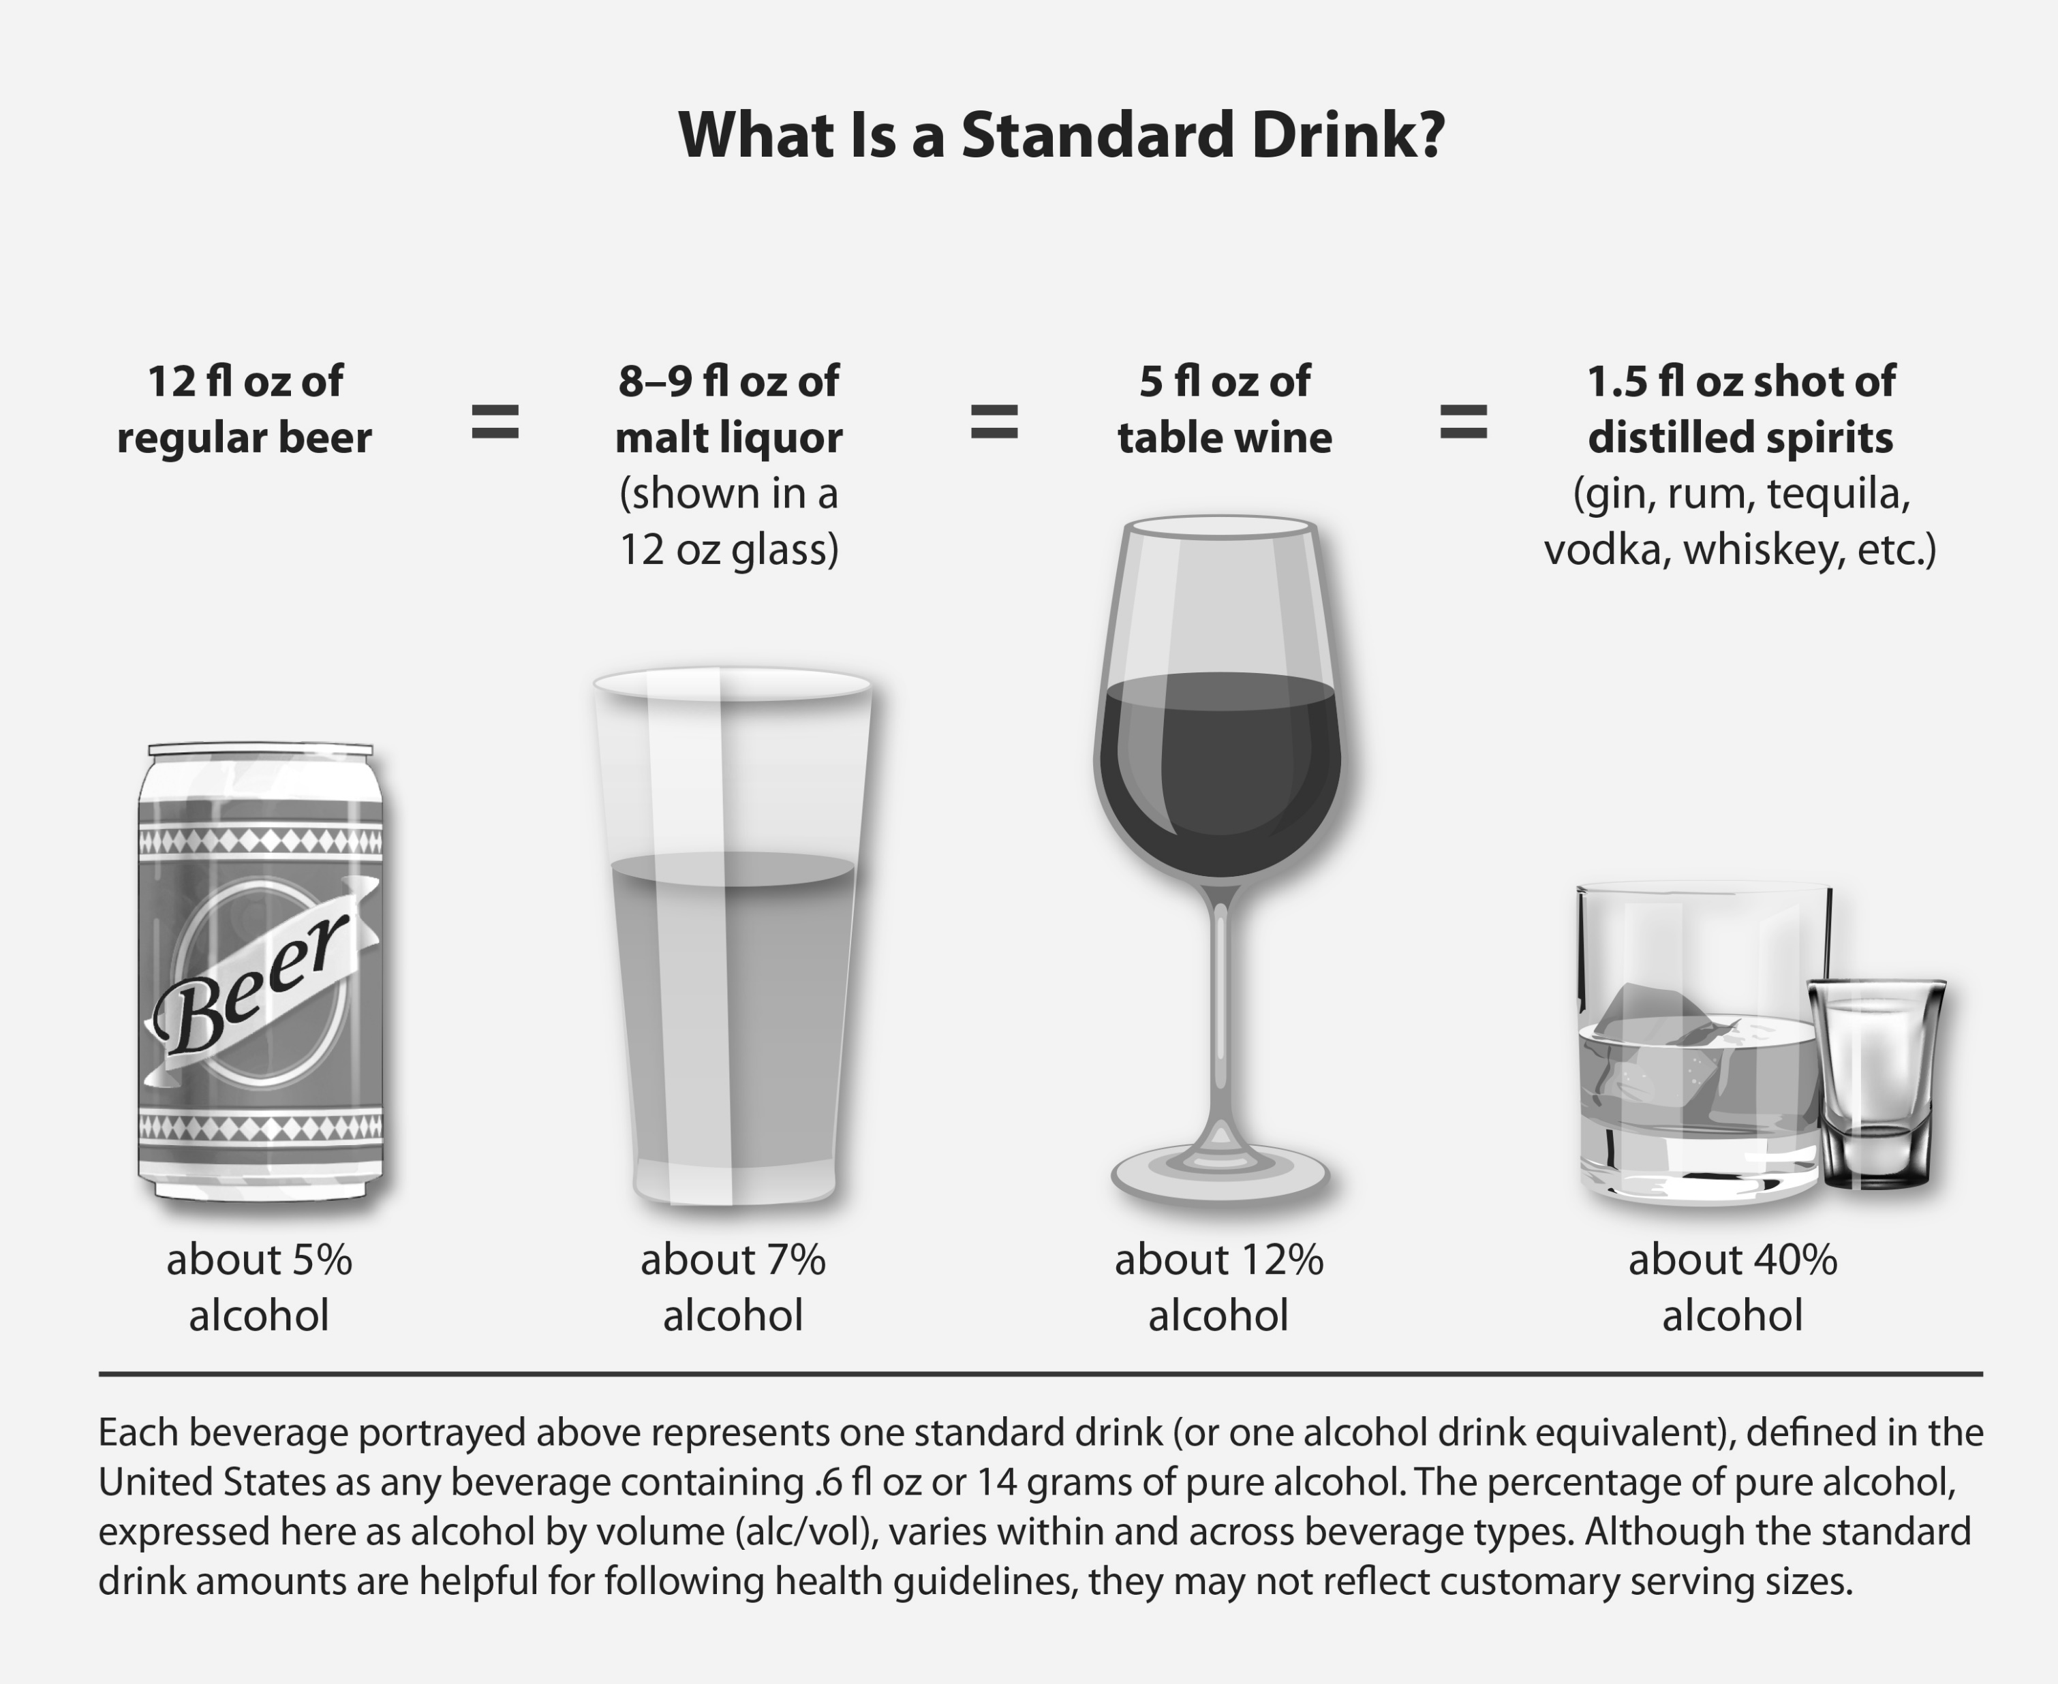
What is a Standard Drink?
Notes:
If we are going to discuss binge drinking or alcohol misuse, it is important to be clear on what is a “standard drink” of alcohol. Of course, the effects of a night of drinking will depend on the amount drank and the alcohol content of each drink.
Image Retrieved from: https://www.niaaa.nih.gov/publications/brochures-and-fact-sheets/understanding-dangers-of-alcohol-overdose
Reference(s):
National Institute on Alcohol Abuse and Alcoholism. (2021). Understanding the dangers of alcohol overdose. https://www.niaaa.nih.gov/publications/brochures-and-fact-sheets/understanding-dangers-of-alcohol-overdose

Slide 4
BAC Increases Risk Increases
Decreased motor coordination
Clouded judgment
Increased risk of injuries from falls or car crashes
Engaging in unprotected or unintended sex
Acts of violence
Black outs (memory impairment)
Passing out
Death
https://www.niaaa.nih.gov/publications/brochures-and-fact-sheets/understanding-dangers-of-alcohol-overdose
Notes:
Drinking large amounts of alcohol can overwhelm the body. BAC can continue to increase as the stomach absorbs alcohol – even after a person stops drinking. It is dangerous to assume that a person is “fine” if they pass out or are “sleeping it off” they may be in danger of choking on their own vomit and dying from a lack of oxygen.
Image Retrieved from: https://www.niaaa.nih.gov/publications/brochures-and-fact-sheets/understanding-dangers-of-alcohol-overdose
Reference(s):
National Institute on Alcohol Abuse and Alcoholism. (2021). Understanding the dangers of alcohol overdose. https://www.niaaa.nih.gov/publications/brochures-and-fact-sheets/understanding-dangers-of-alcohol-overdose

Slide 5
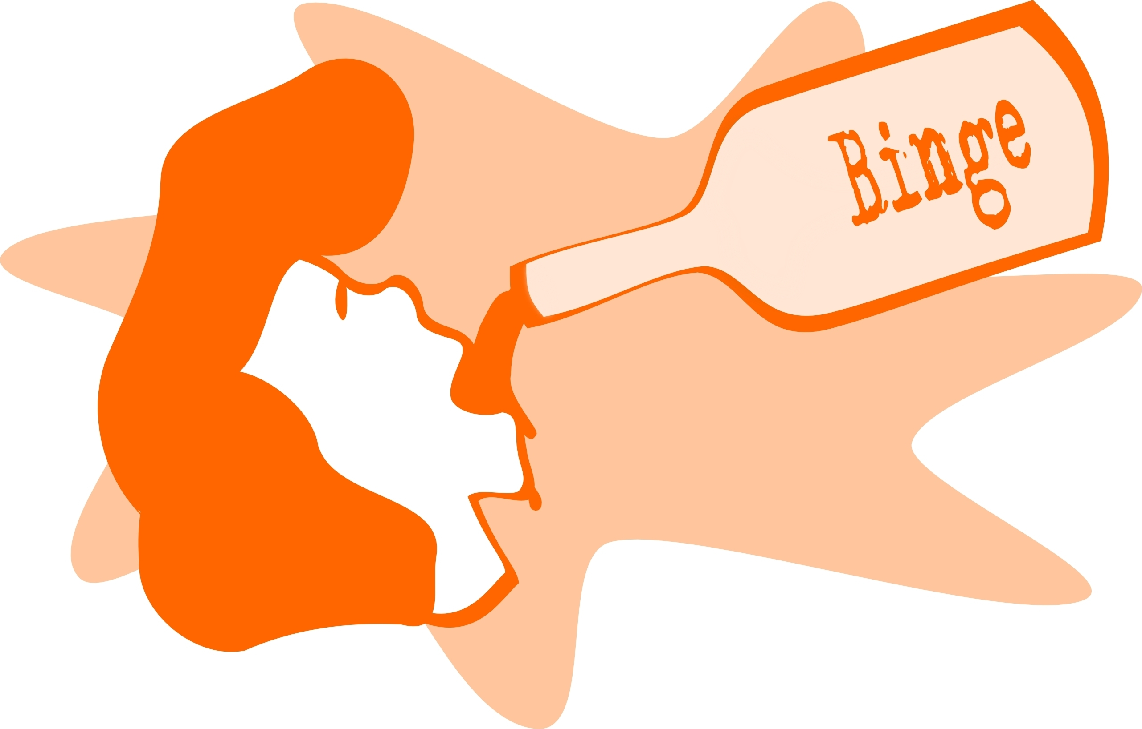
THEN Continuing to drink despite clear signs of significant impairments can result in an alcohol overdose.
Consuming a lot of alcohol in a short period of time can overwhelm the body’s ability to break down and clear alcohol from the bloodstream
https://www.niaaa.nih.gov/publications/brochures-and-fact-sheets/understanding-dangers-of-alcoholoverdose#:~:text=Symptoms%20of%20alcohol%20overdose%20include,permanent%20brain%20damage%20or%20death.
Notes:
Reference(s):
National Institute on Alcohol Abuse and Alcoholism. (2021). Understanding the dangers of alcohol overdose. https://www.niaaa.nih.gov/publications/brochures-and-fact-sheets/understanding-dangers-of-alcohol-overdose

Slide 6
Signs of Alcohol Overdose
Mental Confusion
Difficulty remaining conscious
Vomiting
Seizure
Trouble breathing
Slow heart rate
Clammy skin
Dulled responses such as no gag reflex
Extremely low body temperature
https://www.niaaa.nih.gov/publications/brochures-and-fact-sheets/understanding-dangers-ofalcoholoverdose#:~:text=Symptoms%20of%20alcohol%20overdose%20include,permanent%20brain%20damage%20or%20death.
Notes:
An alcohol OD occurs when there is so much alcohol in the bloodstream that areas of the brain controlling basic life support functions – such as breathing, heart rate and temperature control begin to shut down. It can lead to permanent brain damage or death. Multiple factors impact who is more at risk for an OD, age, tolerance, gender, medications and food. Drinking alcohol and taking medications for pain, sleep or anxiety and also increase the risk of an overdose.
Reference(s):
National Institute on Alcohol Abuse and Alcoholism. (2021). Understanding the dangers of alcohol overdose. https://www.niaaa.nih.gov/publications/brochures-and-fact-sheets/understanding-dangers-of-alcohol-overdose

Slide 7
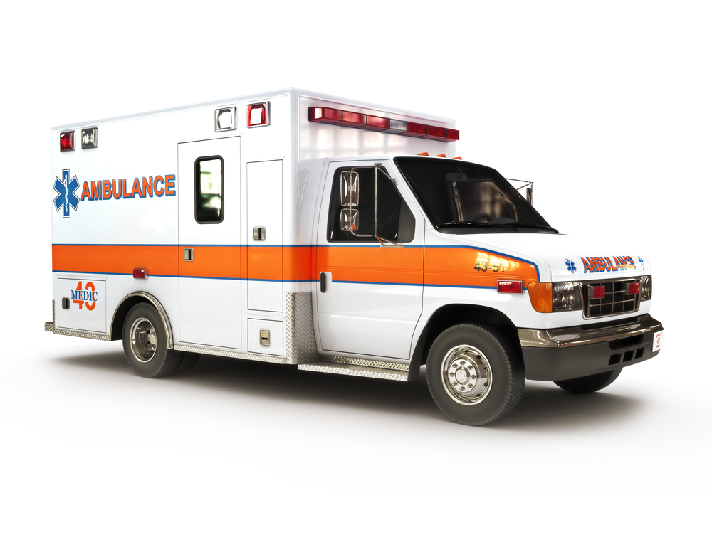
How to Help
Act Quickly….
Stay with the person – do not leave them alone to ‘sleep it off’
Cold showers, hot coffee and walking do not help and can make things worse
Call 911 and be prepared to tell first responders what the person drank, amounts, if there was other drug use
Help the person who is vomiting, have them lean forward to prevent choking. If they are unconscious, roll them on their side to prevent choking.
https://www.niaaa.nih.gov/publications/brochures-and-fact-sheets/understanding-dangers-of alcohol overdose#:~:text=Symptoms%20of%20alcohol%20overdose%20include,permanent%20brain%20damage%20or%20death.
Notes:
Know the danger signs and call for immediate help if you are concerned that someone has overdosed. Be aware that a person who has passed out can die. Cold showers or hot coffee does NOT reverse the effects of alcohol, they need medical care. Be aware of the risks of drinking more than recommended by the Dietary Guidelines for Americans. Source: www.niaaa.nih.gov
Reference(s)
National Institute on Alcohol Abuse and Alcoholism. (2021). Understanding the dangers of alcohol overdose. https://www.niaaa.nih.gov/publications/brochures-and-fact-sheets/understanding-dangers-of-alcohol-overdose

