Slide 1
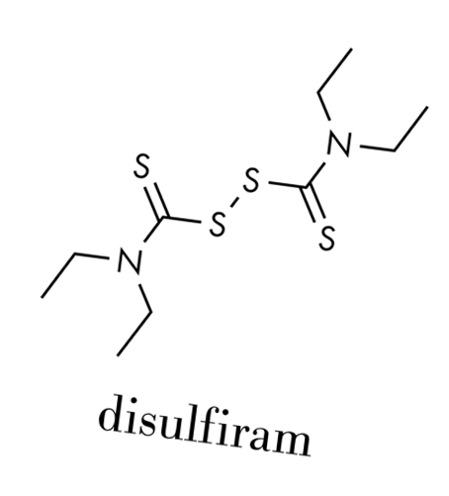
How Does Disulfiram Work
Notes:
SUD Keys to Education is a product for educators and clinical supervisors developed in 2022 by the Mountain Plains and Pacific Southwest Addiction Technology Transfer Centers (MPATTC and PSATTC). The main developers of the alcohol materials are Thomas E. Freese, PhD, Nancy Roget, MS, Kim Miller, MS, and Trisha Dudkowski, BA. Additional guidance and editing support were provided by Kenneth Flanagan, PhD, Terra Hamblin, MA, Cindy Juntenen, PhD, Shannon McCarty, BS, LP, Abby Roach-Moore, MSW, Beth Rutkowski, MPH,, and Maridee Shogren, DNP.
This product was developed to help community college/university faculty, as well as clinical supervisors and recovery support staff have access to brief, science-based content with the goal of providing materials that can be easily infused into existing substance use disorder and related courses (e.g., social work, nursing, criminal justice, foundation of addiction courses, ethics, counseling courses, etc.) and for clinical and recovery staff use in in-service meetings. Individuals can select the specific content to infuse into existing curricula/materials depending on specific needs of their learners. Each slide in the slide decks contain notes to provide guidance on the topics along with references and handouts where appropriate.
If you require further information, please do not hesitate to contact the MPATTC (http://www.mpattc.org) or PSATTC (http://www.psattc.org) . You are free to use these slides and pictures, but please give credit to the MPATTC and PSATTC when using them by referencing both Centers at the beginning of your presentation. The MPATTC (HHS Region 8) and PSATTC (HHS Region 9) are part of the SAMHSA-funded ATTC Network that offers training and technical assistance (TA) services. HHS Region 8 is comprised of Colorado, Montana, North Dakota, South Dakota, Utah, and Wyoming, and HHS Region 9 is comprised of Arizona, California, Hawaii, Nevada, and the six U.S.-affiliated Pacific Jurisdictions (American Samoa, Commonwealth of the Northern Mariana Islands, Federated States of Micronesia, Guam, Republic of the Marshall Islands, and Republic of Palau). For additional information, please visit http://www.mpattc.org and http://www.psattc.org.
Funding for this product was made possible (in part) by SAMHSA Cooperative Agreement numbers UR1 TI080200 (MPATTC) and UR1 TI080211 (PSATTC). The views expressed in these materials do not necessarily reflect the official policies of the Department of Health and Human Services, nor does mention of trade names, commercial practices, or organizations imply endorsement by the U.S. Government. Additional resources are available to enhance and support the information provided in this brief presentation.
Audio Recording: Thomas E. Freese, PhD
Image Credit: Shutterstock (unless otherwise noted)
Date last updated: July 27, 2022.

Slide 2
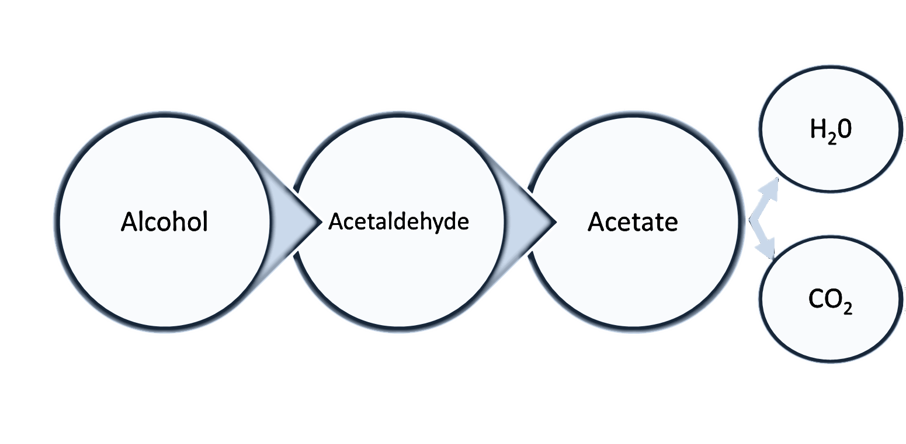
How Does Disulfiram Work?
Alcohol
Dehydrogenase
Acetaldehyde Dehydrogenase
2
Notes:
2
When an individual drinks alcohol, it is broken down in three stages. First, the enzyme Alcohol Dehydrogenase converts alcohol into Acetaldehyde. Acetaldehyde is actually a toxic compound and therefore must be broken down further and eliminated.
This occurs through the enzyme Acetaldehyde Dehydrogenase. It converts that acetaldehyde into acetate. Finally, Acetate is converted into water and carbon dioxide and eliminated from the body.
Disulfiram works by blocking the effect of acetaldehyde dehodrogenase. This causes a build of up the toxic acetaldehyde to levels 5-10 times greater than would normally occur of alcohol was breaking down normally.

