Slide 1
Acute and Chronic Effects of Stimulants on the Body, Part II
Stimulants Mini-Deck #5
Notes:
SUD Keys to Education is a product for educators and clinical supervisors developed in 2022 by the Mountain Plains and Pacific Southwest Addiction Technology Transfer Centers (MPATTC and PSATTC). The main developers of the stimulant materials are Beth Rutkowski, MPH, and Thomas E. Freese, PhD. Additional guidance and editing support was provided by Cindy Juntenen, PhD, LP, Nancy Roget, MS, Trisha Dudkowski, BA, Kenneth Flanagan, PhD, Terra Hamblin, MA, Shannon McCarty, BS, Kim Miller, MS, Abby Roach-Moore, MSW, and Maridee Shogren, DNP.
This product was developed to help community college/university faculty, as well as clinical supervisors and recovery support staff to have access to brief, science-based content with the goal of providing materials that can be easily infused into existing substance use disorder and related courses (e.g., social work, nursing, criminal justice, foundation of addiction courses, ethics, counseling courses, etc.) and for clinical and recovery staff use in in-service meetings. Individuals can select the specific content to infuse into existing curricula/materials depending on specific needs of their learners. Each slide in the slide decks contain notes to provide guidance on the topics along with references and handouts where appropriate.
If you require further information, please do not hesitate to contact the MPATTC (http://www.mpattc.org) or PSATTC (http://www.psattc.org). You are free to use these slides and pictures, but please give credit to the MPATTC and PSATTC when using them by referencing both Centers at the beginning of your presentation. The MPATTC (HHS Region 8) and PSATTC (HHS Region 9) are part of the SAMHSA-funded ATTC Network that offers training and technical assistance (TA) services. HHS Region 8 is comprised of Colorado, Montana, North Dakota, South Dakota, Utah, and Wyoming, and HHS Region 9 is comprised of Arizona, California, Hawaii, Nevada, and the six U.S.-affiliated Pacific Jurisdictions (American Samoa, Commonwealth of the Northern Mariana Islands, Federated States of Micronesia, Guam, Republic of the Marshall Islands, and Republic of Palau. For additional information, please visit http://www.mpattc.org and http://www.psattc.org.
Funding for this product was made possible (in part) by SAMHSA Cooperative Agreement numbers UR1 TI080200 (MPATTC) and UR1 TI080211 (PSATTC). The views expressed in these materials do not necessarily reflect the official policies of the Department of Health and Human Services, nor does mention of trade names, commercial practices, or organizations imply endorsement by the U.S. Government.
Additional resources are available to enhance and support the information provided in this brief presentation.
Date last updated: August 17, 2022.

Slide 2

Chronic Stimulant Use (1)
Acute Overdose:
Severe hyperthermia
Convulsions
Severe dehydration
Rhabdomyolysis (too much myoglobin being filtered by the kidneys) → acute renal failure
Stroke
Myocardial infarction
SOURCE: NIDA, 2019.
Notes:
Acute overdose from use of stimulants is associated with a variety of medical complications. Hyperthermia refers to a group of heat-related conditions characterized by an abnormally high body temperature — in other words, the opposite of hypothermia. The condition occurs when the body's heat-regulation system becomes overwhelmed by outside factors, causing a person's internal temperature to rise. A convulsion is a medical condition where body muscles contract and relax rapidly and repeatedly, resulting in uncontrolled actions of the body. Because epileptic seizures typically include convulsions, the term convulsion is sometimes used as a synonym for seizure. Myocardial Infarction is another name for a heart attack.
Rhabdomyolysis is a serious medical condition that can be fatal or result in permanent disability. It can occur when damaged muscle tissue releases its proteins and electrolytes into the blood. These substances can damage the heart and kidneys and cause permanent disability or even death.
REFERENCE:
National Institute on Drug Abuse. (2019, October 16). Methamphetamine. Retrieved June 11, 2020, from https://www.drugabuse.gov/publications/research-reports/methamphetamine/overview.

Slide 3
Chronic Stimulant Use (2)
Organ System Damage:
Respiratory (pulmonary hypertension, difficulty breathing, pleuritic chest pain, decreased capacity)
Neurological (stroke, seizure, hemorrhage, cerebral vasculitis)
Renal failure (resulting from rhabdomyolysis)
Hepatic failure (resulting from rhabdomyolysis)
Cardiac (tachycardia, arrhythmia, reduced heart rate variability, myocardial infarction, heart failure)
Psychological Effects:
Psychosis (hallucinations, delusions)
Affective (depression, suicidal ideation, mania)
SOURCE: NIDA, 2019.
Notes:
Chronic stimulant use causes damage in structure and/or function. Specific examples of problems caused are listed here for specific organs, including some severe psychological effects.
REFERENCE:
National Institute on Drug Abuse. (2019, October 16). Methamphetamine. Retrieved June 11, 2020, from https://www.drugabuse.gov/publications/research-reports/methamphetamine/overview.

Slide 4
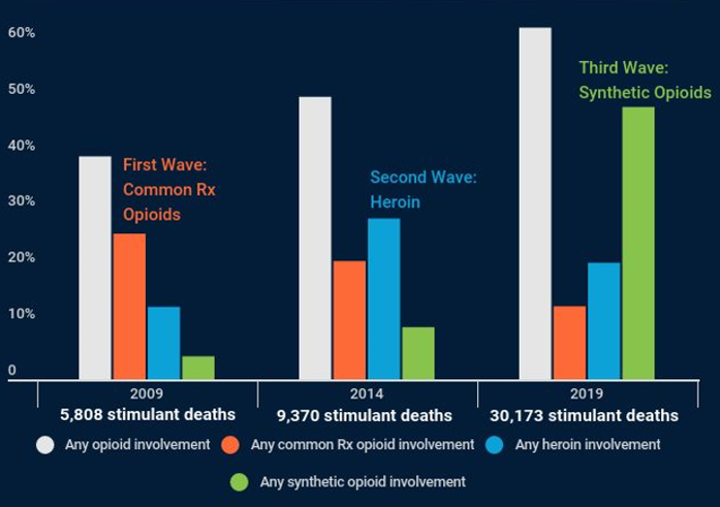
Increasing Risk of Overdose – from both Stimulants and Opioids
SOURCE: NIHCM Foundation, 2021.
Notes:
Although stimulant deaths tend to involve only one type of stimulant (cocaine or methamphetamine), very significant portions of those deaths also involve an opioid. Over the 2009-2019 period, as the number of stimulant overdose deaths increased more than fivefold from 5,808 to 30,173, the share of these deaths that involved one or more opioids rose from 40 percent to 63 percent.
Moreover, the three waves of the opioid crisis can be clearly seen within these stimulant deaths. In 2009, commonly prescribed opioid medications were the opioid type most likely to be involved in stimulant overdoses, being present in 26 percent of stimulant deaths. Five years later, the rising prominence of heroin can be detected, with this substance eclipsing prescription opioids as the type of opioid most often involved in stimulant deaths. By 2019, the importance of both of those opioid types has been dwarfed by the explosion of synthetic opioids. Forty-eight percent of all stimulant overdose deaths in 2019 also involved a synthetic opioid.
The rising stimulant death rates and the growing involvement of synthetic opioids is leading to speculation that fentanyl is increasingly being mixed into cocaine and methamphetamine. This may happen accidentally when dealers handle both fentanyl and stimulants, or it may be intentional to stretch the supply of the stimulants. Additionally, some users may intentionally alternate between opioids (which are depressants) and stimulants to balance out the highs and lows of these different substances.
This data slide originates from a recent Data Insights report released by the National Institute for Health Care Management (NIHCM) Foundation.
REFERENCE:
National Institute for Health Care Management Foundation. (2021, May). Stimulant Deaths on the Rise, Compounded by Rise in Synthetic Opioids. Retrieved June 8, 2021, from https://nihcm.org/publications/stimulant-deaths-on-the-rise-compounded-by-rise-in-synthetic-opioids.

