Slide 1
The Cognitive Impact of Stimulant
Stimulant Keys – Mini Deck 7
Notes:
SUD Keys to Education is a product for educators and clinical supervisors developed in 2022 by the Mountain Plains and Pacific Southwest Addiction Technology Transfer Centers (MPATTC and PSATTC). The main developers of the stimulant materials are Beth Rutkowski, MPH, and Thomas E. Freese, PhD. Additional guidance and editing support was provided by Cindy Juntenen, PhD, LP, Nancy Roget, MS, Trisha Dudkowski, BA, Kenneth Flanagan, PhD, Terra Hamblin, MA, Shannon McCarty, BS, Kim Miller, MS, Abby Roach-Moore, MSW, and Maridee Shogren, DNP.
This product was developed to help community college/university faculty, as well as clinical supervisors and recovery support staff to have access to brief, science-based content with the goal of providing materials that can be easily infused into existing substance use disorder and related courses (e.g., social work, nursing, criminal justice, foundation of addiction courses, ethics, counseling courses, etc.) and for clinical and recovery staff use in in-service meetings. Individuals can select the specific content to infuse into existing curricula/materials depending on specific needs of their learners. Each slide in the slide decks contain notes to provide guidance on the topics along with references and handouts where appropriate.
If you require further information, please do not hesitate to contact the MPATTC (http://www.mpattc.org) or PSATTC (http://www.psattc.org). You are free to use these slides and pictures, but please give credit to the MPATTC and PSATTC when using them by referencing both Centers at the beginning of your presentation. The MPATTC (HHS Region 8) and PSATTC (HHS Region 9) are part of the SAMHSA-funded ATTC Network that offers training and technical assistance (TA) services. HHS Region 8 is comprised of Colorado, Montana, North Dakota, South Dakota, Utah, and Wyoming, and HHS Region 9 is comprised of Arizona, California, Hawaii, Nevada, and the six U.S.-affiliated Pacific Jurisdictions (American Samoa, Commonwealth of the Northern Mariana Islands, Federated States of Micronesia, Guam, Republic of the Marshall Islands, and Republic of Palau. For additional information, please visit http://www.mpattc.org and http://www.psattc.org.
Funding for this product was made possible (in part) by SAMHSA Cooperative Agreement numbers UR1 TI080200 (MPATTC) and UR1 TI080211 (PSATTC). The views expressed in these materials do not necessarily reflect the official policies of the Department of Health and Human Services, nor does mention of trade names, commercial practices, or organizations imply endorsement by the U.S. Government.
Additional resources are available to enhance and support the information provided in this brief presentation.
Date last updated: August 17, 2022.

Slide 2
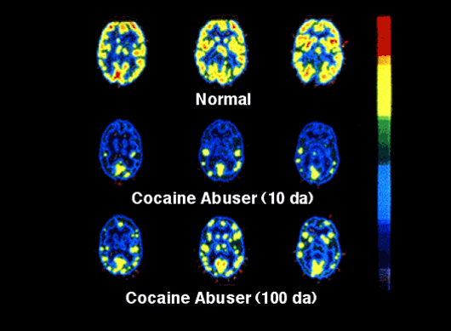
Long-Term Impact of Cocaine Use
SOURCES: NIDA, 2019; Volkow et al., 1993; Volkow et al., 1992
Notes:
This set of PET scan images shows how the brain is affected by long term use of a stimulant drug such as cocaine. In the set of scans, the level of brain function is indicated in the appearance of bright colors, such as yellow. The top row shows a normal-functioning brain without drugs. You can see a lot of brain activity. In other words, there is a lot of yellow color. The middle row shows a “cocaine abuser” [currently we would say person with CUD] brain after 10 days without any cocaine use. Less yellow means less normal activity occurring in the brain - even after they have abstained from the drug for 10 days. The bottom row shows the same person’s brain after 100 days without any cocaine. You can see a little more yellow, so there is some improvement, or more brain activity, as this state of early recovery. But the person’s brain is still not back to a normal level of functioning more than 3 months later. Scientists are concerned that there may be areas in the brain that may never fully recover from a stimulant use disorder.
A Note about Language: This study was done when the DSM-IV was the most up-to-date diagnostic tool, hence the use of the term “cocaine abuser” in the label for the middle and bottom images. With the implementation of the DSM-5, the word abuse is no longer used. Instead, you would label the middle and bottom images as “individual with a cocaine use disorder.”
REFERENCES:
National Institute on Drug Abuse. (2019, February 11). Teaching Addiction Science. Retrieved June 9, 2020, from https://www.drugabuse.gov/publications/teaching-addiction-science/bringing-power-science-to-bear-drug-abuse-addiction.
Volkow, N. D., Fowler, J. S., Wang, G. J., Hitzemann, R., Logan, J., Schlyer, D. J., Dewey, S. L., & Wolf, A. P. (1993). Decreased dopamine D2 receptor availability is associated with reduced frontal metabolism in cocaine abusers. Synapse (New York, N.Y.), 14(2), 169–177. https://doi.org/10.1002/syn.890140210
Volkow, N. D., Hitzemann, R., Wang, G. J., Fowler, J. S., Wolf, A. P., Dewey, S. L., & Handlesman, L. (1992). Long-term frontal brain metabolic changes in cocaine abusers. Synapse (New York, N.Y.), 11(3), 184–190. https://doi.org/10.1002/syn.890110303

Slide 3
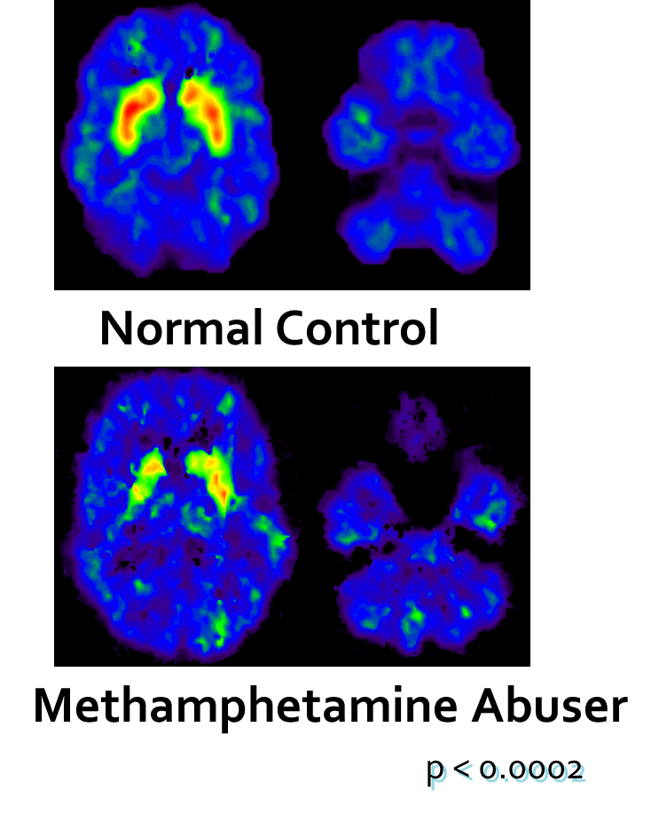
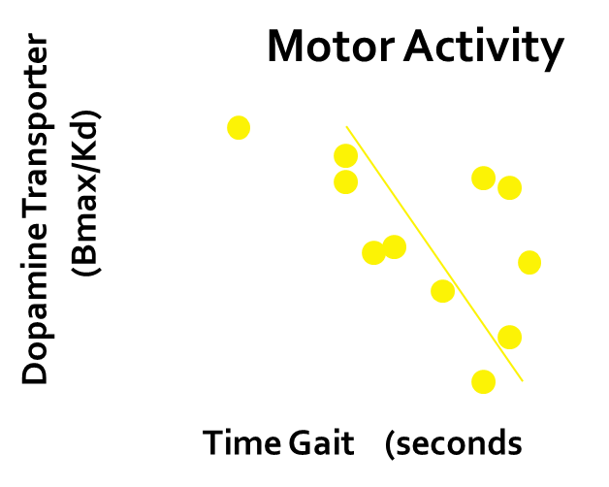
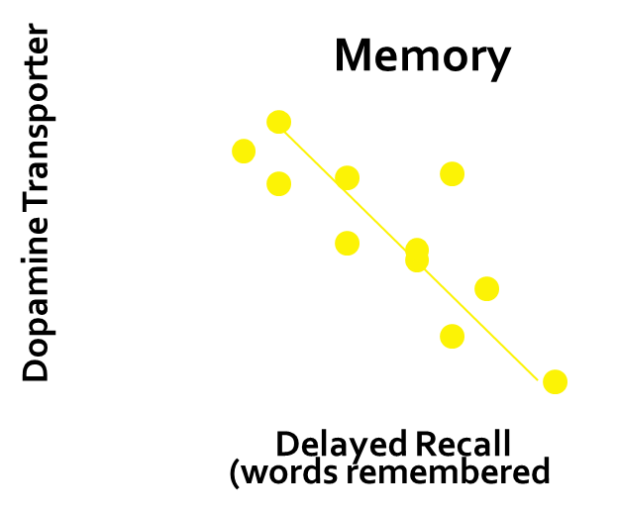
Dopamine Transporters in
People who Use Methamphetamine
p<0.0002
3
Notes:
Methamphetamine use decreases dopamine transporter activity and compromises mental function. The brain image at the top left is a PET image from a normal control subject. The striatum is brightly lit in red and yellow, indicating the presence of many dopamine transporters, which contrasts with the brain of a person who uses methamphetamine (bottom left). What does this mean functionally?
The graphs on the right show the relationship between performance on a motor (upper right) and a memory task (lower right) and methamphetamine-driven decreases in dopamine transporters. The magnitude of the decline in the dopamine transporter binding is positively correlated with the extent of motor and memory impairment; thus, the greater the decline, the greater the impairment in memory and motor reaction time.
REFERENCE:
Volkow, N. D., Chang, L., Wang, G. J., Fowler, J. S., Leonido-Yee, M., Franceschi, D., Sedler, M. J., Gatley, S. J., Hitzemann, R., Ding, Y. S., Logan, J., Wong, C., & Miller, E. N. (2001). Association of dopamine transporter reduction with psychomotor impairment in methamphetamine abusers. The American Journal of Psychiatry, 158(3), 377–382. https://doi.org/10.1176/appi.ajp.158.3.377

Slide 4
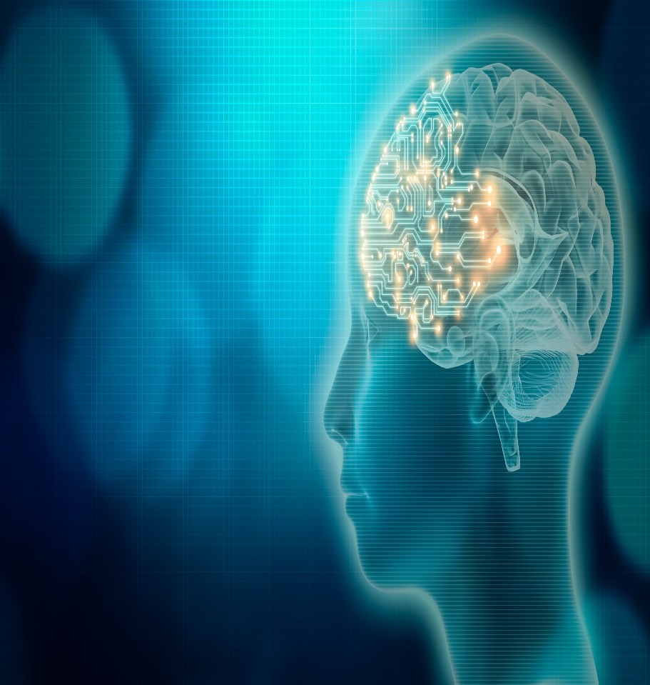
Cognitive Deficits in
Methamphetamine Use Disorder
Compared 108 methamphetamine treatment seekers and 50 matched controls.
Methamphetamine use
was associated with
impulsive decision making
and disinhibition.
Greater disinhibition
associated with longer
durations of
methamphetamine use.
4
Notes:
According to findings from a new research study published in 2020 by Fitzpatrick and colleagues, methamphetamine use was associated with impulsive decision making and disinhibition. Further, greater disinhibition was associated with longer durations of methamphetamine use.
REFERENCE:
Fitzpatrick, R. E., Rubenis, A. J., Lubman, D. I., & Verdejo-Garcia, A. (2020). Cognitive deficits in methamphetamine addiction: Independent contributions of dependence and intelligence. Drug and Alcohol Dependence, 209, (1 April), 107891. https://doi.org/10.1016/j.drugalcdep.2020.107891
IMAGE CREDIT:
Purchased Image, Adobe Stock, 2020.

