Slide 1
Healing from Stimulant Use Disorders Part 2
Brain Healing and Services
Stimulant Keys – Mini Deck 10
Notes:
SUD Keys to Education is a product for educators and clinical supervisors developed in 2022 by the Mountain Plains and Pacific Southwest Addiction Technology Transfer Centers (MPATTC and PSATTC). The main developers of the stimulant materials are Beth Rutkowski, MPH, and Thomas E. Freese, PhD. Additional guidance and editing support was provided by Cindy Juntenen, PhD, LP, Nancy Roget, MS, Trisha Dudkowski, BA, Kenneth Flanagan, PhD, Terra Hamblin, MA, Shannon McCarty, BS, Kim Miller, MS, Abby Roach-Moore, MSW, and Maridee Shogren, DNP.
This product was developed to help community college/university faculty, as well as clinical supervisors and recovery support staff to have access to brief, science-based content with the goal of providing materials that can be easily infused into existing substance use disorder and related courses (e.g., social work, nursing, criminal justice, foundation of addiction courses, ethics, counseling courses, etc.) and for clinical and recovery staff use in in-service meetings. Individuals can select the specific content to infuse into existing curricula/materials depending on specific needs of their learners. Each slide in the slide decks contain notes to provide guidance on the topics along with references and handouts where appropriate.
If you require further information, please do not hesitate to contact the MPATTC (http://www.mpattc.org) or PSATTC (http://www.psattc.org). You are free to use these slides and pictures, but please give credit to the MPATTC and PSATTC when using them by referencing both Centers at the beginning of your presentation. The MPATTC (HHS Region 8) and PSATTC (HHS Region 9) are part of the SAMHSA-funded ATTC Network that offers training and technical assistance (TA) services. HHS Region 8 is comprised of Colorado, Montana, North Dakota, South Dakota, Utah, and Wyoming, and HHS Region 9 is comprised of Arizona, California, Hawaii, Nevada, and the six U.S.-affiliated Pacific Jurisdictions (American Samoa, Commonwealth of the Northern Mariana Islands, Federated States of Micronesia, Guam, Republic of the Marshall Islands, and Republic of Palau. For additional information, please visit http://www.mpattc.org and http://www.psattc.org.
Funding for this product was made possible (in part) by SAMHSA Cooperative Agreement numbers UR1 TI080200 (MPATTC) and UR1 TI080211 (PSATTC). The views expressed in these materials do not necessarily reflect the official policies of the Department of Health and Human Services, nor does mention of trade names, commercial practices, or organizations imply endorsement by the U.S. Government.
Additional resources are available to enhance and support the information provided in this brief presentation.
Date last updated: August 17, 2022.

Slide 2
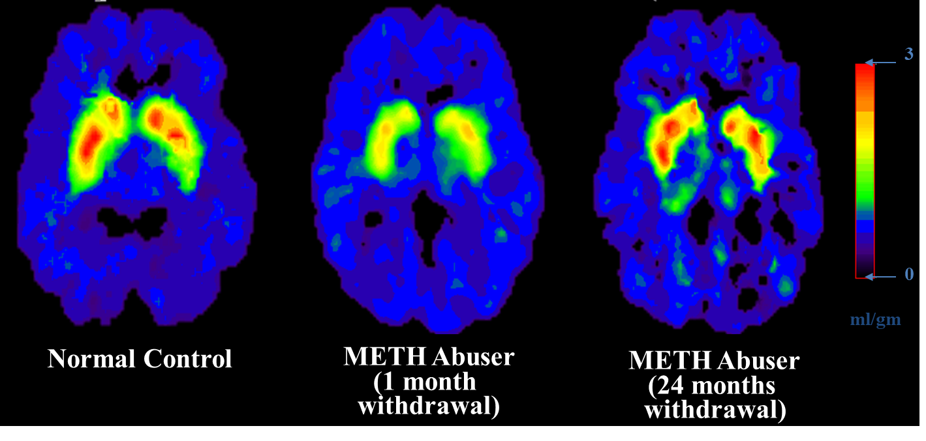
Partial Recovery of Brain Dopamine Transporters
Following Protracted Abstinence
Notes:
It would be unethical to give a human being who has never been exposed to methamphetamine a dose of the drug to see what happens to his/her brain. So, when brain imaging researchers wish to study the effects of methamphetamine on the human brain, they match non-using controls to methamphetamine users (by gender, age, socioeconomic status, etc.). In this study, researchers examined the PET scans of chronic methamphetamine abusers [currently we would say person with a methamphetamine use disorder] who had achieved two years of abstinence from methamphetamine. The scans showed a return to virtually normal dopamine levels. While this is good news and suggests that the brain has an amazing ability to repair itself, the subjects in the study did not regain all of the lost cognitive function associated with the damage, which could suggest an incomplete recovery. While the fact that the brain recovers is good news, the not-so-good news is that the recovery takes months, not days. Treatment and recovery are long-term processes.
REFERENCE:
Volkow, N. D., Chang, L., Wang, G. J., Fowler, J. S., Franceschi, D., Sedler, M., Gatley, S. J., Miller, E., Hitzemann, R., Ding, Y. S., & Logan, J. (2001). Loss of dopamine transporters in methamphetamine abusers recovers with protracted abstinence. The Journal of Neuroscience: The Official Journal of the Society for Neuroscience, 21(23), 9414–9418. https://doi.org/10.1523/JNEUROSCI.21-23-09414.2001

Slide 3
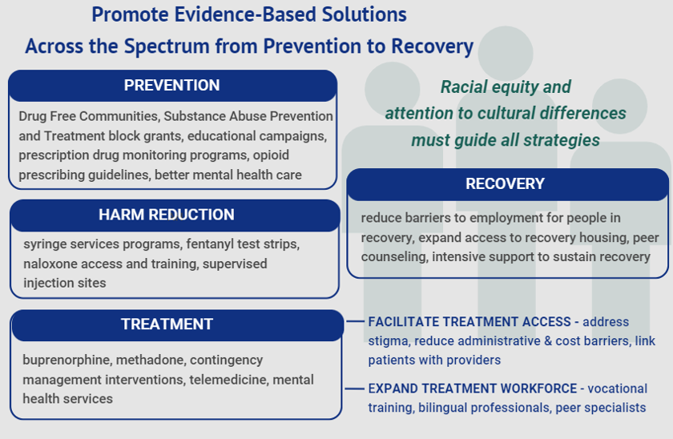
The Importance of Evidence-Based Solutions When Working with People Who Use Stimulants
Notes:
When working with people who use stimulants, it is critically important to promote the use of evidence-based solutions across the spectrum, from prevention to recovery. Further, racial equity and an attention to cultural differences must guide all strategies.
This figure originates from a recent Dying from Drugs: A New Look at Overdose Deaths in the U.S. Infographic released by the National Institute for Health Care Management (NIHCM) Foundation.
REFERENCE:
National Institute for Health Care Management Foundation. (2021, June). Dying from Drugs: A New Look at Overdose Deaths in the U.S. Retrieved February 11, 2022, from https://nihcm.org/publications/dying-from-drugs-a-new-look-at-overdose-deaths-in-the-us.

