Slide 1
Other Behavioral Approaches for Treating
Stimulant Use Disorder
Stimulants Mini-Deck #16
Notes:
SUD Keys to Education is a product for educators and clinical supervisors developed in 2022 by the Mountain Plains and Pacific Southwest Addiction Technology Transfer Centers (MPATTC and PSATTC). The main developers of the stimulant materials are Beth Rutkowski, MPH, and Thomas E. Freese, PhD. Additional guidance and editing support was provided by Cindy Juntenen, PhD, LP, Nancy Roget, MS, Trisha Dudkowski, BA, Kenneth Flanagan, PhD, Terra Hamblin, MA, Shannon McCarty, BS, Kim Miller, MS, Abby Roach-Moore, MSW, and Maridee Shogren, DNP.
This product was developed to help community college/university faculty, as well as clinical supervisors and recovery support staff to have access to brief, science-based content with the goal of providing materials that can be easily infused into existing substance use disorder and related courses (e.g., social work, nursing, criminal justice, foundation of addiction courses, ethics, counseling courses, etc.) and for clinical and recovery staff use in in-service meetings. Individuals can select the specific content to infuse into existing curricula/materials depending on specific needs of their learners. Each slide in the slide decks contain notes to provide guidance on the topics along with references and handouts where appropriate.
If you require further information, please do not hesitate to contact the MPATTC (http://www.mpattc.org) or PSATTC (http://www.psattc.org). You are free to use these slides and pictures, but please give credit to the MPATTC and PSATTC when using them by referencing both Centers at the beginning of your presentation. The MPATTC (HHS Region 8) and PSATTC (HHS Region 9) are part of the SAMHSA-funded ATTC Network that offers training and technical assistance (TA) services. HHS Region 8 is comprised of Colorado, Montana, North Dakota, South Dakota, Utah, and Wyoming, and HHS Region 9 is comprised of Arizona, California, Hawaii, Nevada, and the six U.S.-affiliated Pacific Jurisdictions (American Samoa, Commonwealth of the Northern Mariana Islands, Federated States of Micronesia, Guam, Republic of the Marshall Islands, and Republic of Palau. For additional information, please visit http://www.mpattc.org and http://www.psattc.org.
Funding for this product was made possible (in part) by SAMHSA Cooperative Agreement numbers UR1 TI080200 (MPATTC) and UR1 TI080211 (PSATTC). The views expressed in these materials do not necessarily reflect the official policies of the Department of Health and Human Services, nor does mention of trade names, commercial practices, or organizations imply endorsement by the U.S. Government.
Additional resources are available to enhance and support the information provided in this brief presentation.
Date last updated: August 17, 2022.

Slide 2

Other Behavioral Interventions with Research Support
Cognitive Behavioral Therapy/Relapse Prevention
Motivational Interviewing
The Matrix Model
Exercise
Mindfulness
SOURCES: AshaRani et al., 2020; Stuart et al., 2020; Rawson et al., 2015; Polcin et al., 2014; Rawson et al., 2004.
Notes:
A recent meta-analysis of behavioral treatments for methamphetamine use disorder indicate that Contingency Management is far superior to all other treatments. The effect may be improved by combining with Community Reinforcement Approach or Cognitive Behavioral Therapy. Previous research has provided some evidence for motivational interviewing, physical exercise, mindful meditation, and the Matrix Model. Mini-Deck #16 briefly reviews effective behavioral interventions other than Contingency Management and Cognitive Behavioral Therapy/Relapse Prevention.
REFERENCES:
AshaRani, P. V., Hombali, A., Seow, E., Ong, W. J., Tan, J. H., & Subramaniam, M. (2020). Non-pharmacological interventions for methamphetamine use disorder: a systematic review. Drug and Alcohol Dependence, 212, 108060. https://doi.org/10.1016/j.drugalcdep.2020.108060
Stuart, A. M., Baker, A. L., Denham, A., Lee, N. K., Hall, A., Oldmeadow, C., Dunlop, A., Bowman, J., & McCarter, K. (2020). Psychological treatment for methamphetamine use and associated psychiatric symptom outcomes: A systematic review. Journal of Substance Abuse Treatment, 109, 61–79. https://doi.org/10.1016/j.jsat.2019.09.005
Rawson, R. A., Chudzynski, J., Mooney, L., Gonzales, R., Ang, A., Dickerson, D., Penate, J., Salem, B. A., Dolezal, B., & Cooper, C. B. (2015). Impact of an exercise intervention on methamphetamine use outcomes post-residential treatment care. Drug and Alcohol Dependence, 156, 21–28. https://doi.org/10.1016/j.drugalcdep.2015.08.029
Polcin, D. L., Bond, J., Korcha, R., Nayak, M. B., Galloway, G. P., & Evans, K. (2014). Randomized trial of intensive motivational interviewing for methamphetamine dependence. Journal of Addictive Disease, 33, 253–265. https://doi.org/10.1080/10550887.2014.950029
Rawson, R. A., Marinelli-Casey, P., Anglin, M. D., Dickow, A., Frazier, Y., Gallagher, C., Galloway, G. P., Herrell, J., Huber, A., McCann, M. J., Obert, J., Pennell, S., Reiber, C., Vandersloot, D., Zweben, J., & Methamphetamine Treatment Project Corporate Authors (2004). A multi-site comparison of psychosocial approaches for the treatment of methamphetamine dependence. Addiction (Abingdon, England), 99(6), 708–717. https://doi.org/10.1111/j.1360-0443.2004.00707.x

Slide 3
Cognitive Behavioral Therapy (CBT)
Underlying assumption = learning processes play an important role in the development and continuation of a stimulant use disorder
CBT attempts to help patients recognize the situations in which they are most likely to use stimulants, avoid these situations when appropriate, and cope more effectively with a range of problems and problematic behaviors associated with substance use.
CBT is compatible with a range of other treatments patients may receive, such as pharmacotherapy
Also known as Relapse Prevention
SOURCES: NIDA, 2016; Carroll, 1998.
Notes:
Cognitive Behavioral Therapy (CBT) seeks to help patients recognize, avoid, and cope with the situations in which they are most likely to use drugs. Thoughts cause feelings and behaviors, not external things, like people, situations, and events. You can change the way a person thinks to feel or act better even if the situation does not change.
CBT is a short-term, evidenced-based, focused approach which has been used to help individuals with substance abuse disorders. CBT is a flexible, individualized approach that can be adapted to a wide range of patient and treatment settings. CBT emphasizes learning of skills to be used to achieve abstinence, and addresses other problems, including initiation and mastery of skills through practice, role playing, and extra-sessions tasks. NIDA published a CBT manual, which can be downloaded from: https://archives.drugabuse.gov/sites/default/files/cbt.pdf.
REFERENCES:
National Institute on Drug Abuse. (2016, May 6). Cocaine. Retrieved May 14, 2020, from https://www.drugabuse.gov/publications/research-reports/cocaine/what-cocaine.
Carroll, K., M. (1998). Therapy Manuals for Drug Addiction: A Cognitive-Behavioral Approach: Treating Cocaine Addiction. NIH Publication Number 98-4308. Washington, DC: National Institute on Drug Abuse. Available at: https://archives.drugabuse.gov/sites/default/files/cbt.pdf.

Slide 4
What CBT Skills can Clinicians Use when Working with People Who Use Stimulants?
Functional analysis and patterns of use
Coping with craving
Addressing and resolving ambivalence
Refusal skills
Seemingly irrelevant decisions
Planning for emergencies
Problem solving skills
HIV/HCV risk reduction
SOURCES: McHugh et al., 2010; Carroll, 1998; Carroll et al., 1994.
Notes:
This slide lists the CBT skills that clinicians can use with patients who use stimulants. Key skills for people who use stimulants include:
Analyzing the patterns of use and conducting a functional analysis to determine what the person hoped to gain by using, what the outcome of the use was, and alternative strategies for meeting the need
Identifying early signs of a craving developing and learning strategies to cope with the craving until it passes
Recognizing ambivalence to change and helping the patient resolve the ambivalence in the direction of change
Learning drug refusal techniques and helping the patient develop skills through practice including role play
Making connection between seemingly irrelevant decisions and how these compounds to lead the person toward drug related behaviors
Planning for emergency situations and strategies for respond to them without using
Developing strategies and skills for problem solving; specific in-session practices and role play can be very helpful in developing these skills
Identifying risk for HIV and Hepatitis C and developing strategies to reduce risk
REFERENCES:
McHugh, R. K., Hearon, B. A., & Otto, M. W. (2010). Cognitive behavioral therapy for substance use disorders. The Psychiatric Clinics of North America, 33(3), 511–525. https://doi/org/10/1016/j.psc.2010.04/012
Carroll, K., M. (1998). Therapy Manuals for Drug Addiction: A Cognitive-Behavioral Approach: Treating Cocaine Addiction. NIH Publication Number 98-4308. Washington, DC: National Institute on Drug Abuse. Available at: https://archives.drugabuse.gov/sites/default/files/cbt.pdf.
Carroll, K. M., Rounsaville, B. J., Nich, C., Gordon, L. T., Wirtz, P. W., & Gawin, F. (1994). One-year follow-up of psychotherapy and pharmacotherapy for cocaine dependence. Delayed emergence of psychotherapy effects. Archives of General Psychiatry, 51(12), 989–997. https://doi.org/10.1001/archpsyc.1994.03950120061010

Slide 5
Motivational Interviewing (MI)
“…a directive, client-centered method for enhancing intrinsic motivation for change by exploring and resolving ambivalence” (Miller & Rollnick, 2002).
“…a way of being with a client, not just a set of techniques for doing counseling” (Miller & Rollnick, 1991).
Studies demonstrated reduction in stimulant use with motivational interviewing
SOURCES: Polcin et al., 2014; Miller & Rollnick, 2012; Stein et al., 2009.
Notes:
Compared with non-directive counseling, motivational interviewing is more focused and goal-directed. The examination and resolution of ambivalence is its central purpose, and the counselor is intentionally directive in pursuing this goal.
Additional Information for the Trainer regarding the “MI Spirit”:
The spirit of MI can be characterized in a few key points. The following information was excerpted directly from https://motivationalinterviewing.org/:
Motivation to change is elicited from the patient, and not imposed from without. Other motivational approaches have emphasized coercion, persuasion, constructive confrontation, and the use of external contingencies (e.g., the threatened loss of job or family). Such strategies may have their place in evoking change, but they are quite different in spirit from motivational interviewing which relies upon identifying and mobilizing the patient’s intrinsic values and goals to stimulate behavior change.
It is the patient’s task, not the counselor's, to articulate and resolve his or her ambivalence. Ambivalence takes the form of a conflict between two courses of action (e.g., indulgence versus restraint), each of which has perceived benefits and costs associated with it. Many patients have never had the opportunity of expressing the often confusing, contradictory, and uniquely personal elements of this conflict, for example, "If I stop smoking I will feel better about myself, but I may also put on weight, which will make me feel unhappy and unattractive." The counselor's task is to facilitate expression of both sides of the ambivalence impasse, and guide the patient toward an acceptable resolution that triggers change.
Direct persuasion is not an effective method for resolving ambivalence. It is tempting to try to be "helpful" by persuading the patient of the urgency of the problem about the benefits of change. It is fairly clear, however, that these tactics generally diminish the probability of change (Miller, Benefield and Tonigan, 1993, Miller and Rollnick, 1991).
The counseling style is generally a quiet and eliciting one. Direct persuasion, aggressive confrontation, and argumentation are the conceptual opposite of motivational interviewing and are explicitly proscribed in this approach. To a counselor accustomed to confronting and giving advice, motivational interviewing can appear to be a hopelessly slow and passive process. The proof is in the outcome. More aggressive strategies, sometimes guided by a desire to "confront patient denial," easily slip into pushing patients to make changes for which they are not ready.
The counselor is directive in helping the patient to examine and resolve ambivalence. Motivational interviewing involves no training of patients in behavioral coping skills, although the two approaches not incompatible. The operational assumption in motivational interviewing is that ambivalence or lack of resolve is the principal obstacle to be overcome in triggering change. Once that has been accomplished, there may or may not be a need for further intervention such as skill training. The specific strategies of motivational interviewing are designed to elicit, clarify, and resolve ambivalence in a patient-centered and respectful counseling atmosphere.
Readiness to change is not a patient trait, but a fluctuating product of interpersonal interaction. The therapist is therefore highly attentive and responsive to the patient's motivational signs. Resistance and "denial" are seen not as patient traits, but as feedback regarding therapist behavior. Patient resistance is often a signal that the counselor is assuming greater readiness to change than is the case, and it is a cue that the therapist needs to modify motivational strategies.
The therapeutic relationship is more like a partnership or companionship than expert/recipient roles. The therapist respects the patient's autonomy and freedom of choice (and consequences) regarding his or her own behavior.
REFERENCES:
Polcin, D. L., Bond, J., Korcha, R., Nayak, M. B., Galloway, G. P., & Evans, K. (2014). Randomized trial of intensive motivational interviewing for methamphetamine dependence. Journal of Addictive Disease, 33, 253–265. https://doi.org/10.1080/10550887.2014.950029
Miller, W. R., & Rollnick, S. (2012). Motivational Interviewing: Helping People Change, 3rd Edition. New York, NY: The Guilford Press.
Stein, M. D., Herman, D. S., & Anderson, B. J. (2009). A motivational intervention trial to reduce cocaine use. Journal of Substance Abuse Treatment, 36(1), 118–125. https://doi.org/10.1016/j.jsat.2008.05.003

Slide 6
MI: Principles and Micro-Skills
MI Principles:
  Express empathy
  Develop discrepancy
  Address sustain talk and discord
  Support self-efficacy
MI Micro-Skills (OARS)
  Open-Ended Questioning
  Affirming
  Reflective Listening
  Summarizing
SOURCE: Miller & Rollnick, 2012.
Notes:
The strategic goals of MI are to: (a) resolve ambivalence; (b) avoid eliciting or strengthening resistance; (c) elicit “Change Talk” from the patient; (d) enhance motivation and commitment for change; and (e) help the patient move through the Stages of Change. A series of MI micro-skills (which will be described on the next slide) can be used to move a patient through the Stages of Change to elicit and reinforce self-motivational statements (a.k.a., Change Talk).
Empathy may be the most crucial principle. It creates an environment conducive to change, instills a sense of safety and a sense of being understood and accepted, and reduces defensiveness. Empathy sets the tone within which the entire communication occurs. Without it, other components may sound like mechanical techniques.
By developing discrepancy, the clinician can help the patient to become more aware of the discrepancy between their addictive behaviors and their more deeply-held values and goals. Part of this is helping patient to recognize and articulate negative consequences of use. It is more effective if the patient does this, not the clinician.
It is not helpful to argue with patients. Confrontation elicits defensiveness, which predicts a lack of change. It is particularly counter-therapeutic for a clinician to argue that there is a problem while the patient argues that there isn’t one. The patient does not need to accept a diagnostic label (e.g. “addict” or “alcoholic”) for change to occur.
Supporting self-efficacy can be conceptualized as a specific form of optimism, that is, a “can-do” belief in one’s ability to accomplish a particular task or change. This principle is crucial to help the patient see and experience his/her own ability to make positive changes. Part of this is the clinician believing in the patient’s ability to change.
Open-ended questions: (a) solicits information in a neutral way; (b) helps the person elaborate his/her own view of the problem and brainstorm possible solutions; (c) helps the therapist avoid prejudgments; (d) keeps communication moving forward; (e) allows the patient to do most of the talking.
Affirmations should be focused on achievements of the individual, and are intended to: (a) support the individual’s persistence; (b) encourage continued efforts; (c) assist the individual in seeing the positive in the situation; and (d) support the individual’s proven strengths.
With reflective listening, one should: (a) listen to both what the person says and to what the person means; (b) check out assumptions; (c) create an environment of empathy (nonjudgmental); and (d) be aware of intonation (statement, not question). The clinician does not have to agree with the patient.
Summaries capture both sides of the ambivalence (You say that ___________ but you also mentioned that ________________.) They demonstrate the clinician has been listening carefully. Summaries also prompt clarification and further elaboration from the person. Lastly, summaries prepare patients to move forward.
REFERENCE:
Miller, W. R., & Rollnick, S. (2012). Motivational Interviewing: Helping People Change, 3rd Edition. New York, NY: The Guilford Press.

Slide 7
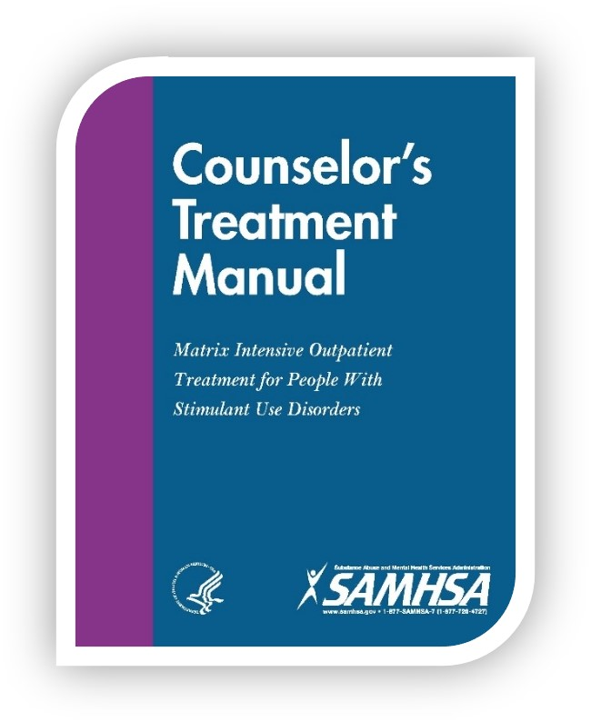
The Matrix Model
16-week intensive outpatient treatment was modestly better than treatment as usual to improve retention and reduce methamphetamine use
Therapist functions as teacher and coach
Incorporates a variety of approaches:
  CBT
  CM
  MI
  12-Step Facilitation
  Family Involvement
  Person-Centered Therapy
SOURCES: CSAT, 2006; Rawson et al., 2004
Notes:
The Matrix Model is an intensive, outpatient treatment approach for individuals with substance use disorders, which was developed through 30 years of experience in real-world treatment settings. The intervention integrates aspects of several treatment approaches, including cognitive-behavioral therapy, contingency management, motivational interviewing, 12-step facilitation, family involvement, and supportive/person-centered therapy. Core components consist of early recovery groups, relapse-prevention groups, family education, social-support groups, and individual counseling delivered over a 16-week period. Patients learn about issues critical to addiction and relapse, such as cue-induced craving and related behaviors. Patients also receive direction and support from a trained therapist, become familiar with self-help programs, and are monitored for drug use by urine and breath testing. Family members receive education to help understand and support the recovery process.
The therapist functions simultaneously as teacher and coach, fostering a positive, encouraging relationship with the client and using that relationship to reinforce positive behavior change. The interaction between the therapist and the patient is realistic and direct, but not confrontational or paternalistic. Therapists are trained to conduct treatment sessions in a way that promotes self-esteem, dignity, and self-worth.
The Matrix Model Manual can be downloaded from: https://store.samhsa.gov/product/Matrix-Intensive-Outpatient-Treatment-for-People-With-Stimulant-Use-Disorders-Counselor-s-Treatment-Manual/SMA13-4152.
REFERENCES:
Center for Substance Abuse Treatment. (2006). Counselor’s Treatment Manual: Matrix Intensive Outpatient Treatment for People With Stimulant Use Disorders. HHS Publication No. (SMA) 13-4152. Rockville, MD: Substance Abuse and Mental Health Services Administration.
Rawson, R. A., Marinelli-Casey, P., Anglin, M. D., Dickow, A., Frazier, Y., Gallagher, C., Galloway, G. P., Herrell, J., Huber, A., McCann, M. J., Obert, J., Pennell, S., Reiber, C., Vandersloot, D., Zweben, J., & Methamphetamine Treatment Project Corporate Authors (2004). A multi-site comparison of psychosocial approaches for the treatment of methamphetamine dependence. Addiction (Abingdon, England), 99(6), 708–717. https://doi.org/10.1111/j.1360-0443.2004.00707.x
IMAGE CREDIT:
SAMHSA, Matrix Model Manual cover, 2013.

Slide 8
Does Exercise Improve Outcomes Post-Treatment?
Yes!
Fewer exercise patients returned to meth use compared to the education participants at 1-, 3-, and 6-months post-discharge (not statistically significant)
Significant interaction found for self-reported meth use and meth urine drug test results – lower severity users in the exercise group reported using meth significantly fewer days at the three post-discharge time points than lower severity users in the education group
Lower severity users in the exercise group also had a lower percentage of positive urine results at the three time points than the lower severity users in the education group (relationships not seen in higher severity groups)
SOURCES: Rawson et al., 2015; Mooney et al., 2014.
Notes:
Background: Effective pharmacotherapies to treat methamphetamine (MA) dependence have not been identified, and most behavioral therapies are marginally effective. Based on behavioral studies demonstrating the potential efficacy of aerobic exercise for improving depressive symptoms, anxiety, cognitive deficits, and substance use outcomes, the study described here is examining exercise as a potential treatment for MA-dependent individuals.
Methods: This study is randomizing 135 participants with MA dependence at a residential treatment facility for addictive disorders to receive either a thrice-weekly structured aerobic and resistance exercise intervention or a health education condition.
Seeking evidence for a possibly effective adjunct to traditional behavioral approaches for treatment of MA dependence, this study assessed the ability of an 8-week aerobic and resistance exercise protocol to reduce relapse to MA use during a 12-week follow-up period after discharge from residential-based treatment.
Results: While fewer exercise participants returned to MA use compared to education participants at 1-, 3- and 6-months post-discharge, differences were not statistically significant. A significant interaction for self-reported MA use and MA urine drug test results by condition and MA severity was found: lower severity users in the exercise group reported using MA significantly fewer days at the three post-discharge time points than lower severity users in the education group. Lower severity users in the exercise group also had a lower percentage of positive urine results at the three time points than lower severity users in the education group. These relationships were not present in the comparison of the higher severity conditions.
Conclusion: Results support the value of exercise as a treatment component for individuals using MA 18 or fewer days/month.
REFERENCES:
Rawson, R. A., Chudzynski, J., Mooney, L., Gonzales, R., Ang, A., Dickerson, D., Penate, J., Salem, B. A., Dolezal, B., & Cooper, C. B. (2015). Impact of an exercise intervention on methamphetamine use outcomes post-residential treatment care. Drug and Alcohol Dependence, 156, 21–28. https://doi.org/10.1016/j.drugalcdep.2015.08.029
Mooney, L. J., Cooper, C., London, E. D., Chudzynski, J., Dolezal, B., Dickerson, D., Brecht, M. L., Peñate, J., & Rawson, R. A. (2014). Exercise for methamphetamine dependence: rationale, design, and methodology. Contemporary Clinical Trials, 37, 139–147. https://doi.org/10.1016/j.cct.2013.11.010

Slide 9
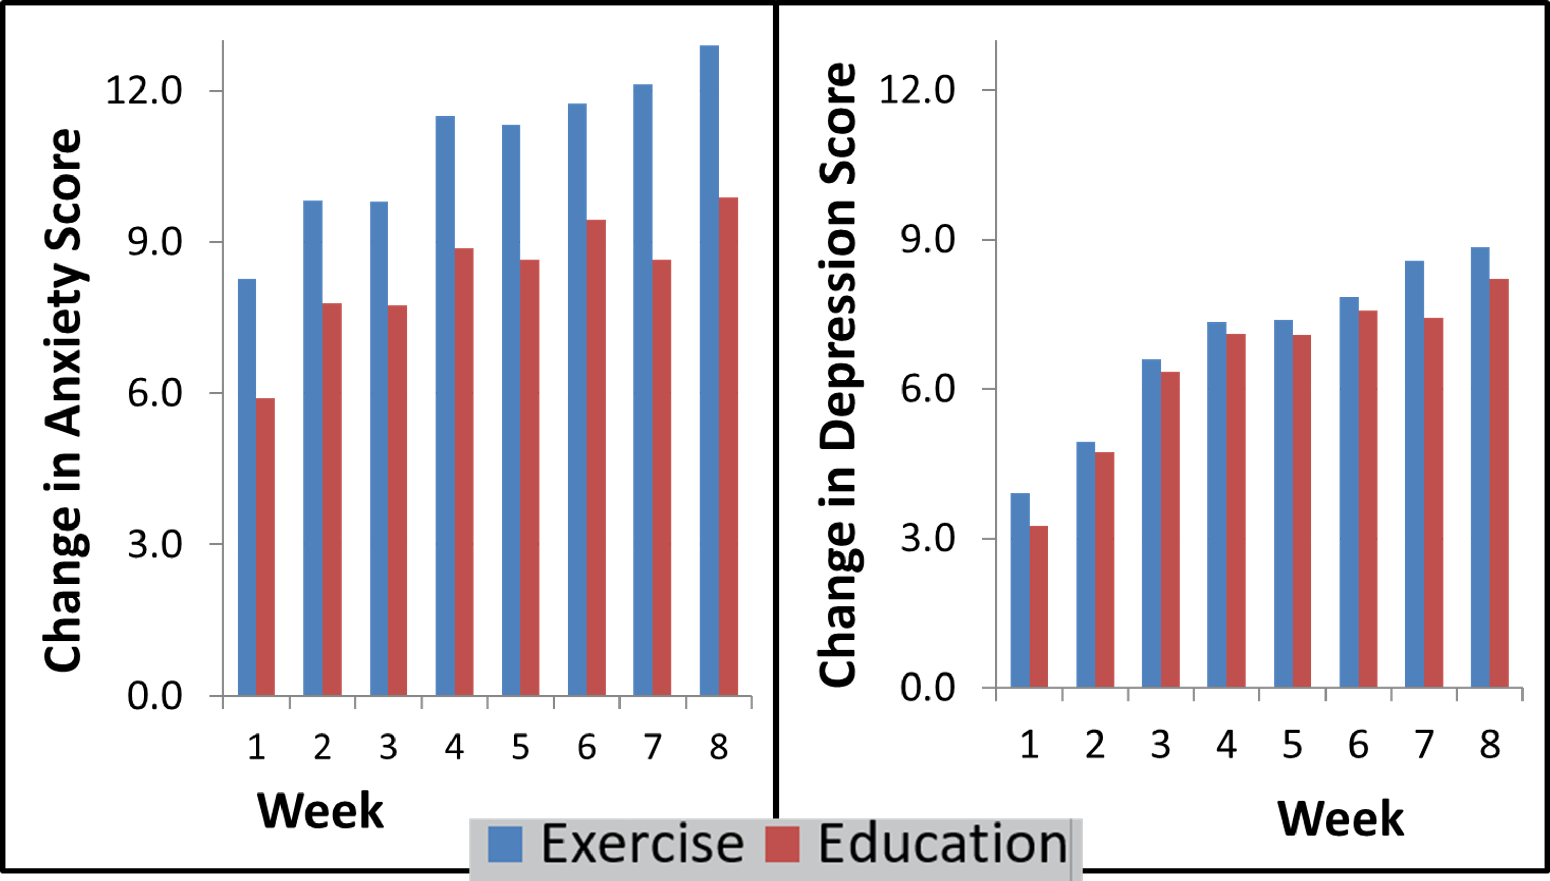
The Impact of Exercise on Symptoms of
Depression and Anxiety
SOURCE: Rawson et al., 2015.
Notes:
These graphs show change scores for anxiety (left) and depression (right). The blue bars correspond to the exercise condition, and the red bars correspond to the education/control condition. Higher scores indicate more change and therefore show improvement in the mood symptom.
Key findings include:
No significant differences were seen in baseline characteristics between the two groups in either Beck Anxiety Inventory (BAI) or Beck Depression Inventory (BDI) scores
A significant interaction effect between exercise intervention and session attendance; Session attendance at education sessions was not related to anxiety/depression scores
Those who attended more exercise sessions had significantly lower BDI and BAI scores over time, compared to the control group
The change in BAI anxiety scores from baseline to Week 8 appeared to be larger in terms of effect size relative to BDI
REFERENCE:
Rawson, R. A., Chudzynski, J., Gonzales, R., Mooney, L., Dickerson, D., Ang, A., Dolezal, B., & Cooper, C. B. (2015). The Impact of Exercise On Depression and Anxiety Symptoms Among Abstinent Methamphetamine-Dependent Individuals in A Residential Treatment Setting. Journal of Substance Abuse Treatment, 57, 36–40. https://doi.org/10.1016/j.jsat.2015.04.007

